Slide 1
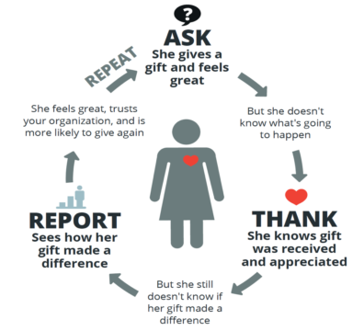
Notes:
Asking, is, the first step in what we in the fundraising world call the “virtuous giving cycle.”
Please allow me a few minutes to review some Fundraising Fundamentals as we think about the ALL TOGETHER NOW grant.
Ask, thank, Report, Repeat

Slide 2
Quiz: Ask, Thank, Report, Repeat, or none of these?
Please donate for scholarships and shade pavilion this spring
Send a person thank you note
Snapshot of the new dining hall outdoor shade pavilion
“Thinking of you on opening day” email
Information about 2022 Camp fees and early bird registration
Invite to join the site and facilities committee
Donor wall dedication for new dining hall outdoor shade pavilion
Save the date for Giving Day
Announcement of Giving Day
Reminder of Giving Day
Thank you everyone who gave on Giving Day. We raised $12,425. You can still give if you missed Giving Day!

Slide 3
Report & Repeat
ASK
Thank
FALL
Report on Impact
Urgent Bonus 10K
Giving Day
Year-End Fundraising
SPRING
TOP: A few personal conversations
Middle: Appeal letter
Bottom: Social media
SUMMER
Stewardship from the Bubble
Alumni & Community Engagement (reunions, anniversaries)
Notes:
So returning to the ASK, Thank, Report, and Repeat,
Here is how we GENARICALLY think about the annual fundraising cycle, and this year in particular.

Slide 4
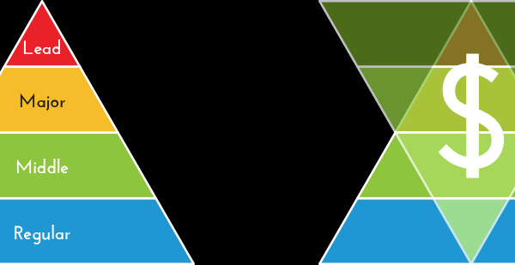
Notes:
Opportunities
Shared understanding of COVID
Eagerness to help
Grow the base of support – Regular donors
Engage more people to champion your mission
Strengthen partnerships
Identify new major donors
Challenges:
Focusing on opening camp safely
Limited time and human resources
Might already have ATN grant strategy in place
Not a “fundraising Board”
Worried about “donor fatigue”
Not experienced with fundraising
Strategy: Could use the grant to inspire major gifts or even meet the match with one LEAD gift. And / or could use the grant to grow your base of small gifts. The choice is up to you.
What you see in this image is fact that

