Slide 2
“The great thing about chutzpah is that it inspires people to exceed their capabilities…people will fight to the death if they are led by a [person] with chutzpah.”
Guy Kawasaki, former Apple’s chief evangelist, author of ”The Macintosh Way”

Slide 3
Doing Whatever It Takes as a Director:
Turning Up the Dial on Your Chutzpah
Jodi Sperling
JCamp 180 2019
jodi@jodisperling.com

Slide 4
1
10
Low chutzpah
High chutzpah

Slide 5
noun: chutzpah
shameless audacity; impudence.
"love him or hate him, you have to admire Cohen's chutzpah”
“It’s the audacity to act outside the box and change the rules of the game, without fear of failure or criticism.”
- from “Positive Chutzpah”

Slide 6
Origin:
late 19th century: Yiddish, from Aramaic ḥu ṣpā
here
or
mouth
outside

Slide 7
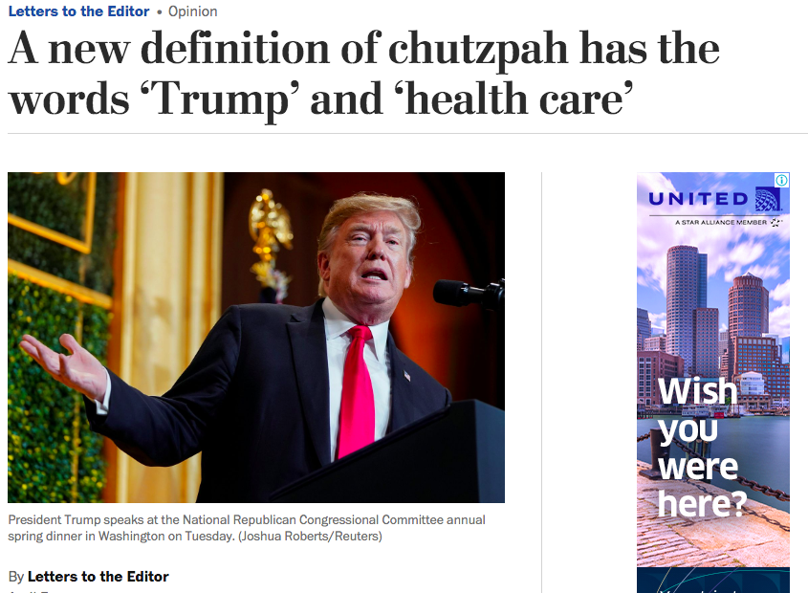
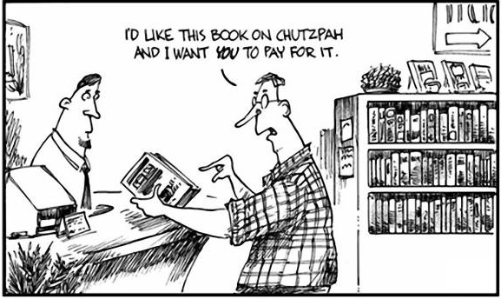
Chutzpah ☹

Slide 8
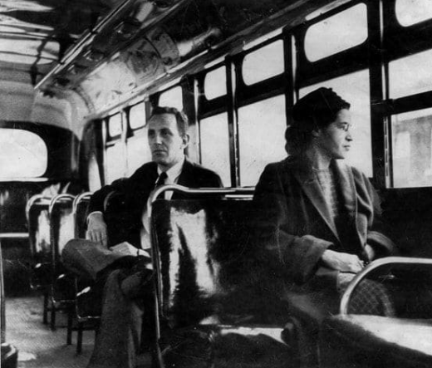
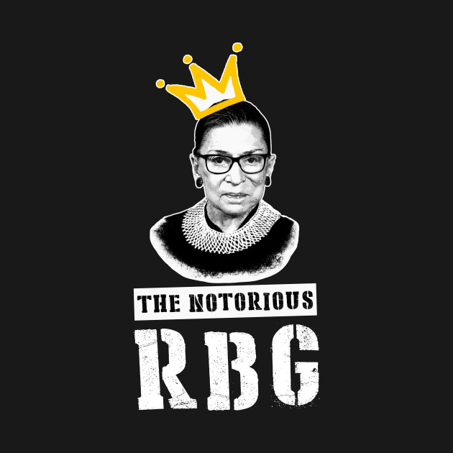
Chutzpah ☺

Slide 10
“For Abraham, surrender is a sin.
To accept the world as it is — to declare ‘what is, is what is meant to be’ — is blasphemy.
The unrelenting insistence on justice — even if it means challenging God — marks Abraham as a singular religious hero.
Our hero.
It is chutzpah at its finest. It is the essence of the Jewish soul.”
- Rabbi Ed Feinstein

Slide 12
1. Who is someone you know who you admire for their leadership?
2. Where would they be on the spectrum?
1
10
Low chutzpah
High chutzpah
3. If I were to ask anyone who works with you or for you, would they say you value high or low chutzpah in your team?

Slide 13
Chutzpah as a camp value?

Slide 14
