Slide 1
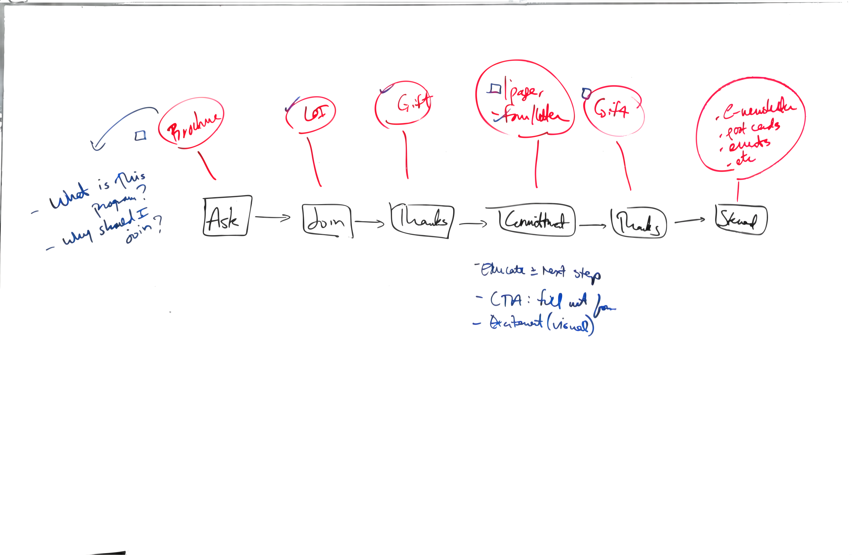
Brochure LOI GIFT 1 page, Gift e-newsletter
Form/Letter post cards
Ask Join Thank Commitment Thanks Steward
- What is this program?
- Why should I join?
Educate + next steps
CTA full out form
Excitement (visual)
Donor Journey Map

