Slide 1


Financial Relief for Your Camp in 2021
What U.S. Camp Finance Mavens Need to Know About the Latest COVID-19 Relief Bill
January 14, 2021
Steven Woolf Andrew Gurwitz Ziv
Senior Tax Policy Counsel Associate Director
Jewish Federations of North America Eden Village Camp

Slide 2
Agenda
Paycheck Protection Program - Steven Woolf, JFNA
Employer Retention Credit - Andrew Gurwitz Ziv, Eden Village Camp
Q&A
Next Steps

Slide 3
Agenda
Paycheck Protection Program - Steven Woolf, JFNA
Employer Retention Credit - Andrew Gurwitz Ziv, Eden Village Camp
Q&A
Next Steps

Slide 4
PPP Second Draw Update

Slide 5
Payroll Protection Program
Loans under CARES Act - First Draw
New loans under CAA21 – Second Draw
Notes:
First draw is under Cares Act- even if borrow monies now, the first loan is defined as First Draw

Slide 6
Paycheck Protection Program
Existing PPP loan forgiveness
    Update application to reflect new additional permitted expenses
    Covered period ends when monies are spent
    EIDL loan advances no longer reduce forgiveness
    Simplified one-page forgiveness application for loans under $150k
    When to apply for forgiveness?
    Excess payroll/ERTC
Notes:
Under $150,000 loans: Not need to provide forgivable expenses. Sign certification form which will be provided shortly from SBA
Waiting for additional guidance relating to Form 3510
Next session of Congress may consider additional changes for the $150K-$2MM loans
Interest does not begin until 10 months from end of Covered Period. Covered period defined as when the loan proceeds are spent between 8 and 24 weeks.
Unless there is a reason to apply before additional guidance, no advantage to apply now.
Shift in application approach to consider using up to 40% of the loan for non-payroll expenses so can use excess payroll expense to apply for ERTC

Slide 7
Paycheck Protection Program
Updated eligible expenses for both First and Second Draw Loans
  Operational expenditures
  Property damage costs related to public disturbances in 2020 not otherwise covered
  Expenditures to suppliers
  Worker protection and facility modifications expenditures
Limited to 40% of loan spending
Notes:
Operational expenditures-software or cloud computing, inc accounting, development, HR, any other software subscription fees paid during covered period
Property damage costs related to property damage/vandalism/looting due to public disturbances in 2020 not otherwise covered by insurance or other compensation
Expenditures to suppliers essential to current operations at time of purchase
Worker Protection and facility modifications expenditures-inc PPE to comply w/Covid 19
Work to maximize use for operational expenses

Slide 8
First Draw PPP Loan
First Draw PPP Loans reopened
  First time borrower
  Borrower who returned funds
  Borrower entitled to additional funds
    Increase loan amount to include eligible payroll expenses
    Have not received loan forgiveness prior to 12/27/2020
    Applies also to seasonal borrowers
Notes:
First Draw loan governed by original requirements: limited to less than 500 employees (based on calculation now), loan amount
Apply for additional if had not included all the payroll costs in the first calculation
Cannot apply if already received forgiveness

Slide 9
Paycheck Protection Program
Second Draw PPP Loans
  Must have spent or expect to spend First Draw
  No more than 300 employees
  25% reduction in gross receipts in any quarter (2020 v. 2019)
  2.5x average monthly payroll up to $2M (or 3.5x - food and lodging)
  Necessity certification for continuity and ongoing operations
Notes:
First draw must be spent or expect to be disbursed prior to 2nd draw expected to be disbursed – COMMENTARY- How long will processing take this time. SBA indicated it will take longer to approve because must review change in gross receipts
Total employees at time of application- includes both PT and FTE
Avg monthly payroll can be either 2019 or 2020 payroll w/limitations of $100K per employee
If use 2019 and the same lender, may not need to submit this data again (will depend on lender’s system)- look at payroll to determine which is higher. For most agencies, 2019 may be higher if there were staff reductions in 2020. Consider must still be able to spend 60% of the loan amount on payroll in 24 weeks or less
Can also use precise 12 months, if choose (except self-employed)
Seasonal- Gross receipts during 6 months of off-season are not more than 1/3 of gross receipts of 6 months in session or does not operate more than 7 months/year.
Necessity certification: How to determine- i.e. undesignated reserves, memo to file,
Eligibility requirement: must not have permanently closed but Can be temporarily closed or suspended business (pg 12 IFR)

Slide 10
Paycheck Protection Program
Second Draw PPP Loan application differences
  Form 2483-SD
  Include First Draw SBA Loan Number
  Calculation of Reduction in Gross Receipts
  Certification questions different
Notes:
Differences:
EIDL certification question (was #4 on First Draw) not included on 2nd Draw application and no representation about it on page 2
Page 2: 3rd bulletpoint: certifies who they are
Certifications in Good Faith differ
Include certifying reduction in gross receipts & will have spent First Draw before 2nd Draw is disbursed

Slide 11
Paycheck Protection Program
How to calculate Gross Receipts (Total Revenue)
  Use Form 990 categories
  Based on Borrower’s revenue recognition practice
  Excludes First Draw PPP
  Ineligible: Shuttered Venues, others
Notes:
Includes all revenue in whatever form received or accrued (in accordance w/entity’s acctng methods: sales of products/services, interest, investment income dividends, rents, royalties, fees or commissions reduced by returns and allowances. Excludes net capital gains or losses as defined on 990.
Categories: contributions, program service revenue, investment income and sale of assets, misc
Excludes: amts collected for another (i.e. conference mgmt service provider);
Ineligibility guidelines
Entities engaged in political activities or lobbying, including those organized for research or engaging in advocacy (i.e. think tank) as described in public documents.
Relationship with China, Hong Kong or ties to both
Section 2 of Foreign Agents Registration Act – need to register
received grant from Shuttered Venue Operators grant
certain political affiliations limited to 20% ownership
publicly traded company
Gross receipts calculation – compare gross revenues quarter over quarter or total year 2019 versus 2020 (based on tax form -990- not reasonable for most NFPs because not calendar YE)

Slide 12
Paycheck Protection Program
Process
  SBA released applications
    Documentation different if loan is less than $150,000
  Be Patient – Sufficient funds available
    Banks will open portals to accept applications
    Banks are proactively asking for information
    More due diligence upfront
  SBA and Treasury to continue to post FAQs as program develops
Notes:
Possible advantage of using previous PPP existing lender
If you intend to use 2019 payroll again, lender may not require you to resubmit payroll costs
Already established relationship with banker
Loans under $150K do not need to provide payroll data or gross receipts with loan request. Will provide documentation when file for forgiveness
SBA portal staggering opening of portal. CDFIs could start submitting applications to SBA this past Monday assuming their portals were ready. CDFI 2nd Draw today and all other lenders next week.
Basket of $25BN set aside for borrowers w/ a max of 10 employees or small loans in eligible low- or moderate-income neighborhoods.
Applications can be submitted until 3/31/2021.
Terms same regardless of lender or borrower. Identical to First Draw

Slide 13
Agenda
Paycheck Protection Program - Steven Woolf, JFNA
Employer Retention Credit - Andrew Gurwitz Ziv, Eden Village Camp
Q&A
Next Steps

Slide 14
PPP & ERC for Camps
Andrew Gurwitz Ziv // Eden Village Camp

Slide 15
PPP for Seasonal Camps
Do we qualify for the 3.5x multiplier?
  Yes, independent camps are NAICS code 72124 and fall within the category of businesses that qualify.
  Non-independent camps will need to check with their parent org
What’s the “any 12 week” base period option for seasonal employers?
  This alternate base period, announced at the end of April for seasonal businesses is very advantageous for camps, but guidance on how to calculate it is sparse.
  It’s up to your bank on how to count it, but you should find the 12-week window from 2019 when your payroll was highest. It can be any date range. If it’s June 2 to August 24th, run a payroll journal for those dates and give that data to your lender.
  Your total for 12 weeks * 90.2% will be your PPP loan amount.
Are we seasonal?
  Yes, if gross receipts of 6 months of off-season are not more than ⅓ of the gross receipts of the 6 months of on-season

Slide 16
What’s the Employer Retention Credit (ERC)
A reimburseable payroll tax credit - your credit will be filed with your payroll taxes (IRS FORM 941) and the IRS will send you a check for unused credits
Available for 2020 and 2021, but differences for each year
Now available to those who got PPP - and can be claimed retroactively in 2020
In 2020, up to $5,000 credit per employee. In 2021, up to $14,000

Slide 17
ERC for 2020
PPP borrowers can now retroactively claim the ERC for 2020
50% of up to $10,000 in wages & health benefits per employee
  =$5,000 per employee
Must be funds that are not applied towards PPP forgiveness
  If your payroll and qualified expenses exceeded your PPP loan amount, you can apply ERC towards your excess payroll costs
Talk to your payroll provider about filing a 941x to retroactively claim this credit

Slide 18
ERC for 2021
70% of up to $10,000 in wages & health benefits per employee, per quarter
  =$14,000 per employee
  Expires June 30, 2021 (for now)
Must be funds that are not applied towards PPP forgiveness
Talk to your payroll provider about claiming the credit on your payroll tax forms

Slide 19
ERC Eligibility
2020 & 2021
Partially or completely shutdown because of government order that “has more than a nominal effect on the business operations”
  Can claim for the entire period that the shutdown is in place
  Cannot be self-imposed restrictions
  Examples:
    Camp or retreat permit not issues
    Group gatherings not allowed preventing programming on the site or camper recruitment
  The shutdown does not have to impact your profitability, just disrupt your operations
OR
Reduction in gross receipts (more on next slide)

Slide 20
ERC Eligibility
2020
Reduction in gross receipts in one quarter by 50%, relative to the same quarter in 2019
  All subsequent quarters are eligible until the quarter after gross receipts exceed 80% compared to the same quarter in 2019
  Gross receipts test gets you a “bonus quarter” where ERC still applies
2021
Reduction in gross receipts is now just by 20%
Gross receipts does not include tax credits or PPP funds.

Slide 21
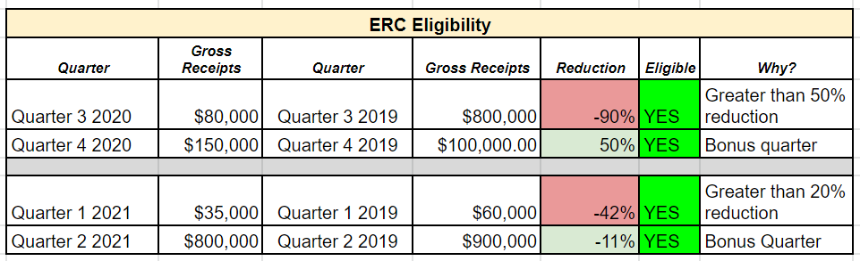
ERC Eligibility
Reduction in gross receipts by quarter (using accrual accounting)

Slide 22
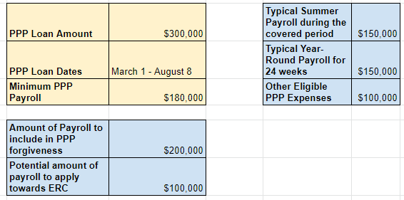
ERC & PPP
You can claim ERC at the same time as PPP, but not for the same wages. Here’s an example.

Slide 23
Takeaways
PPP
Can you increase your 2020 loan?
How can I time my covered period to maximize the ERC and forgiveness?
ERC
Contact payroll company to claim 2020 ERC
Pay close attention to grant and donation timing in order to qualify in Q1 2021

Slide 24
More info
See previous updates and sign up for future updates at:
Andrewziv.substack.com
Email questions to andrew@edenvillagecamp.org

Slide 25

Questions?

Slide 26
Next Steps
Spend your PPP1 loan! (Forgiveness not necessary)
Make sure your PPP1 forgiveness application maximizes 2020 retroactive ERC
Contact your PPP1 lender to see what documentation to assemble for PPP2
Start a PPP due diligence file in case SBA reviews economic necessity, use of funds, etc. (retain for 6 years)
Apply for PPP2 on Tuesday!
For updates:
  Sign up for jewishtogether.org alerts (“Stay Informed” at top of page)
  Keep an eye on the jcamp180.org/gov page

Slide 27
Financial Relief for Your Camp in 2021
What U.S. Camp Finance Mavens Need to Know About the Latest COVID-19 Relief Bill
January 14, 2021
Steven Woolf Andrew Gurwitz Ziv
Senior Tax Policy Counsel Associate Director
Jewish Federations of North America Eden Village Camp

