Slide 1


Title

Slide 2
How Should/Can BOARD CHAIRS be Supporting their Top Professional Right NOW?
July 7, 2020
Natasha Dresner
JCamp 180 Mentor and LEAP Director
Natasha@hgf.org

Slide 3

Why is it important to support your TP?
Title Box

Slide 4

Breakout 1
Title Box
What are you doing to support your Top Professional now?

Slide 5
Title Box
What does support look like?
- From Chair
- From Board
- From Staff

Slide 6
Breakout 2
Title Box
What should you do more of?
Stop doing?

Slide 7
What you could do to support your Top Professional:
be proactive and listen
make sure the Board is too
have regular check-ins (not just about business)
be genuine when asking “What does support look like to you?”
ask for the support you need
appreciate them (publicly & privately)
don’t do anything to compromise the trust between you & your Top Professional
don’t model, expect, or reward workaholism
be human first
show, don’t tell!

Slide 8
Next Steps
Title Box
What is/are the immediate next step(s) I must take to better support my Top Professional?
1.
2.
3.
What good ideas have I heard?
What do I need to do more of? Stop doing?

Slide 9



Slide 10
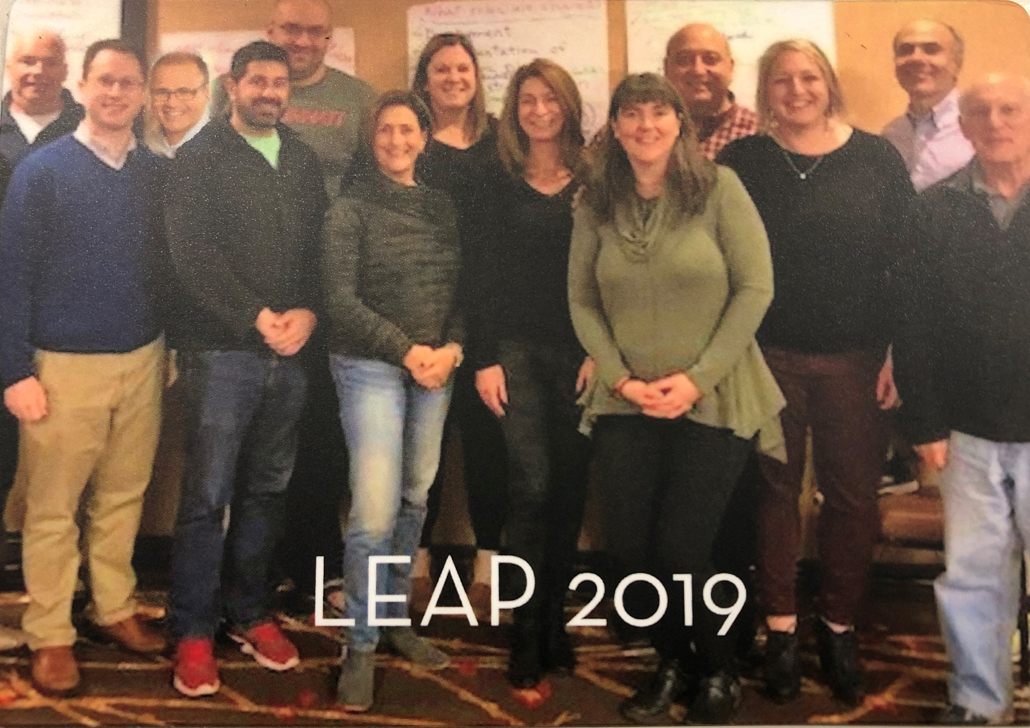
“The program was very helpful in focusing me on the critical function of our Board of Directors and specifically my role in facilitating that. Natasha has been an expert in distilling what is most critical for each participant in the program. She has deftly balanced the skills of the participants, highlighted and supported our growth opportunities and matched all that with the needs of each specific camp’s lifecycle. Wow! The experience has been worthwhile, fulfilling and provided an excellent foundation for present and future Board service.”
Joshua Charlat, Board Chair of Camp Ramah Canada

Slide 11
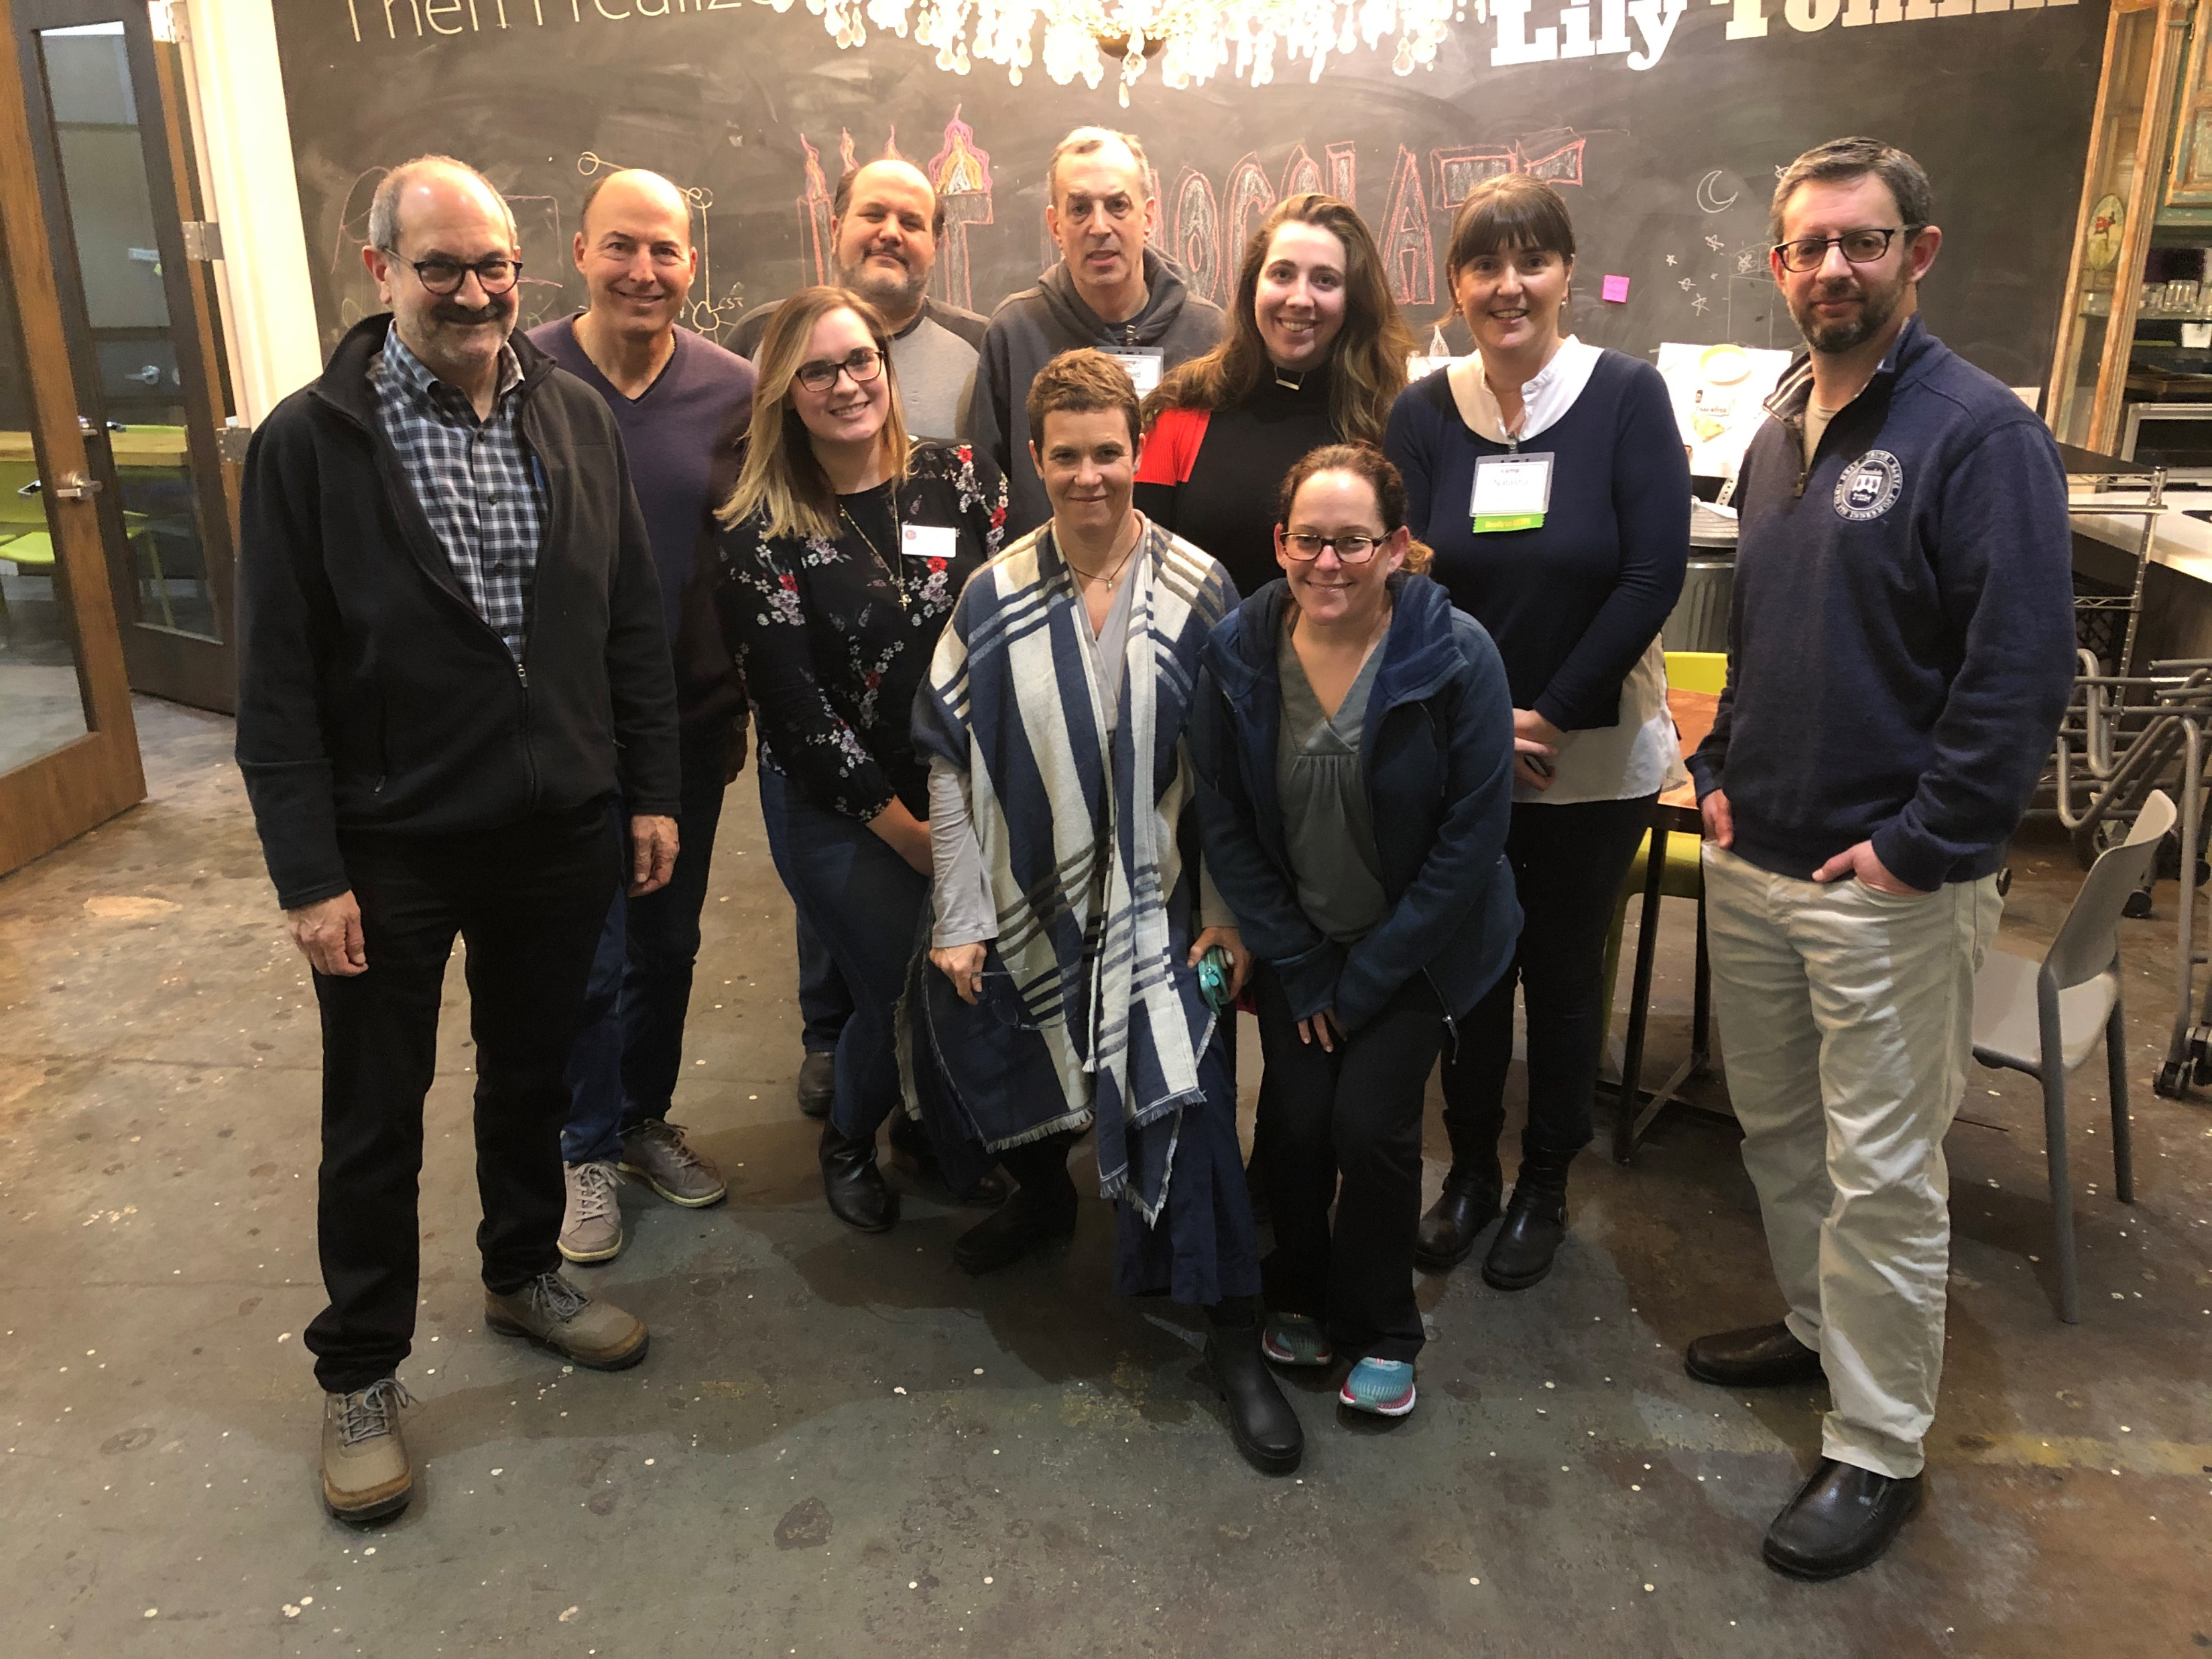
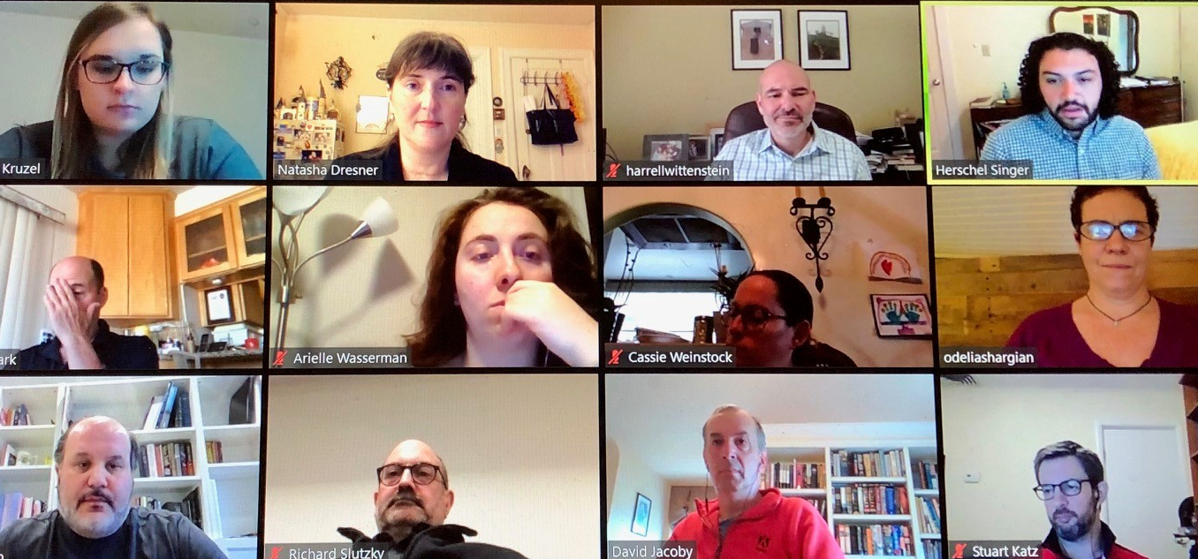

Headline here
“…I thought it was really helpful to have in the midst of this communal crisis. Thank you!”
Title Box
LEAP 2020

Slide 12
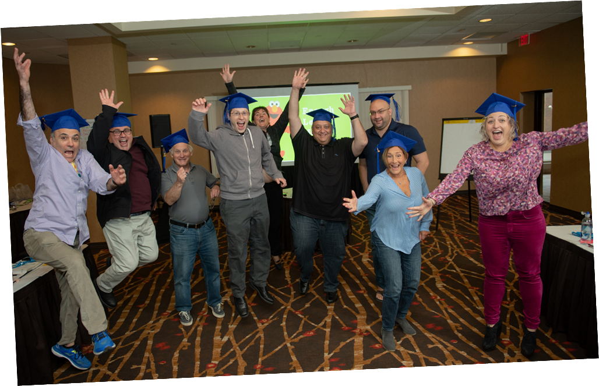
8-12 participants
For Board Chairs/Camp Committee Chairs and Vice Chairs ONLY
New Cohort applications will open in late September or early October.
https://jcamp180.org/leap

Slide 13
Title
Thank you! Your love of camp and the generosity of your time, energy, and resources DO NOT go unnoticed!

