Slide 1


LEADING IN DIFFICULT TIMES:
Camp Lay and Professional Leadership in Action
April 22, 2020
Natasha Dresner
Mentor & LEAP Director
natasha@hgf.org

Slide 2

Welcome
Title Box

Slide 3
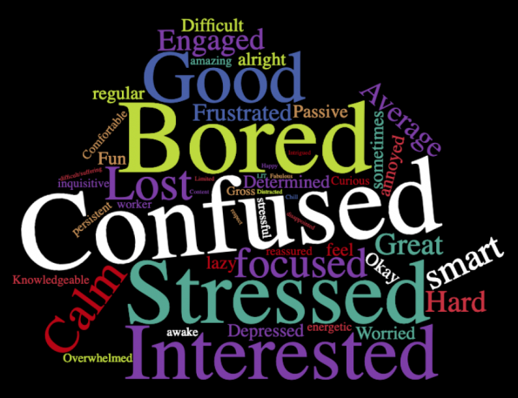


Slide 4


Slide 5
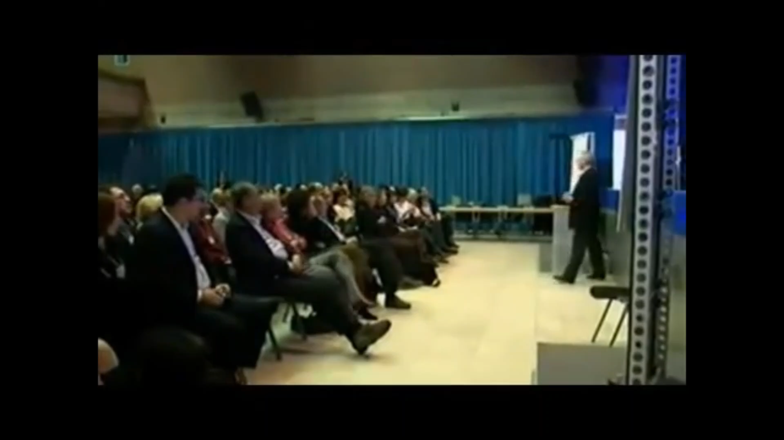
Title
Title Box

Slide 6
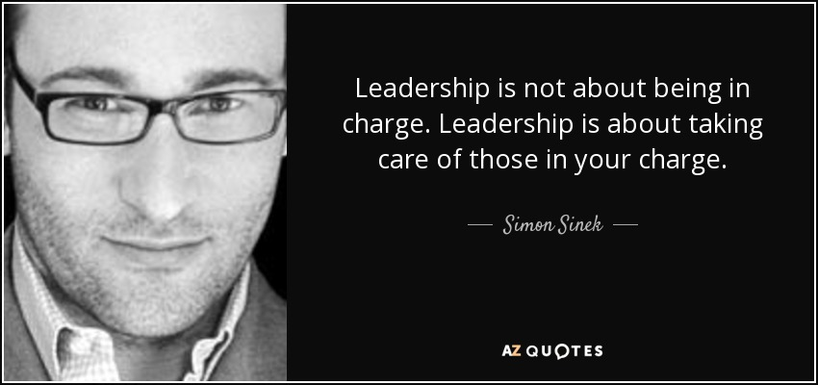
Title
Title Box

Slide 7



Title
Title Box

Slide 8
my priorities are My legacy
and
my legacy is my priorities
By the end of this particularly difficult crisis time, my camp leadership will be known/remembered for:
-
-
-
As a result, my priorities are:
1.
2.
3.
le Box

Slide 9



Breakout
Question 1:
In your unique role, what are you doing to lead during this crisis?
group leader
group scribe
group reporter

Slide 10

Here How We Lead…
stay true to your values
stay calm
listen
be honest
self-care
communicate more
give (passion, expertise, money, time, skill)
do what you are best at and ask for help

Slide 11
Breakout
Question 2:
In your unique role, what are you doing to support partnerships?
group leader
group scribe
group reporter

Slide 12

Leadership that Supports Partnerships
be honest and transparent
delegate
ask for help
don’t make assumptions
recruit new Board members
be available and communicative
don’t do too much at the EC level
ask “What does support look like now?”

Slide 13
Breakout
Question 3:
In your unique role, and based on what you’ve heard from others, what could you be doing more of/less of/differently to lead more effectively?
group leader
group scribe
group reporter

Slide 14
To Lead More Effectively…
lead with your legacy and focus on your priorities
remember what “business” you are in
challenge yourself to one thing
don’t blame this crisis for old issues
keep your sense of humor
see and speak “possibility”
lead from courage and place of strength

Slide 15
Wrap-up/Resources
Central COVID-19 Resources - https://jcamp180.org/covid-19
Updated Government Resources for Camps - https://jcamp180.org/gov
All Together Now: A Matching Grant for Jewish Camp - https://jcamp180.org/all-together-now
JCamp 180 Knowledge Center - https://jcamp180.org/knowledge-center
Nonprofit Boards & EDs Must Jointly Act During the COVID-19 Crisis http://www.massnonprofit.org/expert.php?artid=6079&catid=22
Why We Need Exceptional Board Governance More Than Ever
How to Talk to Your Team When the Future Is Uncertain
https://hbr.org/2020/04/how-to-talk-to-your-team-when-the-future-is-uncertain
Crisis Communications: Four Things Your Board Needs to Know

Slide 16


