Slide 1

Effective Boards and Camp Committees
David Sharken
Mentor
JCamp 180

Slide 2
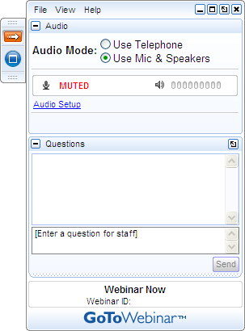
Get Involved!
A) Grab Tab – Click red arrow to open/close Control Panel. Click blue square to toggle Viewer Window between full screen/window mode. Click mic icon to mute/unmute your audio.
B) Audio Setup – Select audio format. Click Audio Setup to verify Speakers & Microphone.
C) Questions Pane – Attendees can submit questions and review answers.
D) Type your question and click Send to submit it to the organizer.
A →
B →
C →
D →

Slide 3
Agenda
What Makes Effective Boards/Camp Committees?
Submitted Questions

Slide 4
Today’s Topics
What Makes Effective Boards/Camp Committees?
  Clear Mutual Expectations
  Match Skills & Interest with Organizational Needs
  Training and Education Opportunities
  Mission Reminders
  Make it Enjoyable!
  Evaluate
Submitted Questions
  Recruitment
  Board Giving
  Geographic Diversity
  Board Role

Slide 5

Clear Mutual Expectations
Tools
    Job Description
    Annual Check-in
    Buddy System
    Contract

Slide 6
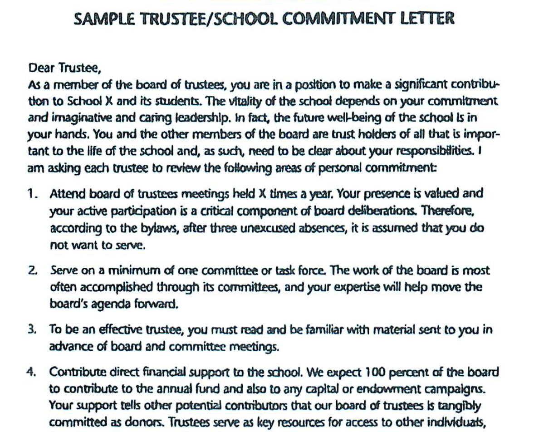

Slide 7
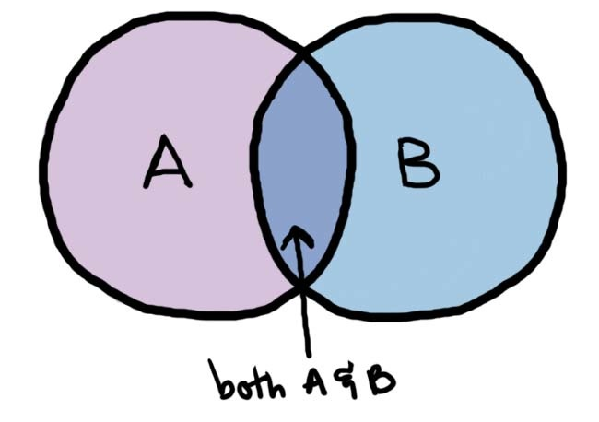
Match Skills & Interest with Organizational Needs
The right sub-committee or taskforce
Regular check-ins

Slide 8
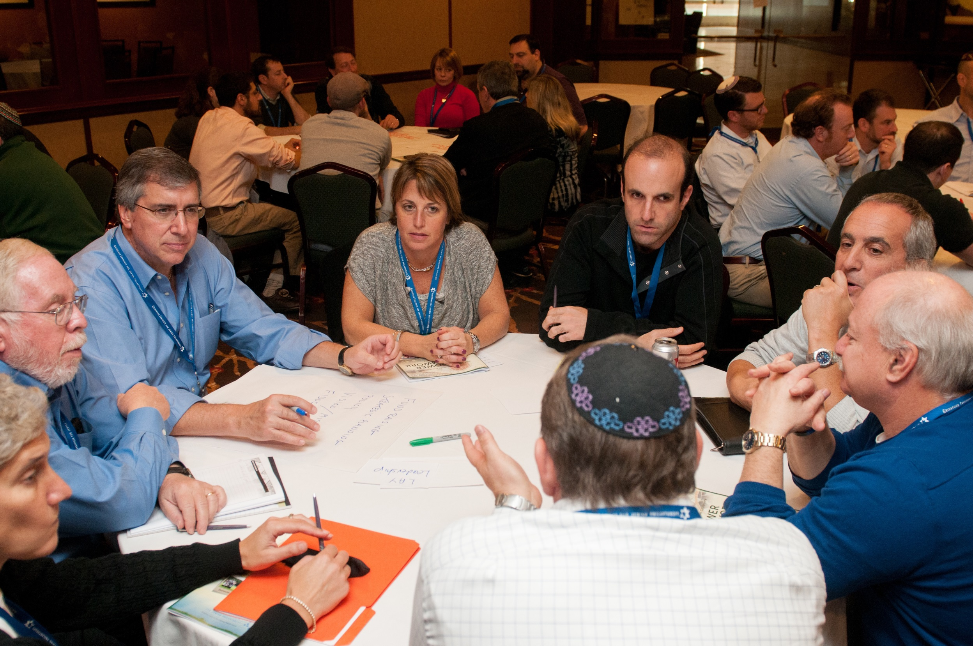
Training and Education Opportunities

Slide 9
Training and Education Opportunities
At Board meetings and by notes, reports, emails
At JCamp180 Annual Conference and webinars
Ask Board members what they need

Slide 10
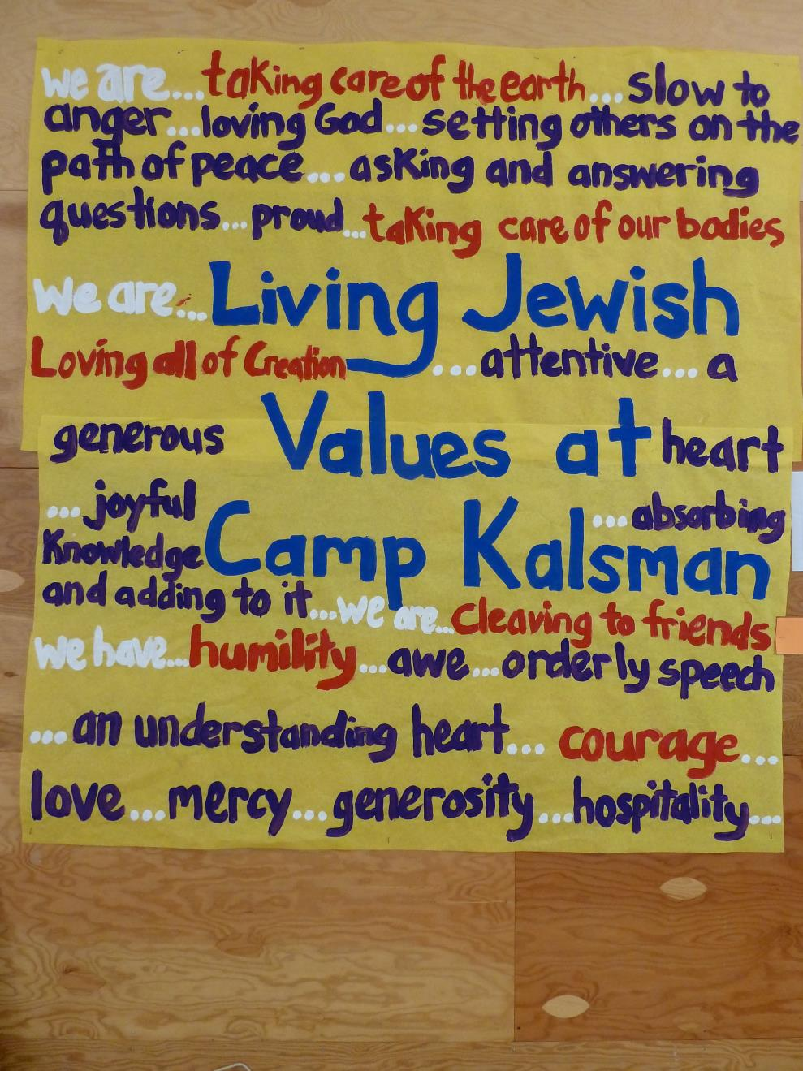
Mission
Reminders
Guest speakers at meetings
Camper, Staff, Alumni, Program updates and stories

Slide 11
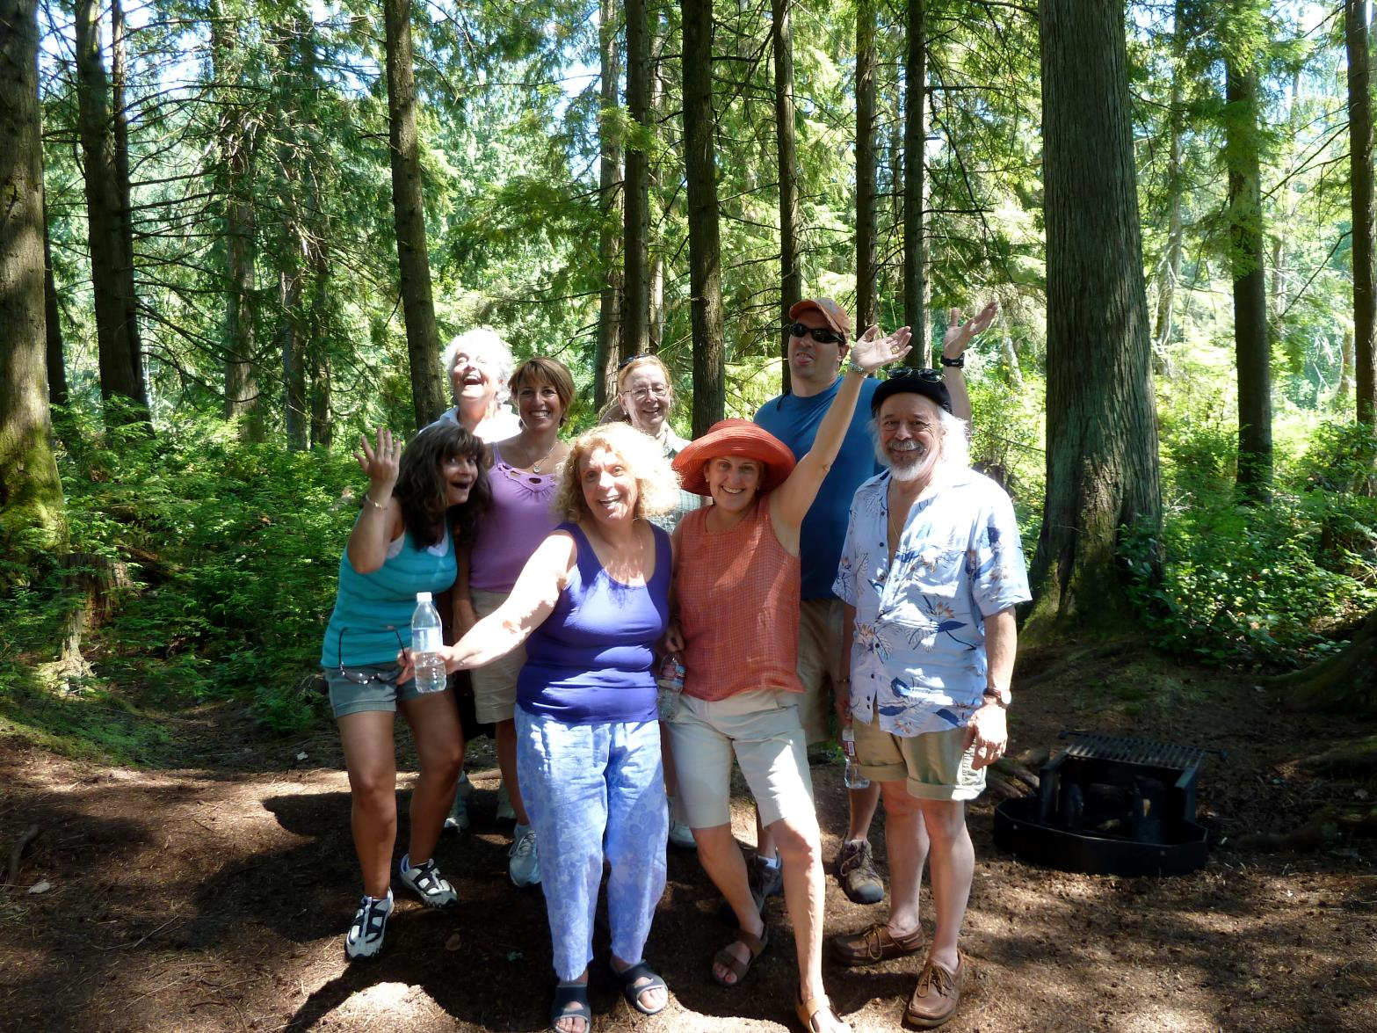
Enjoyable
Meaningful discussions
Refreshments
Time for socializing

Slide 12

Evaluate
Regular Board self-assessments
Governance Committee review of members

Slide 13
Submitted Questions

Slide 14

Recruitment
What is best way to recruit members: by capacity to give or by energy and enthusiasm?
Should we have community representation as well as people with strong ties to camp?
Should there be a trial period for Board members?
Who is the “Ideal” Board member?

Slide 15
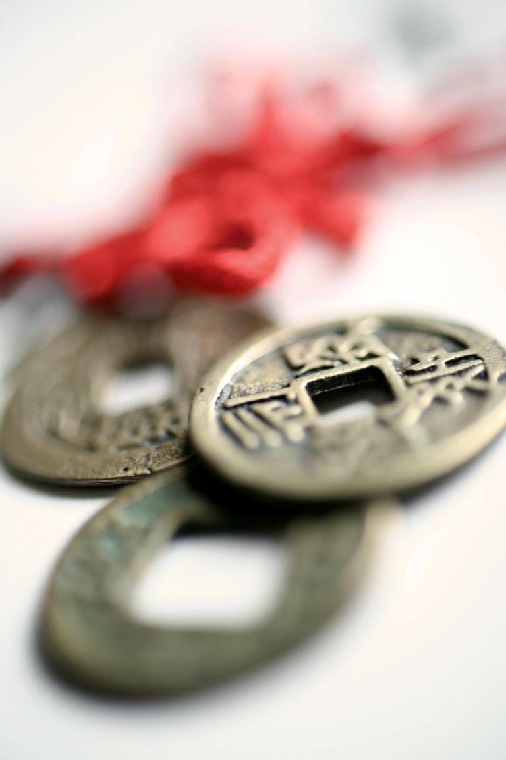
Board Giving
What is best way to determine individual giving? By set amount or by individual capacity?

Slide 16
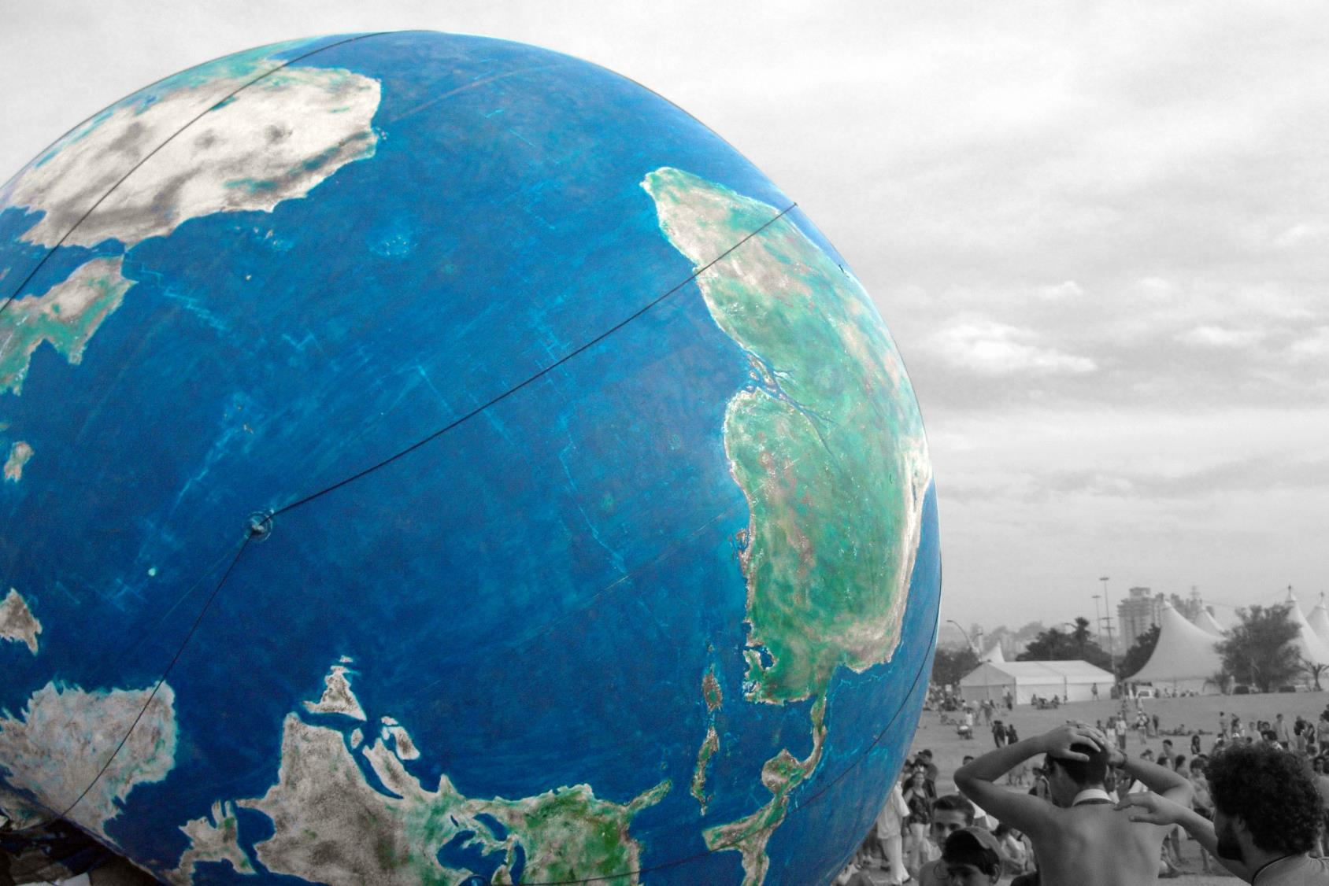
Geographic Diversity
What is best structure for a board or camp committee with geographic diversity?

Slide 17
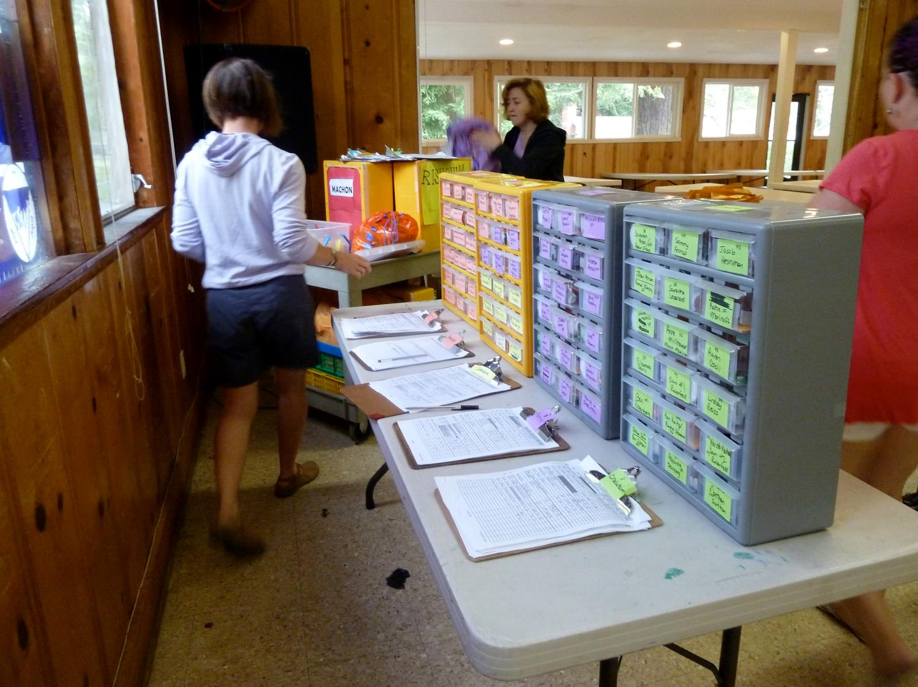
Board Role
What is the appropriate level of involvement of Camp Committee and Board in operations?
What do you think should be required of board members?

Slide 18
More Questions?
Ask/answer questions with your peers in the Jewish Camps Google Groups
  http://bit.ly/JewishCampsGroup
Find resources in Knowledge Center
  http://jcamp180.org/knowledge-center/board-development-and-governance.aspx
Contact your JCamp180 Mentor
Contact David – david@hgf.org

