Slide 1

A Culture of Philanthropy: Building on What Works in Challenging Times

Slide 2
Welcome!
Notes:
LAURIE: WELCOME TO BUILDING A CULTURE OF PHILANTHROPY! I’M LAURIE AND WE WANT TO WELCOME YOU… INTRODUCE OTHERS…. YOU’RE GOING TO HEAR FROM ALL OF US TODAY!

Slide 3


Purpose & Intended Result:
To have clear ideas of how you can strengthen your organization now, in the midst of a crisis, with the foundations and practices of a Culture of Philanthropy

Slide 4
Agenda
Welcome
Agenda
How to use the Technology
Introductions
Context for This Session
What is a Culture of Philanthropy?
Best Practices from The Field
Take-aways
What’s Next? What will You Take On?
Optional Q & A

Slide 5
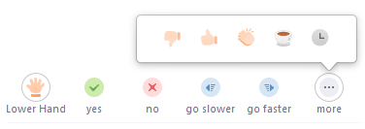
Get Involved
Use the Chat icon to send/view messages to everyone or the meeting host.
The host may also post files to review during the meeting in the Chat window.
Use the Camera icon to show/hide your video
Use the Microphone icon to mute/unmute yourself.
The small arrow next to the Microphone will help you change your audio options or fix audio issues.
Use Participant icon to see the list of participants.
You will also find icons to share feedback with the meeting host.

Slide 6
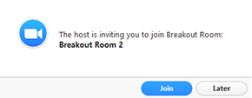
Breakout Rooms
When it’s time, you’ll be asked to join a breakout room.
Click the “Join” button to enter the breakout room
You’ll be able to Chat and speak with those in your Breakout Room only.
Keep an eye out for blue messages from the Webinar host while in the Breakout Room

Slide 7

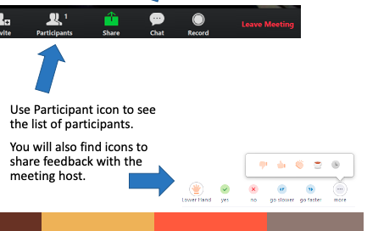
Who’s in the
room?
Notes:
BETH: SO, LET’S GET A FEEL FOR WHO IS IN THE ROOM. PLEASE RAISE YOUR HAND IF: 1) YOU’RE AN ED OR CEO OF AN AGENCY, 2) IF YOU ARE A DEVELOPMENT PROFESSIONAL, 3) IF YOU’RE A BOARD MEMBER OR VOLUNTEER FOR AN AGENCY, 4) A PROGRAM STAFF PERSON, DID I MISS ANYONE? HOW ABOUT IF YOU ARE EXPERIENCED IN DEVELOPMENT? NEW TO IT? LOVE DEVELOPMENT? HATE IT? GREAT. WE HOPE THAT WITH ALL DIFFERENT EXPERIENCES AT THE TABLE. WE ASK THAT YOU ALL PARTICIPATE FULLY IN THIS WORKSHOP. WE ARE COUNTING ON ALL OF YOU TO MAKE IT INTERESTING!

Slide 8
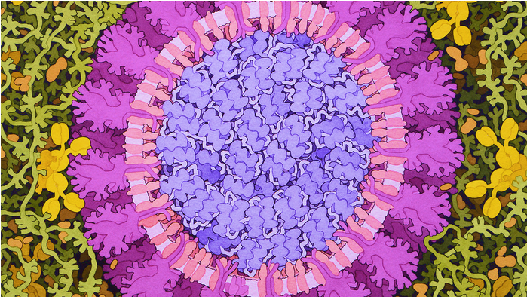
A Context for Today’s Webinar
Artistic Rendering of COVID-19 by Artist David Goodsell

Slide 9
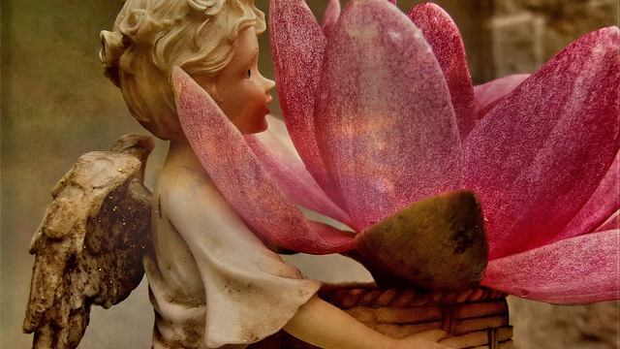
How Do We Define Philanthropy?

Slide 10

Notes:
Eric

Slide 11
Phil + anthropos = love of humankind
Notes:
EP

Slide 12
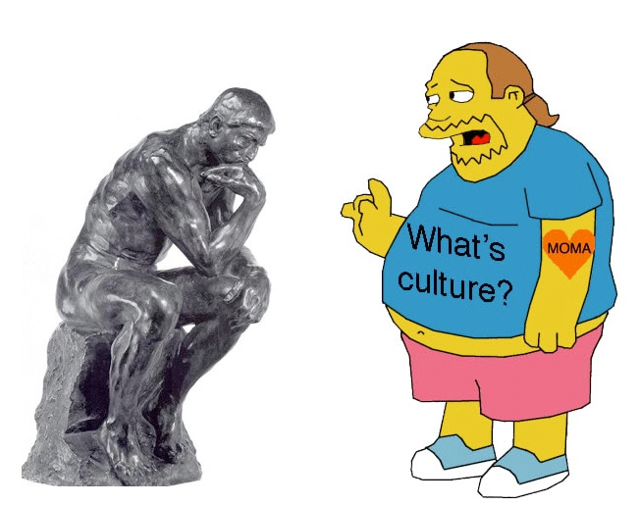
Notes:
EP

Slide 13

Culture Eats Strategy for Breakfast

Slide 14
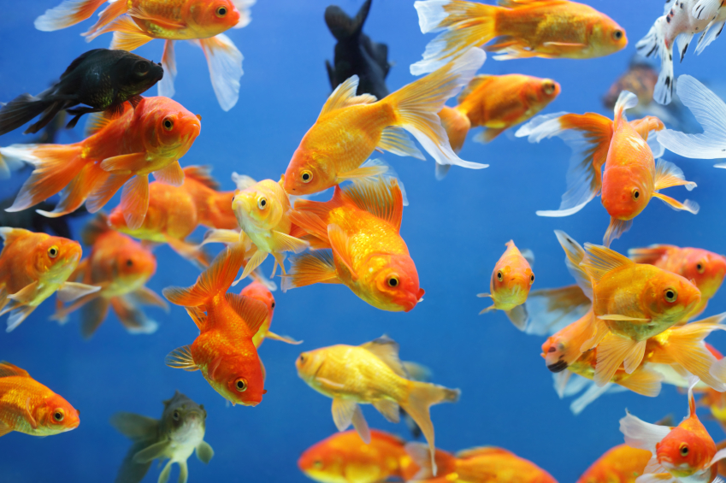

Slide 15
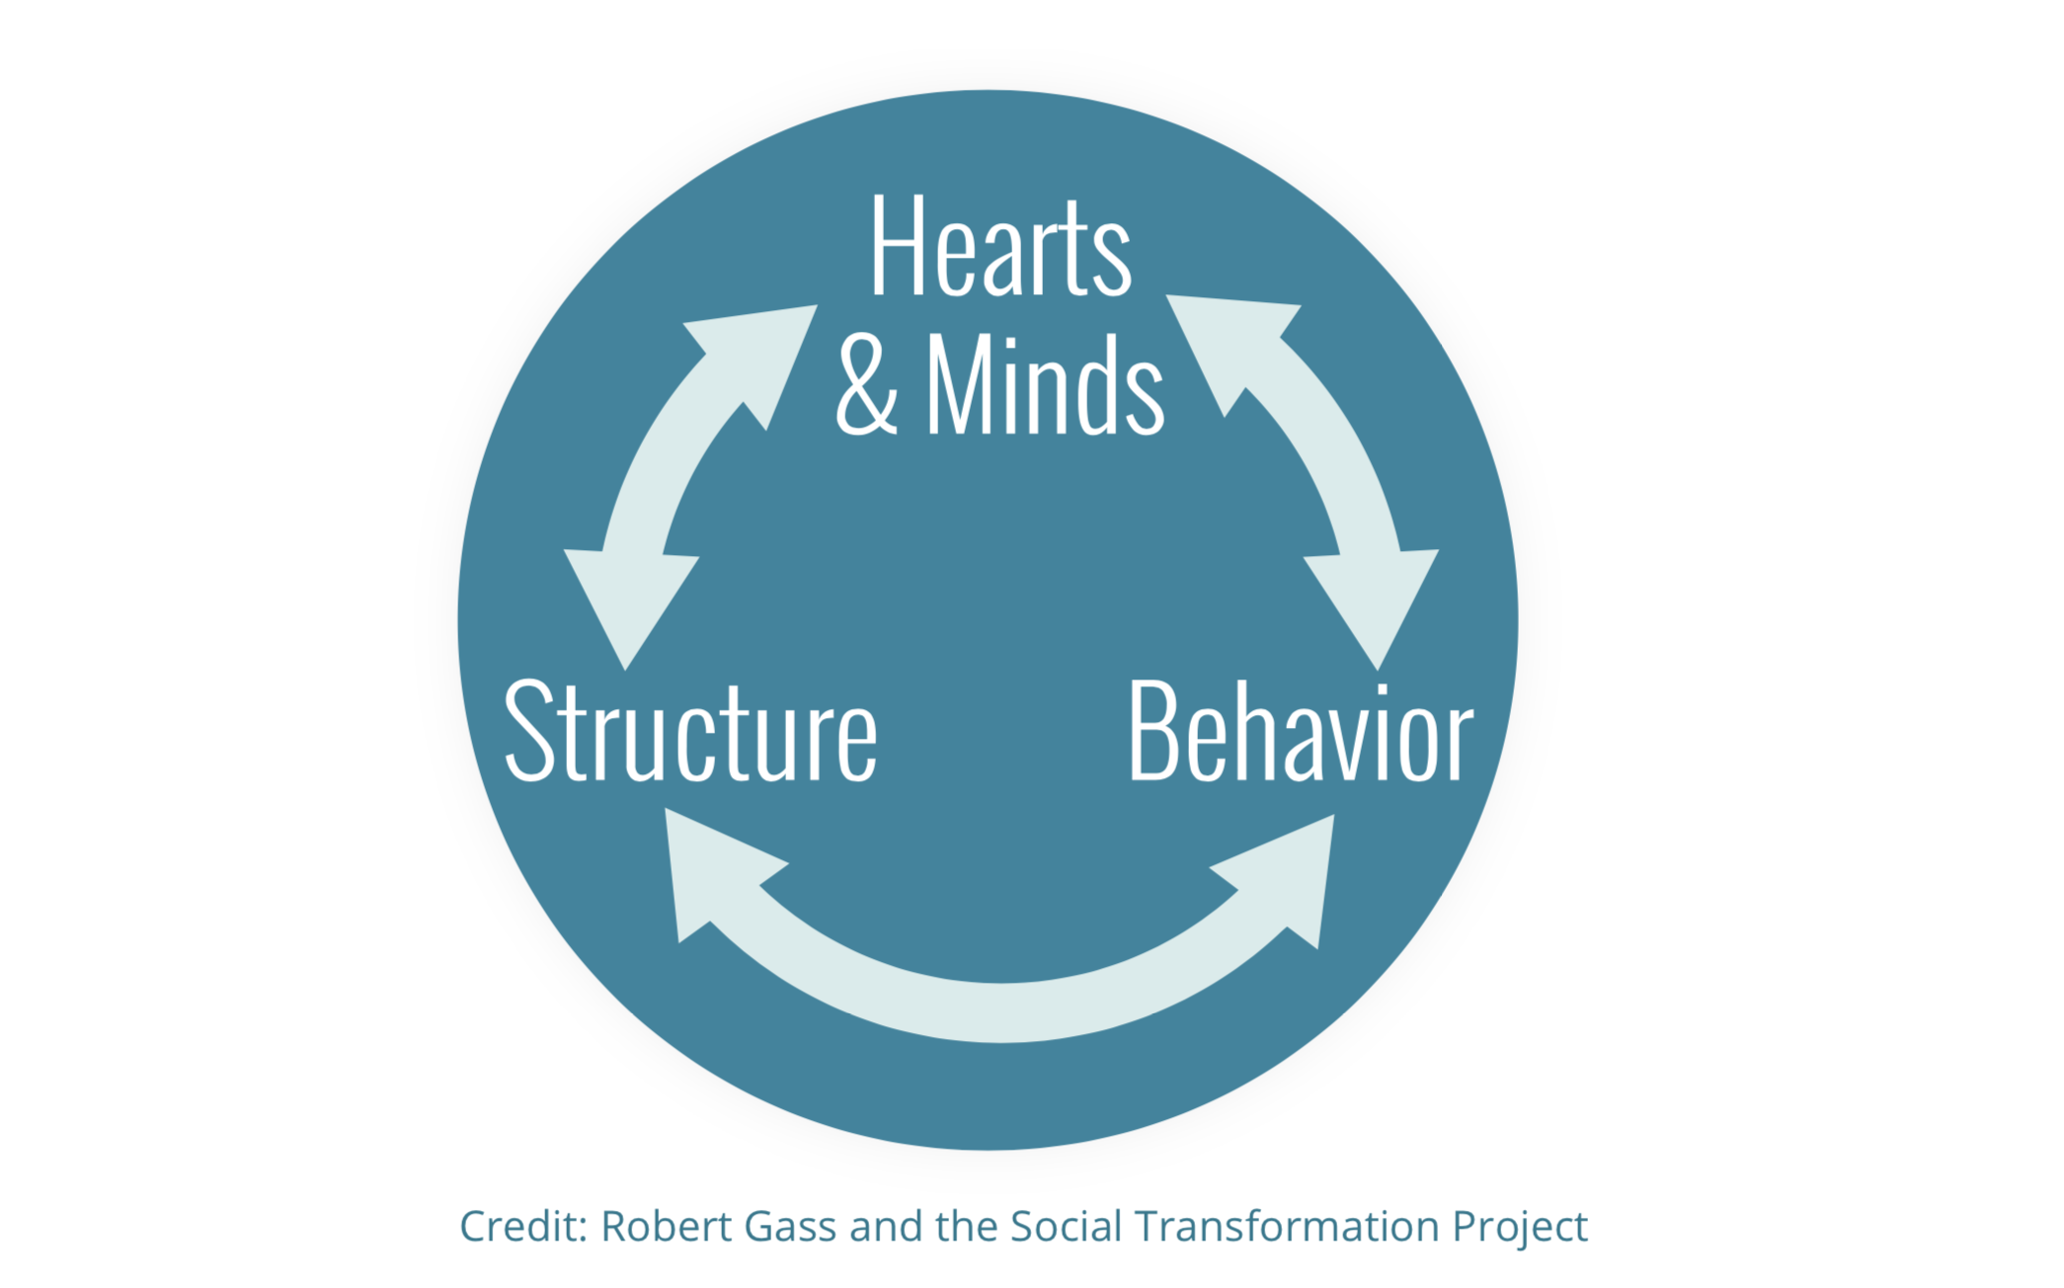
The Wheel of Change

Slide 16

BREAKOUT QUESTION: What are the challenges you are currently facing?
Photo by Paweł Czerwiński on Unsplash

Slide 17

BREAKOUT QUESTION: What is something from the last 2-3 weeks that you are grateful for?

Slide 18
We don’t get to choose our difficulties, but we do have the freedom to select our responses.
Viktor Frankl
Photo by Paweł Czerwiński on Unsplash

Slide 19
If tomorrow, the virus was completely contained, and we were told we could go back to business as usual, what,
if anything, will we wish we had done differently?

Slide 20
SELF
FAMILY & CLOSEST COMMUNITY
YOUR ORGANIZATION

Slide 21

BREAKOUT QUESTION: Utilizing the Wheel of Change, what are things that you can do for self care, so that you can be centered and draw from possibility in your life and work?

Slide 22
Do things that center you
Photo by Mukuko Studio on Unsplash
Photo Credit: madison lavern, with Unsplash
Photo by Christina @ wocintechchat.com on Unsplash
Photo by Kelly Sikkema on Unsplash
Photo Credit: madison lavern, with Unsplash

Slide 23
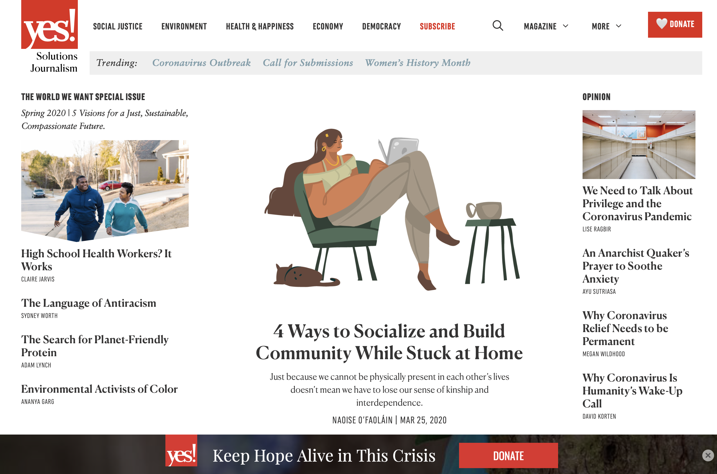
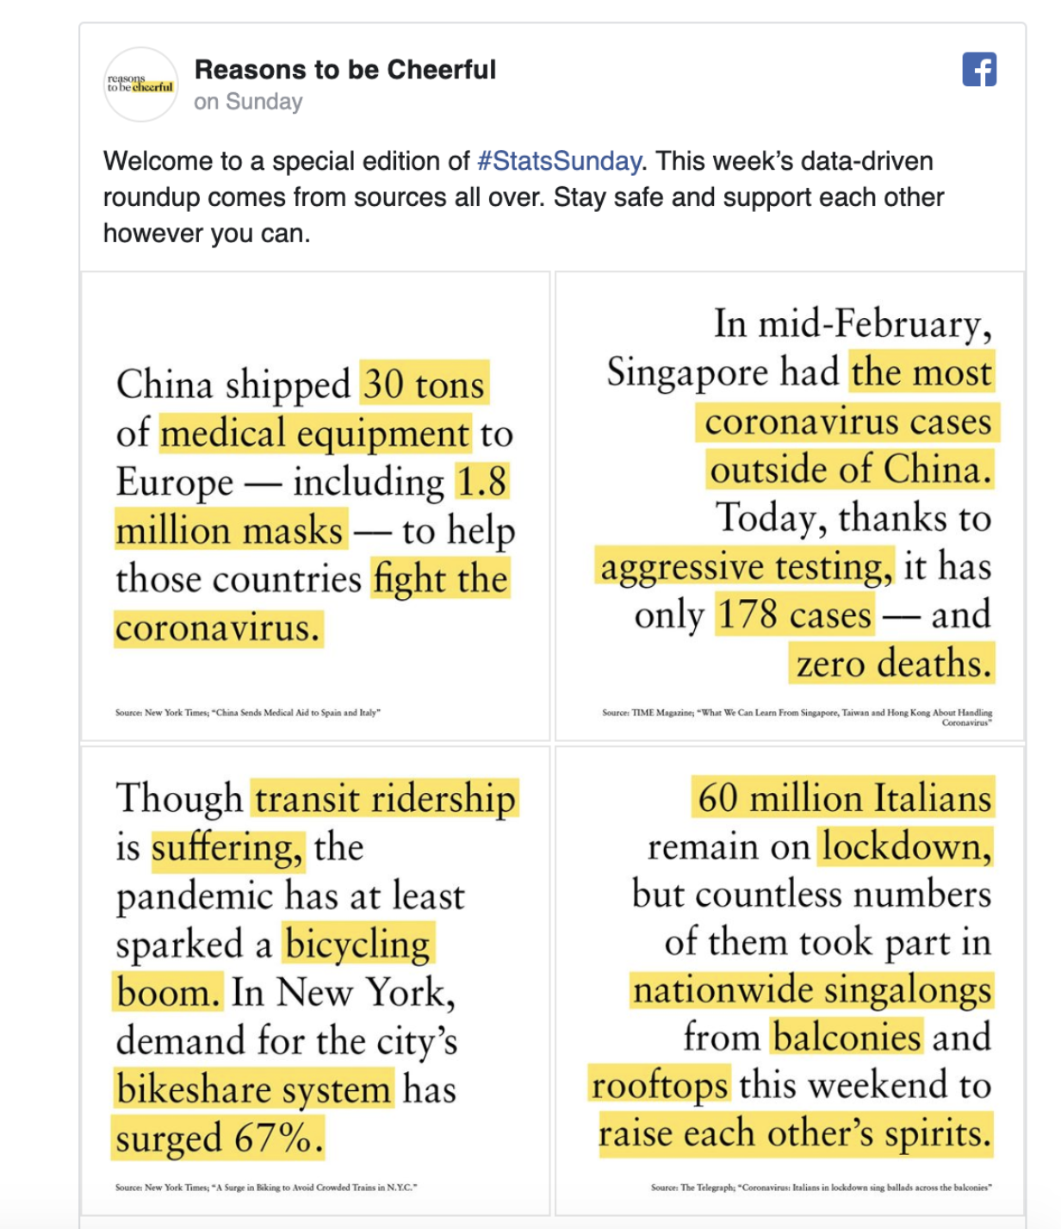
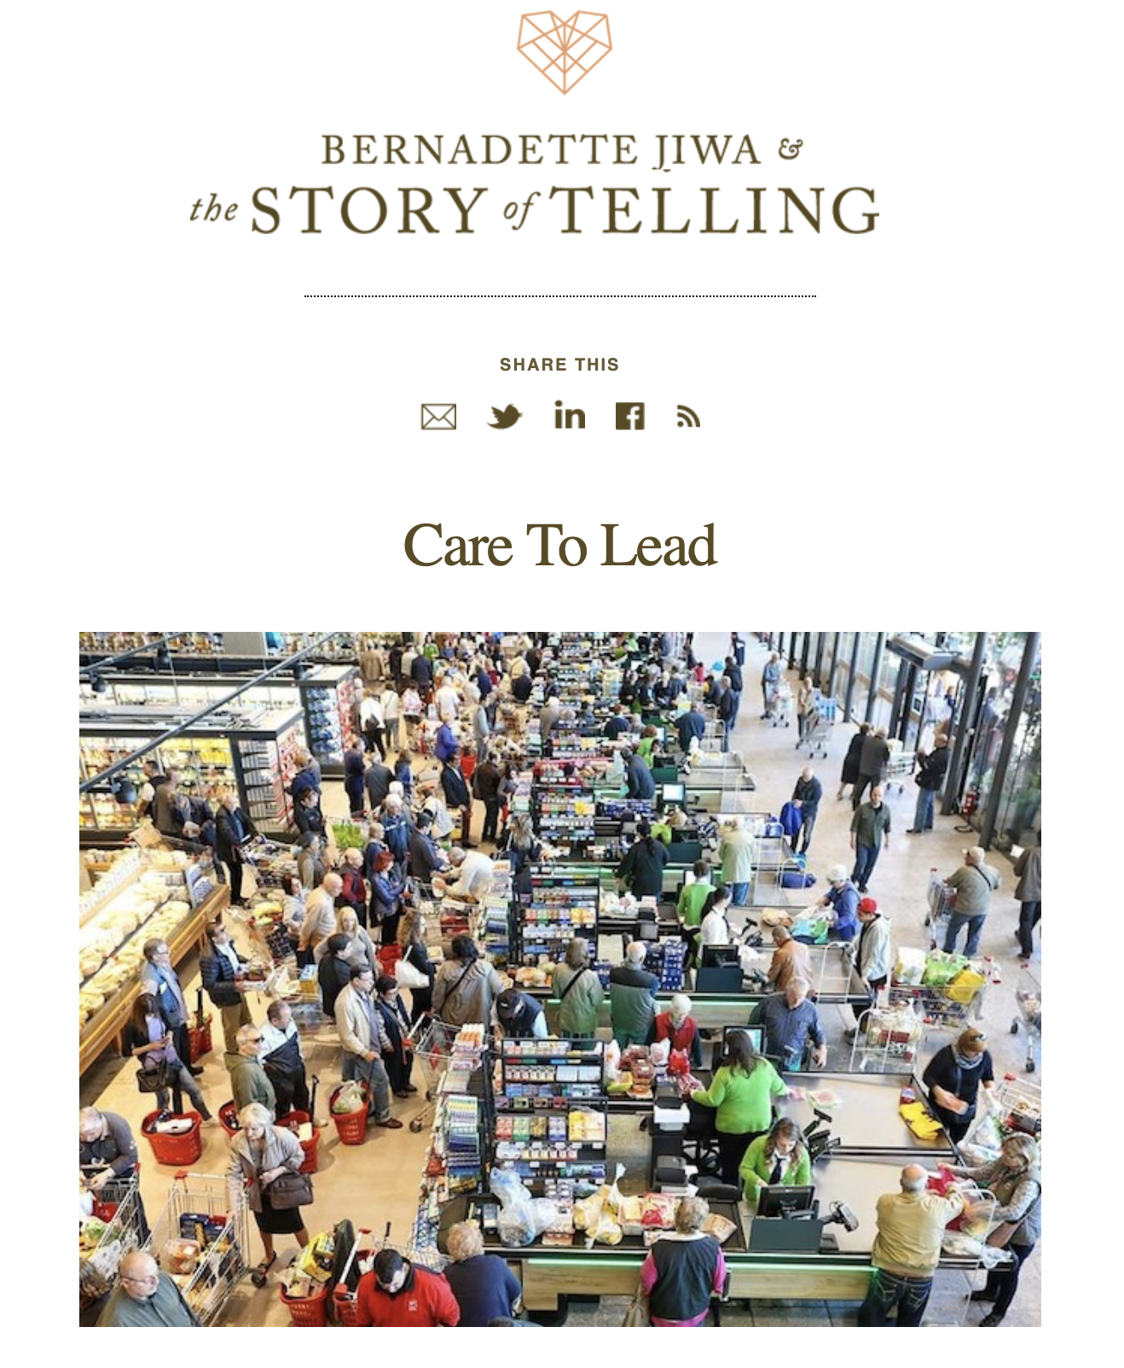
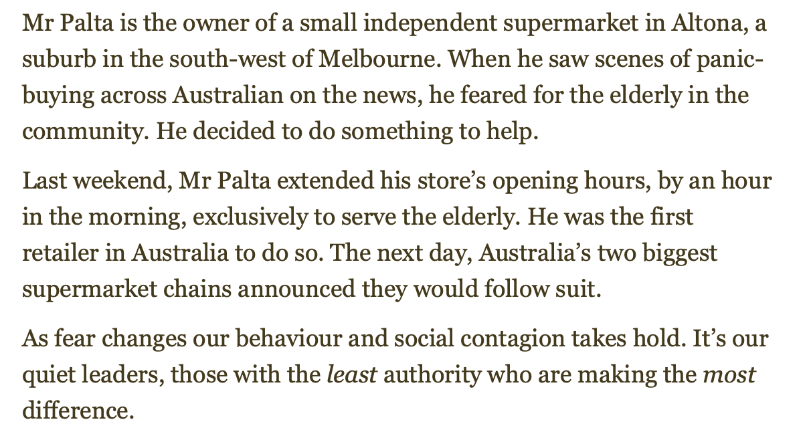
Surround Yourself With Positive Messages
https://unsplash.com/@markadriane

Slide 24
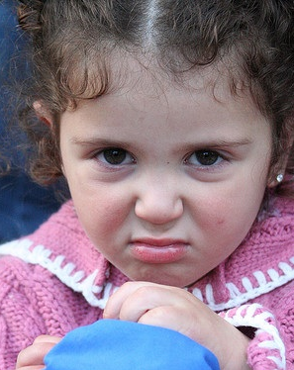
Don’t Repeat Negativity
Find a
Friend You Can Vent To, Who Won’t Take You Too Seriously
Then Let it Go!

Slide 25
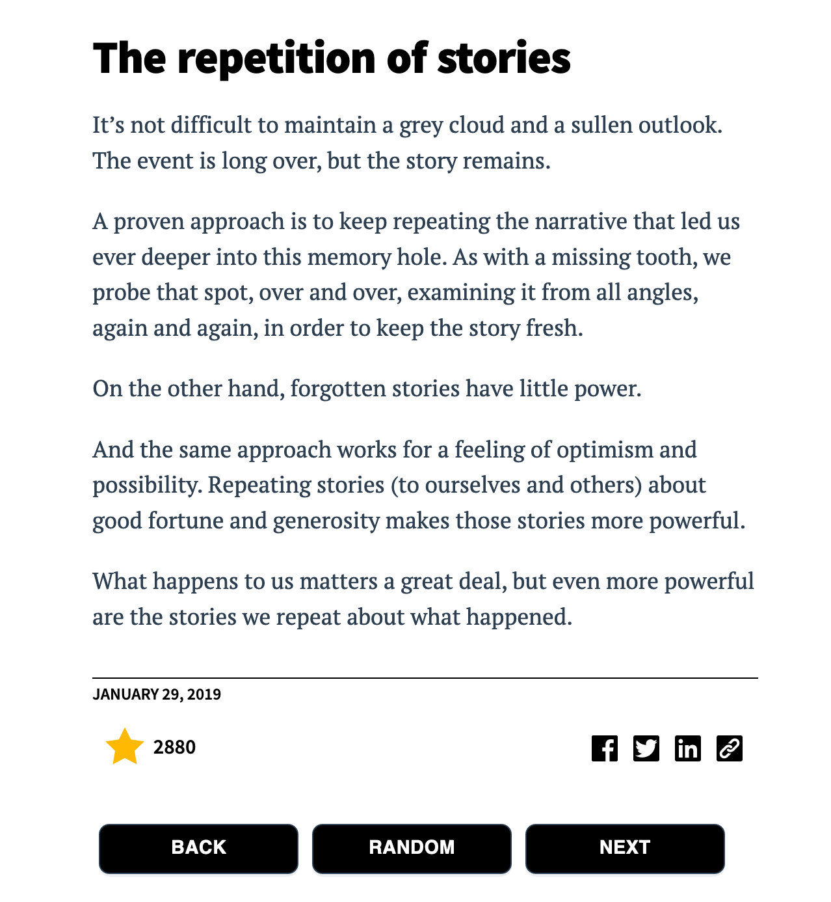


Slide 26
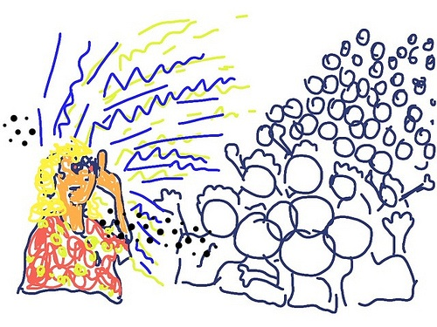
Share Good News and Things That Are Working!
Be A Possibilitarian!

Slide 27
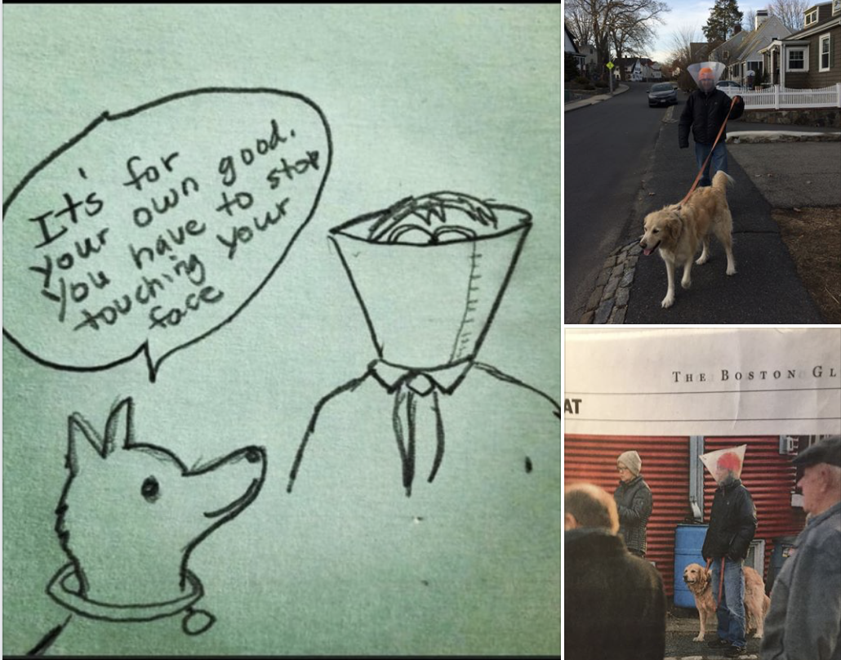
Try to Have a Sense of Humor
Credit Lori Lobenstein

Slide 28
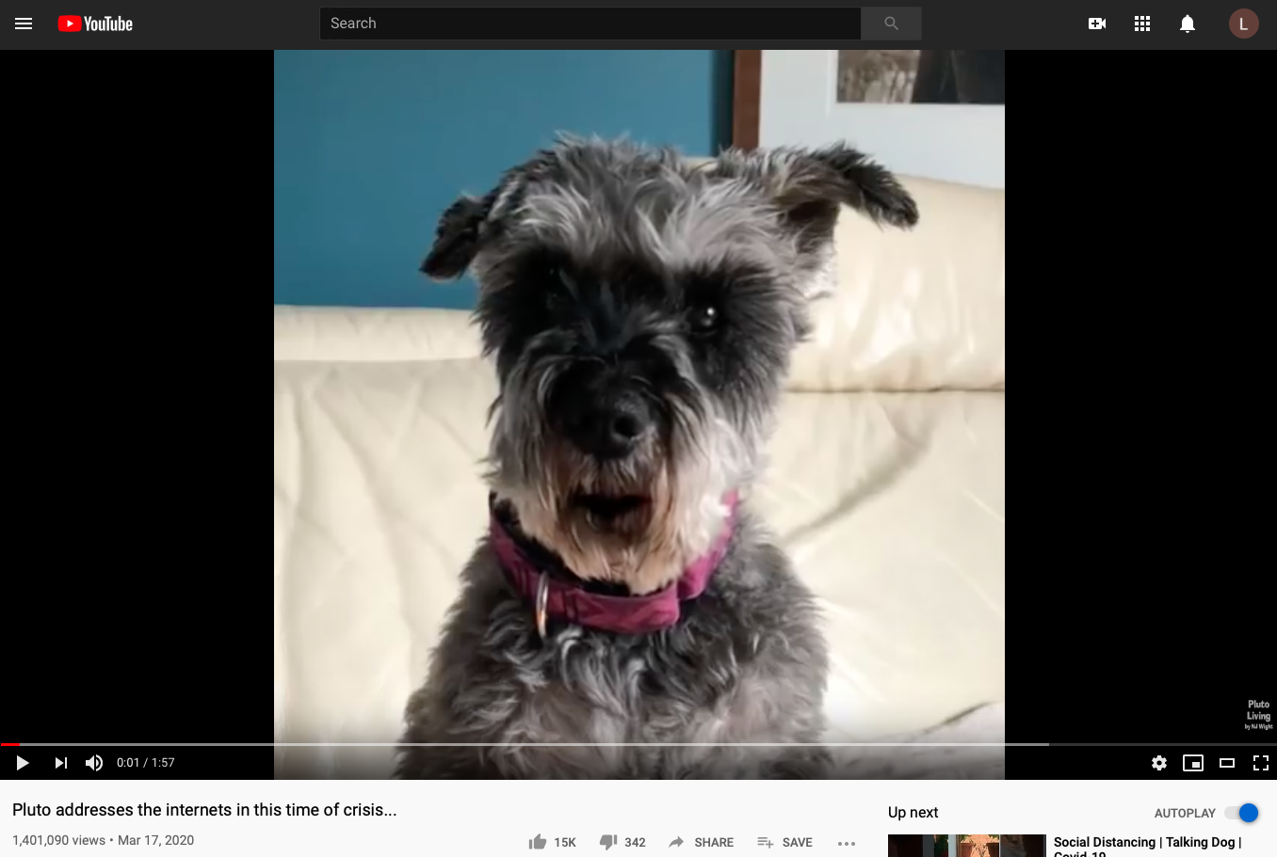

Slide 29
A Few Ways to Create Possibility for Yourself
1. Do things that Center You
2. Surround Yourself with Positive Messages
3. Don’t Repeat Negativity/Find a
Friend You Can Vent To, Who Won’t Take You Too Seriously
4. Try to Have a Sense of Humor
5. Share Abundantly when you Hear of Something Good

Slide 30


Slide 31
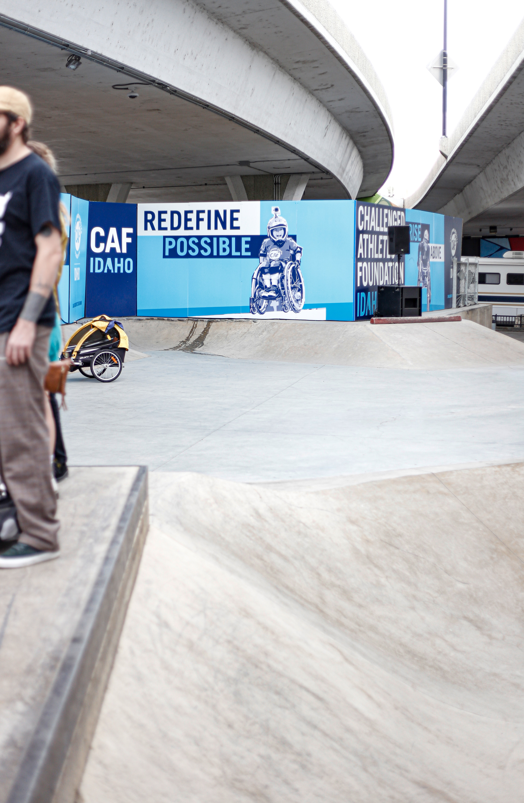
3 Steps for Building a Culture of Philanthropy
Take Care of Yourself
Shared Responsibility for Development
Strong Donor Relations
Photo by Allie Smith on Unsplash

Slide 32
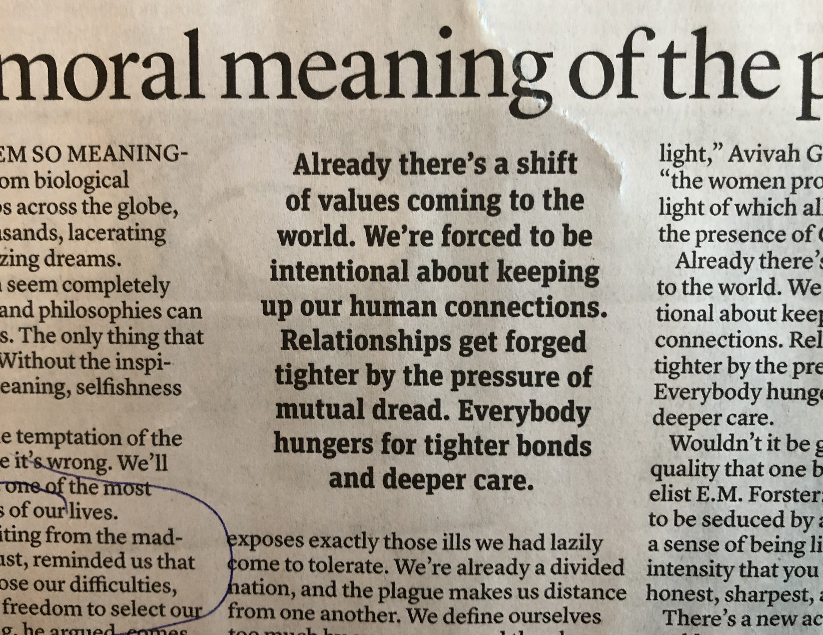
What Are Ways to Create Possibility for Your Organization?

Slide 33

The Cycle of Fundraising
Fundraising Planning – setting clear goals and a course to get there
Identifying Prospective Donors –recognizing the individuals who share your commitment throughout your surrounding communities
Cultivating and Engaging – building relationships and engaging individuals in your successes and challenges
Enrolling– inviting people to invest their resources to advance your vision
Stewarding – appreciating people for their contributions and maintaining a connection between them and the work of your organization
Notes:
EP

Slide 34
3 Points for Building a Culture of Philanthropy
Take Care of Yourself
Shared Responsibility for Development
Strong Donor Relations
BREAKOUT QUESTION: Are there ways that individuals from different parts of your organization – including the board and other volunteers, the program staff, the executive director and others are helping with development? (Especially during COVID-19?)
Photo by Allie Smith on Unsplash

Slide 35

A Shared Responsibility for Development
As a board member I’d love to share how we’re doing with some supporters!
I’d like to send a note to our donors, is there anything you’ve heard that would be inspiring?
Did you hear what Ms. Finch said about how much our programs mean to her and her family?
How Can You Work with Board & Staff to Build a Stronger Culture of Philanthropy?

Slide 37
What are ways the Executive Director
Can Lead a Culture of Philanthropy?
Hearts & Minds
Start with yourself: Get grounded and conscious of what you are grateful for.
Pass out messages of gratitude for the individuals who make your camp work (donors, volunteers, staff, board, and other community members).
Behaviors
Call top donors to ask how they are doing. Listen. If they ask about camp, let them know how its going, including challenges. This should be a stewardship call.
Create a visionary video updating donors and other stakeholders how things are going during this crisis.
Structures
If development systems are not in place for development success, make a commitment now to upgrade immediately post COVID-19 emergency.
Be certain that details from any connections you make get passed on to development.

Slide 38
What are ways Development Professionals
Can Lead a Culture of Philanthropy?
Hearts & Minds
Start with yourself: Get grounded and conscious of what you are grateful for.
Call your top donors and ask how they are doing. Listen. See if there is anything you can provide for them…or something that would make their day a little sweeter.
Behaviors
Work with non-development staff and board members, providing them with a list of people they can call and a system to capture data (ideally a relationship-based database).
Print postcards or blank notecards and pass them out to board and staff to mail out to top donors. The notes should be full of appreciation and gratitude.
Structures
Take time now to work on individual plans for your top donors.
Present a development strategy to the Executive Director.

Slide 39
What are ways Board Members
Can Lead a Culture of Philanthropy?
Hearts & Minds
Start with yourself: Get grounded and conscious of what you are grateful for.
Get good at describing the difference the organization makes. Get moved to tears then start communicating it to others.
Behaviors
With the blessing and coordination of the Development Professional, check in with key donors and report back to staff how it went. Be a listener. How are they? What do they need?
With cards provided by development, write notes of appreciation and gratitude to the top donors.
Structures
Establish mission moments at the start of each board meeting.
Establish a Culture of Philanthropy Committee and have board members lead discussions each meeting that are enlightening and inspiring to board members.

Slide 40
What are ways Donors
Can Lead a Culture of Philanthropy?
Hearts & Minds
Start with yourself: Get grounded and conscious of what you are grateful for.
Get good at describing the difference the organization makes. Get moved to tears then start communicating it to others.
Behaviors
Meet with the Executive Director and Development Professional to find out how you can be useful at this time.
With the blessing of the staff, if you have connections that would be useful for development, make an introduction to the agency. If you can’t meet in person, be creative about how to do that.
Structures
Consider hosting a Jeffersonian Dinner post COVID Emergency or do one on-line!
Organize a group of volunteers to provide something needed by the agency.

Slide 41
What are ways Program Staff
Can Lead a Culture of Philanthropy?
Hearts & Minds
Start with yourself: Get grounded and conscious of what you are grateful for.
Pass out gratitude generously. Lead from what might be possible if we put forth our best effort.
Behaviors
Share connections in the community (vendors, family members, donors, government agencies) with development staff. Strategize with development on how to engage people.
Get good at talking about the agency and the impact of your work.
Structures
Start all program staff meetings with a mission moment. Gather inspiring stories from your clients or family members and save them. Share them with development.
Organize a group of volunteers to provide something needed by the agency.

Slide 42
3 Points for Building a Culture of Philanthropy
Take Care of Yourself
Shared Responsibility for Development
Strong Donor Relations
BREAKOUT QUESTION: Are there ways that your organization has strengthened donor relations?
(Especially during COVID-19?)
Photo by Allie Smith on Unsplash

Slide 43

Ways to Connect With Donors NOW
Stay Connected and Increase Communication –Maintain an Attitude of Gratitude
Go Small to have a Big Impact
Learn From the Past: Stay Cool
Communicate Clearly
Be Genuinely Relevant (And Only If It Applies)
Build or Maintain Structures to support a Culture of Philanthropy

Slide 44
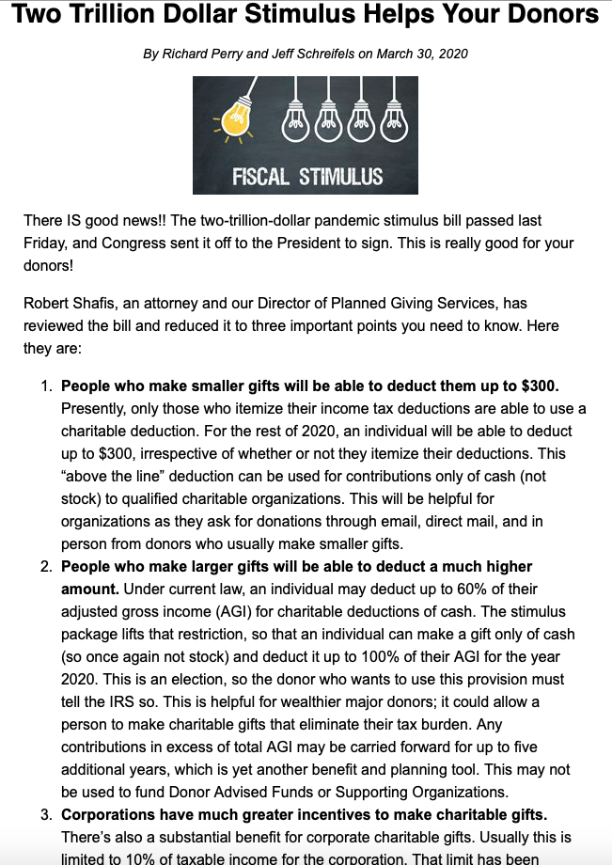

Slide 45
What conversations need to STOP, START or CONTINUE? (Hearts and Minds)
What behaviors need to STOP, START OR CONTINUE? (Behaviors)
We will strengthen our organization by…
What structures do we need to put in place, take down or CONTINUE using? (Structures)
Notes:
NOTE – review the 3 LAWS and the Leadership Correlaries

Slide 46
Got Questions?
Notes:
LAURIE: WELCOME TO BUILDING A CULTURE OF PHILANTHROPY! I’M LAURIE AND WE WANT TO WELCOME YOU… INTRODUCE OTHERS…. YOU’RE GOING TO HEAR FROM ALL OF US TODAY!

Slide 47

The person who removes a mountain begins by carrying away small stones.
Chinese proverb
47

