Slide 1
BEBER THEATER PRESENTS
DON'T THROW AWAY YOUR SHOT
marketing and recruiting during the summer to hit the ground running for Summer 2023

Slide 2
01
DON'T THROW AWAY YOUR SHOT
ABOUT THE MARKETING
This is a dramatic, comedic, and action packed summer that The Beber Camp Team (Trudy, Stacy, Debbie, Will and Michael) will present to you!

Slide 3
02
DON'T THROW AWAY YOUR SHOT
WHAT'S THIS ABOUT?
Utilizing the facility
Tours
Family Camp
In camp marketing
Rites of passage/recognition
Photos/social media

Slide 4
03
TESTIMONIALS
"You're only as good as your last summer!"
"Run a great program!"
JEWISH CAMP TRIBUNE
JEWISH CAMP DIRECTORS

Slide 5
04
ASK YOURSELF
WHAT IS YOUR TOUR CLOSE RATE?

Slide 6
05
TOURS AND TRUDY
DETAILS MATTER
TRUDY SIRKIS
as TOUR COORDINATOR
TRAINING

Slide 7
06
ASK YOURSELF
WHAT PERCENTAGE OF LOCAL FAMILIES HAVE VISITED YOUR CAMP FACILITY?

Slide 8
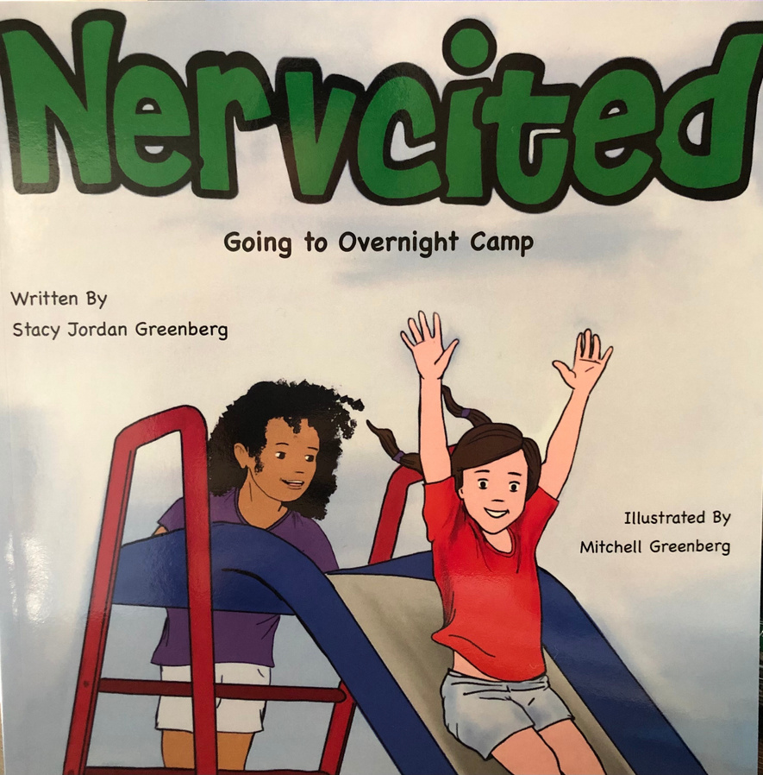
07
FAMILY FUN AND STACY
STACY GREENBERG
as AUTHOR

Slide 9
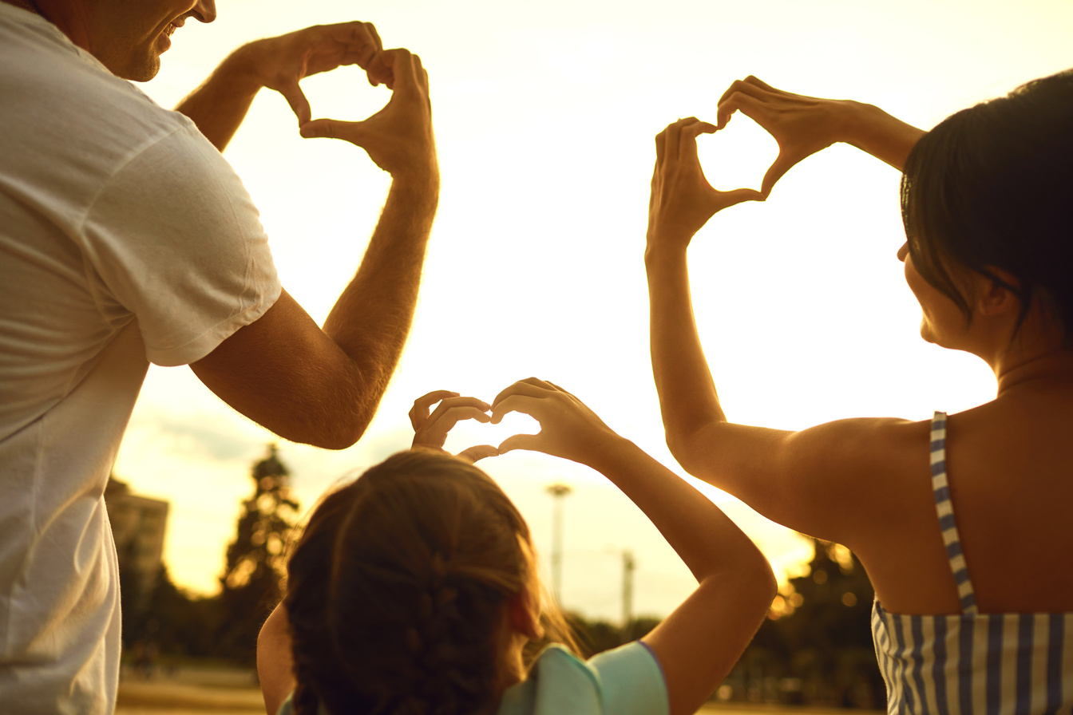
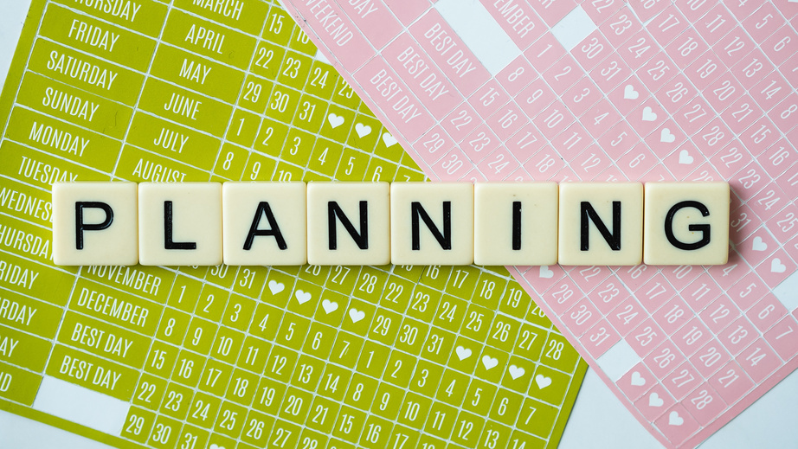
08
FAMILY FUN AND STACY
All in the family
STACY GREENBERG
as PROGRAM GURU
It's all part of the plan

Slide 10
09
ASK YOURSELF
WHAT TRADITION AT YOUR CAMP DO CAMPERS LOOK FORWARD TO SEVERAL YEARS DOWN THE ROAD?

Slide 11
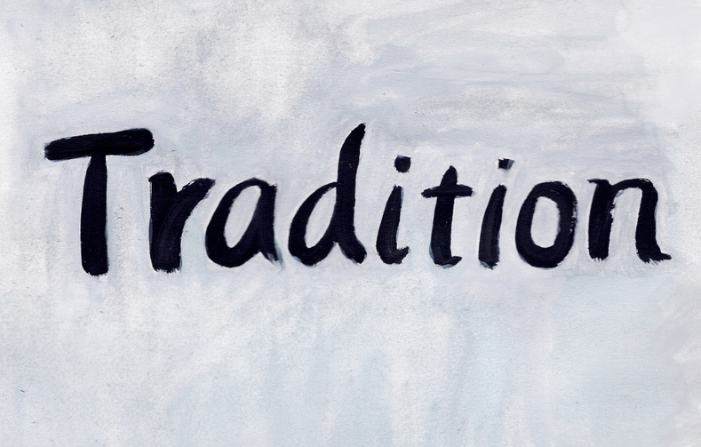
09
DEBBIE TIME
DEBBIE MORRIS
as HERSELF

Slide 12
10
ASK YOURSELF
DO YOU HAVE A WRITTEN DOWN SOCIAL MEDIA STRATEGY?

Slide 13
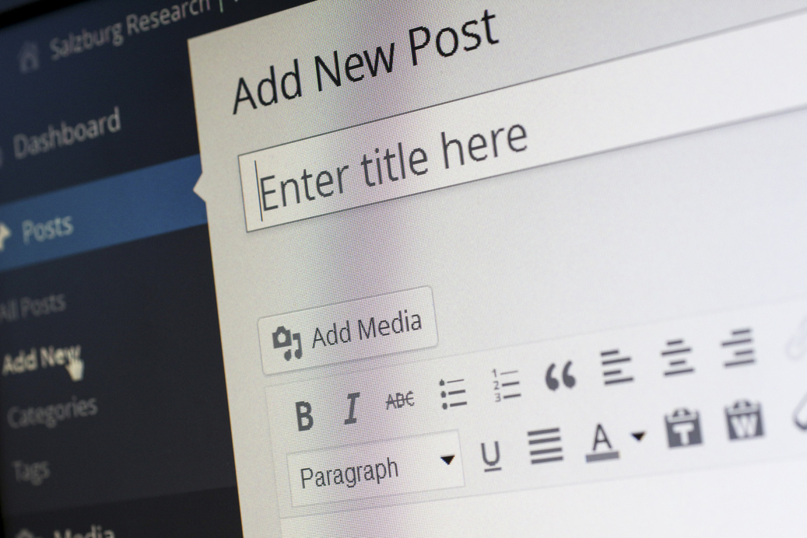
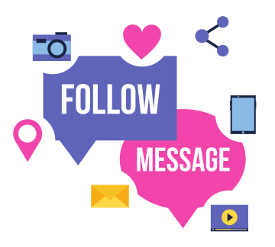
11
WILL'S WORLD, WILL'S WORLD
WILL JARVIS
as THE TECHIE

Slide 14
12
WILL'S WORLD, WILL'S WORLD
DAILY BLOG
“TODAY WAS THE LAST FULL DAY OF CABIN ACTIVITIES AS THERE IS ONLY ONE TOMORROW DUE TO THE BANQUET FESTIVITIES. CAMPERS HAVE REALLY ENJOYED THEIR OPPORTUNITY TO SAMPLE ALL THE ACTIVITIES THAT WE HAVE TO OFFER HERE AT CAMP. FROM THE FARM TO THE WATERFRONT, THEY HAVE DONE IT ALL."
Intentional writing
Interactive
Video Blog

Slide 15
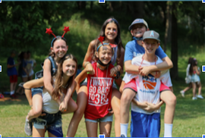
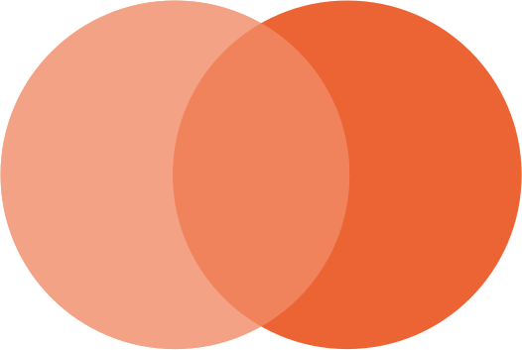
13
WILL'S WORLD, WILL'S WORLD
Photos
For the
Parents
Photos
For
Marketing
PERFECTION!

Slide 16
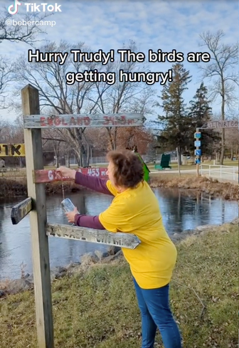
14
WILL'S WORLD, WILL'S WORLD
SOCIAL MEDIA
Facebook - Parents + Older Demograhics
Instagram & TikTok - Young Parents/Alumni
AND THE SURVEY SAYS....
98% of marketers say Instagram is the most influential platform for marketing, which is 44% higher than Facebook.
TikTok was the most downloaded app in 2020
Hubspot - "Social Media Marketing Statistics for 2021

Slide 17
15
ASK YOURSELF
DO YOU HAVE YOUR DATES FOR SUMMER 2023?
DO YOU HAVE YOUR REGISTRATION DATES SET FOR SUMMER 2023?

Slide 18
16
A WALK TO THE MOON
BEFORE THE CURTAIN CLOSES
Announcement of Dates before Summer
Visiting Families before registration
Following up with leads (tours and non-tours)
Surveys
Phone Calls
Genius marketing will work and helps you get new campers BUT, you still have to keep them!!!

Slide 19
BEBER THEATER PRESENTS
THANK YOU!
good luck this summer!

