Slide 1


Title

Slide 2

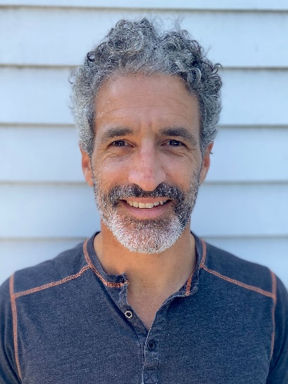


Enrollment 2021 Drop-In: Facing the Challenge Together
August 6, 2020
Aron Goldman Kevin Martone Herschel Singer
Mentor, Enrollment Program Director Technology Program Manager Analytics Manager
JCamp 180 JCamp 180 JCamp 180

Slide 3
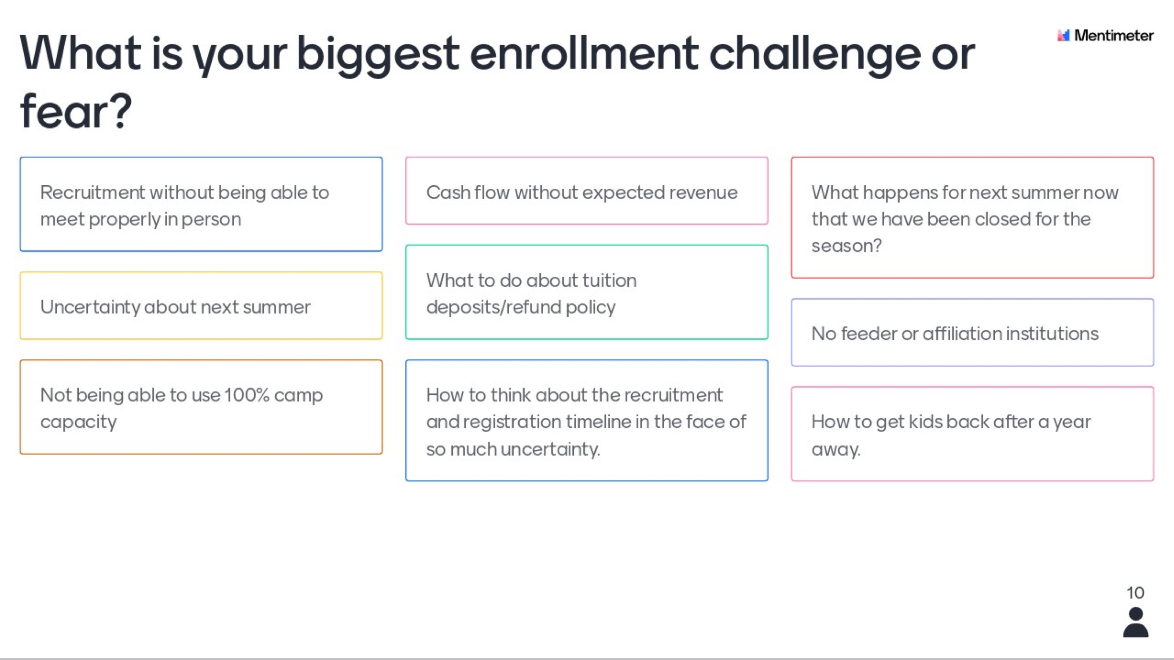

Slide 4
Agenda
Title Box
Welcome, Introductions
Decision tree models
Breakouts and reports out (x2)
Enrollment Program Info
Enrollment challenges/Enrollment Drop-ins

Slide 5
Matt Levitt
Chief Operating Officer, Ramah in the Rockies (CO)

Slide 6
Breakout #1
Title Box
How do I makeup for the loss of powerful in-person recruitment strategies in an even more competitive marketplace in 2021?
Breaking down the problem (discussion guide):
How do you plan to replace lost in-person recruitment opportunities?
What new investments in recruitment and retention might you implement (such as increased referral incentives, or increased online advertising)?
How might you reorient staff and board roles to face this challenge together?

Slide 7
Breakout #2
Title Box
How do I plan for cash flow—including right now--amid substantial uncertainty about 2021 tuition revenue?
Breaking down the problem (discussion guide):
Do you need multiple financial scenario contingencies?
Segregating funds: Is there a risk of spending "summer revenue" before the summer?
When and how do you use (emergency) fundraising proceeds for general operations?
Is a different incentives strategy needed for 2021?
Do you need a more sophisticated (and bigger) scholarship program?
What deposit and refund policies for 2021 will be most effective and consistent with your mission?

Slide 8
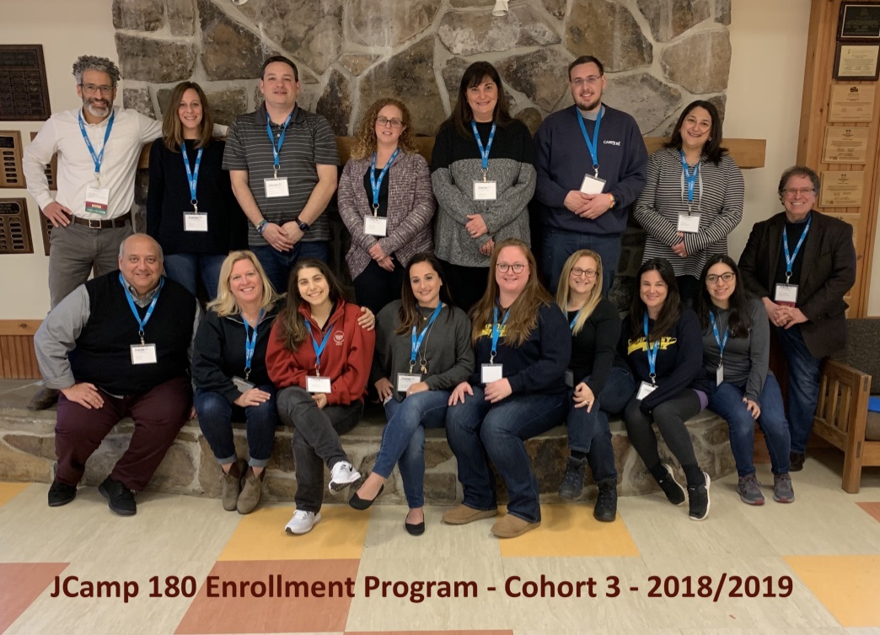
Get on board!
Title Box
Register here: www.jcamp180.org/enrollment
Registration ends Friday,
August 14!

Slide 9
Drop-in Sessions
Title Box
August 13 & 20
Same Zoom link you used today.
Summer 2021 Enrollment Plans survey!

Slide 10

Drop-in Sessions
Title Box

