Slide 1

Data2Donors:
Knowing your data
to
Knowing your donors
Notes:
Kevin: Welcome to No More Dusty Records.
Growing your base of support for recruitment and fundraising starts with a commitment to unearth old and dusty records and get as many entered correctly into your database.
Our latest Webinar - "No More Dusty Records" - will show you how to find and reconnect with your alumni and other constituents.
This Webinar will start in just a minute

Slide 2
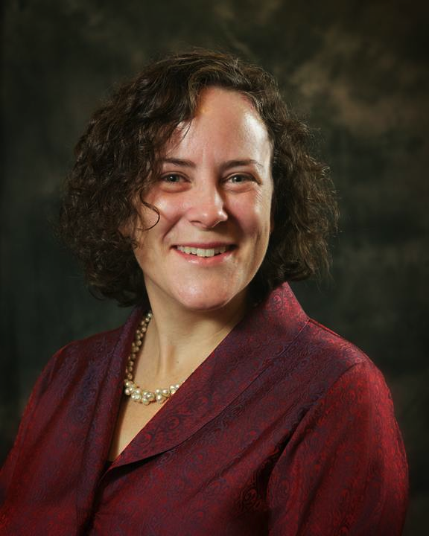
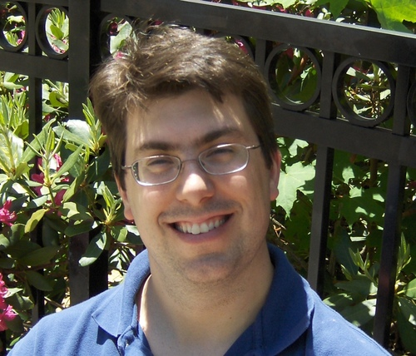
Julia Riseman and Kevin Martone
Julia@hgf.org
Kevin@hgf.org
Notes:
Julia: Happy New Year, everyone. I am Julia Riseman, Mentor, at Jcamp 180 working with camps across North America since 2008 – providing consulting services on Strategic Planning, Strong Governance, and, my personal passion, Fundraising.
I enjoy working with Kevin Martone – a great partner.
Kevin: Thanks. I am the Technology Program Manager here at JCamp 180. I consult with our affiliated camps to help them use technology to support their fundraising and outreach efforts, including donor databases, social media, eNewsletters, and more.
Julia: Together Kevin and I dreamed up this webinar, along with a six month course, Data2Donors which a number of you are now enrolled. We’ve build this session around our learning working with over 100 Jewish Camps.
It isn’t complicated – but important work to get done.

Slide 3
Agenda
Announcements
Knowing your top prospects
Looking Ahead
Notes:
Julia:
I’m going to tell you NOW what you will learn in this webinar.
We’re going to share with you a real world example to the TRUE dollar value of unearthing your old donor records – and the intense amount of money you will never realize should you continue to do nothing with your dusty records. If this doesn’t convince your Leadership to invest in inputting dusty records – then …. (um) let’s talk off line.
Then we’re going to review places to look for your old and dusty records – and you’re going to brainstorm your own list.
Kevin is going to tell you how to handle incomplete data
And we’re both going to rush through information on how to move imcomplete information into good, current, and up-to-date contact information for all the alumni and friends of camp.
We’ll end with a discussion and questions

Slide 4
Announcements
Results of the mid-point survey
  Overall: Very positive
  Feedback: Confusing instructions on AlumniFinder; Confusion on flagging for D2D
  Improvements for next year: Too much in January; Build stronger connection to other camps in the program; Offer $ for data staff during program
  Improvements for rest of program: how to use results for fundraising and provide a realistic sample timeline.
  Recommend to other camps? Yes
Notes:
Julia:
I’m going to tell you NOW what you will learn in this webinar.
We’re going to share with you a real world example to the TRUE dollar value of unearthing your old donor records – and the intense amount of money you will never realize should you continue to do nothing with your dusty records. If this doesn’t convince your Leadership to invest in inputting dusty records – then …. (um) let’s talk off line.
Then we’re going to review places to look for your old and dusty records – and you’re going to brainstorm your own list.
Kevin is going to tell you how to handle incomplete data
And we’re both going to rush through information on how to move imcomplete information into good, current, and up-to-date contact information for all the alumni and friends of camp.
We’ll end with a discussion and questions

Slide 5
Announcements
Office Hours March 4th, 3 pm EST (w Julia)
Homework Due March 11th
Next Webinar: Tuesday, March 18th, 1pm EST: “Turning Data into Donors”
Last Webinar!
Thursday, April 24th @ 1 pm
“Do the Celebratory Data Dance”
Notes:
Julia:
I’m going to tell you NOW what you will learn in this webinar.
We’re going to share with you a real world example to the TRUE dollar value of unearthing your old donor records – and the intense amount of money you will never realize should you continue to do nothing with your dusty records. If this doesn’t convince your Leadership to invest in inputting dusty records – then …. (um) let’s talk off line.
Then we’re going to review places to look for your old and dusty records – and you’re going to brainstorm your own list.
Kevin is going to tell you how to handle incomplete data
And we’re both going to rush through information on how to move imcomplete information into good, current, and up-to-date contact information for all the alumni and friends of camp.
We’ll end with a discussion and questions

Slide 6
What is YOUR Goal?
Capital Campaign
Endowment Building
Special Projects
Grinspoon Matching Grant

Slide 7
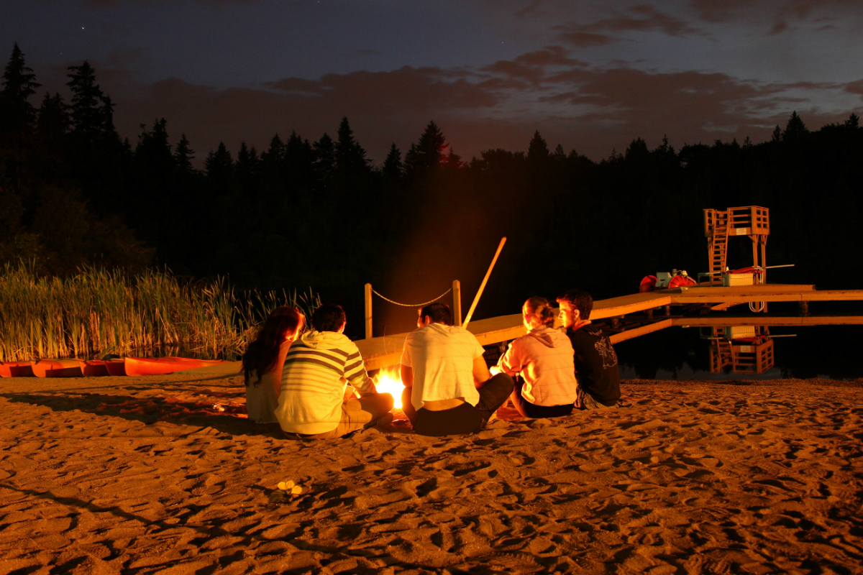
Jef Nobbe
Camp Solomon Schechter, Washington
Notes:
Julia:
Data2 Donors is:
A new program of JCamp 180, run with monthly webinars by Kevin and myself.
This year we are fully booked – so apply next year.
The following camps are in the program this year: List?
Data2 Donors is A six month systematic and supportive approach to moving from dusty records to growth in Alumni outreach and onto major donor fundraising.
Kevin:
We will pay for your data to be run through 3 separate datasets to further enhance the data:
NCOA – update recent address changes
AlumniFinder – update more distant address changes
WealthEngine – capacity information
Julia:
Good data management
Qualified major donor prospect list ready for campaign fundraising

Slide 8
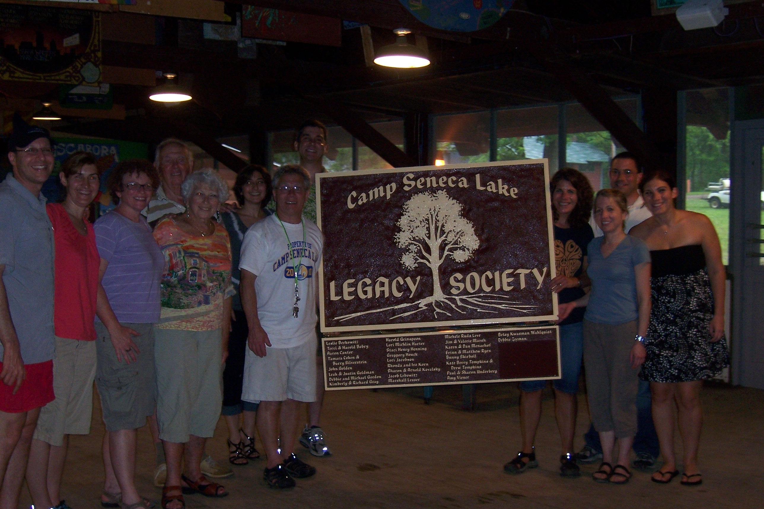
Staci Hiller
Aaron Cantor
Camp Seneca Lake
New York
Notes:
Julia:
Data2 Donors is:
A new program of JCamp 180, run with monthly webinars by Kevin and myself.
This year we are fully booked – so apply next year.
The following camps are in the program this year: List?
Data2 Donors is A six month systematic and supportive approach to moving from dusty records to growth in Alumni outreach and onto major donor fundraising.
Kevin:
We will pay for your data to be run through 3 separate datasets to further enhance the data:
NCOA – update recent address changes
AlumniFinder – update more distant address changes
WealthEngine – capacity information
Julia:
Good data management
Qualified major donor prospect list ready for campaign fundraising

Slide 9
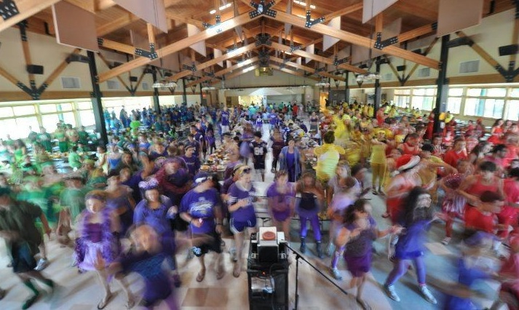
Wendy Clyman
Herzl Camp
Wisconsin
Notes:
Julia:
Data2 Donors is:
A new program of JCamp 180, run with monthly webinars by Kevin and myself.
This year we are fully booked – so apply next year.
The following camps are in the program this year: List?
Data2 Donors is A six month systematic and supportive approach to moving from dusty records to growth in Alumni outreach and onto major donor fundraising.
Kevin:
We will pay for your data to be run through 3 separate datasets to further enhance the data:
NCOA – update recent address changes
AlumniFinder – update more distant address changes
WealthEngine – capacity information
Julia:
Good data management
Qualified major donor prospect list ready for campaign fundraising

Slide 10
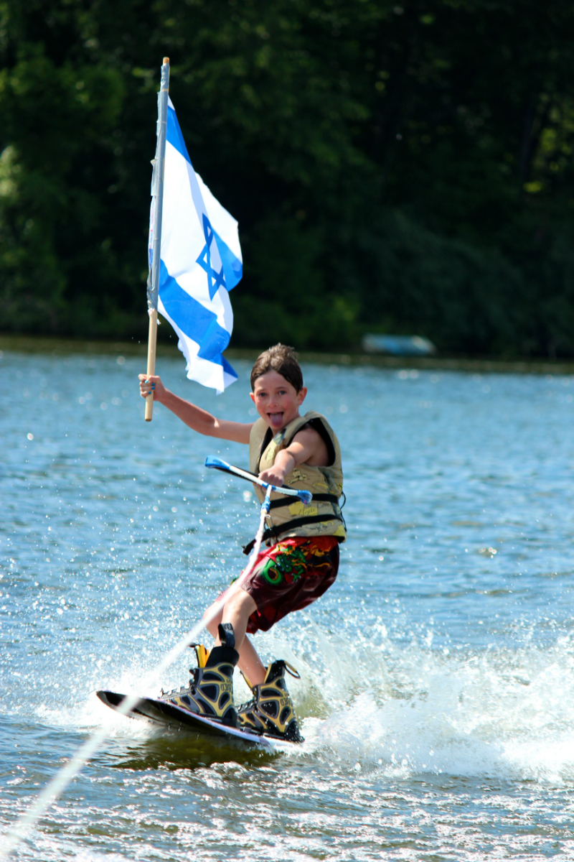
Gabe Neistein
Tamarack Camps
Michigan
Notes:
Julia:
Data2 Donors is:
A new program of JCamp 180, run with monthly webinars by Kevin and myself.
This year we are fully booked – so apply next year.
The following camps are in the program this year: List?
Data2 Donors is A six month systematic and supportive approach to moving from dusty records to growth in Alumni outreach and onto major donor fundraising.
Kevin:
We will pay for your data to be run through 3 separate datasets to further enhance the data:
NCOA – update recent address changes
AlumniFinder – update more distant address changes
WealthEngine – capacity information
Julia:
Good data management
Qualified major donor prospect list ready for campaign fundraising

Slide 11
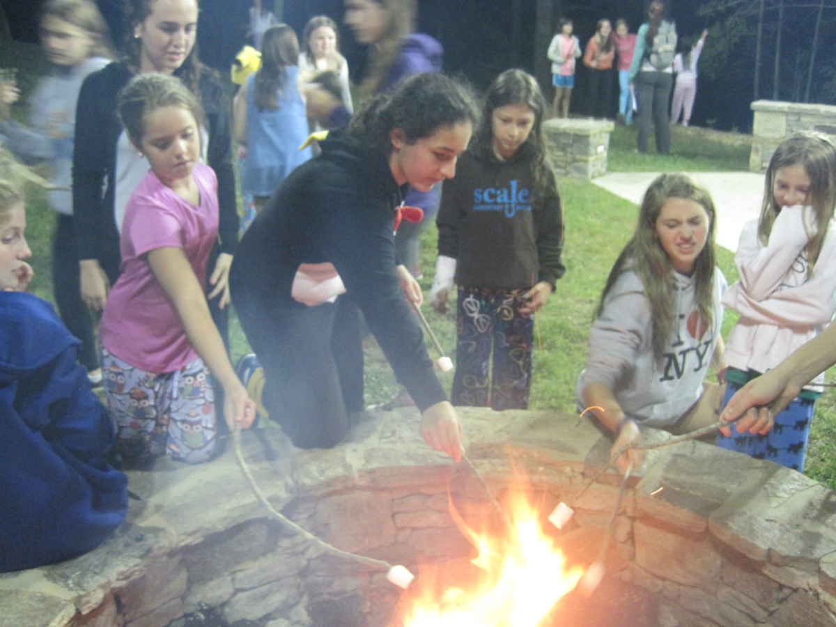
David Weiss
Camp Judaea
North Carolina
Notes:
Julia:
Data2 Donors is:
A new program of JCamp 180, run with monthly webinars by Kevin and myself.
This year we are fully booked – so apply next year.
The following camps are in the program this year: List?
Data2 Donors is A six month systematic and supportive approach to moving from dusty records to growth in Alumni outreach and onto major donor fundraising.
Kevin:
We will pay for your data to be run through 3 separate datasets to further enhance the data:
NCOA – update recent address changes
AlumniFinder – update more distant address changes
WealthEngine – capacity information
Julia:
Good data management
Qualified major donor prospect list ready for campaign fundraising

Slide 12
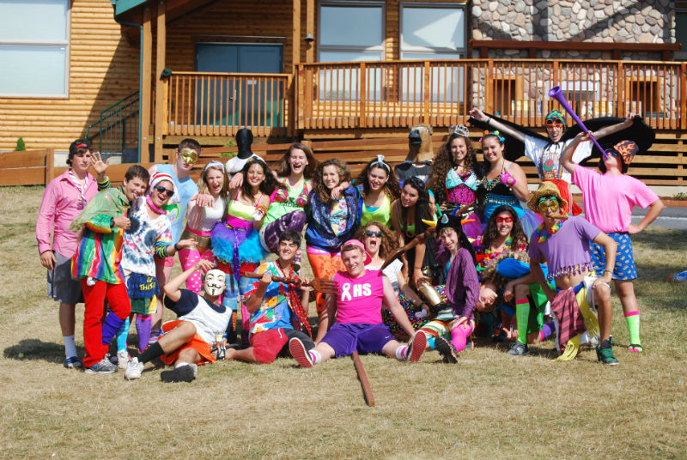
Barbara Gordon
B’nai B’rith Camp
Oregon
Notes:
Julia:
Data2 Donors is:
A new program of JCamp 180, run with monthly webinars by Kevin and myself.
This year we are fully booked – so apply next year.
The following camps are in the program this year: List?
Data2 Donors is A six month systematic and supportive approach to moving from dusty records to growth in Alumni outreach and onto major donor fundraising.
Kevin:
We will pay for your data to be run through 3 separate datasets to further enhance the data:
NCOA – update recent address changes
AlumniFinder – update more distant address changes
WealthEngine – capacity information
Julia:
Good data management
Qualified major donor prospect list ready for campaign fundraising

Slide 13
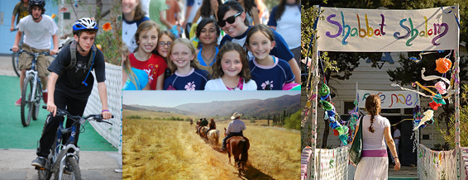
Lesley Plachta
Sarah Donner
Camp Alonim
California
Notes:
Julia:
Data2 Donors is:
A new program of JCamp 180, run with monthly webinars by Kevin and myself.
This year we are fully booked – so apply next year.
The following camps are in the program this year: List?
Data2 Donors is A six month systematic and supportive approach to moving from dusty records to growth in Alumni outreach and onto major donor fundraising.
Kevin:
We will pay for your data to be run through 3 separate datasets to further enhance the data:
NCOA – update recent address changes
AlumniFinder – update more distant address changes
WealthEngine – capacity information
Julia:
Good data management
Qualified major donor prospect list ready for campaign fundraising

Slide 14
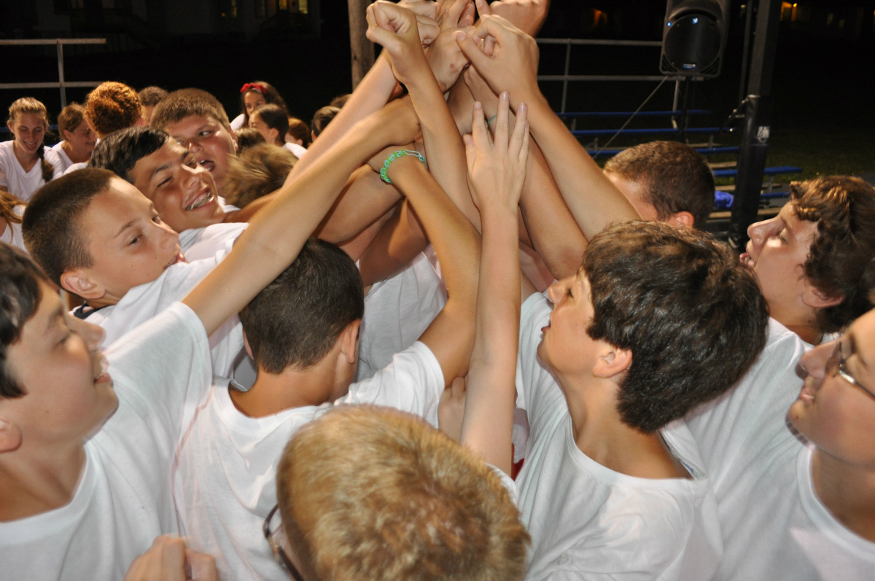
Ellen Goldstein
Marty Krupnick
Marc Rauch
Camp Kinder Ring
New York
Notes:
Julia:
Data2 Donors is:
A new program of JCamp 180, run with monthly webinars by Kevin and myself.
This year we are fully booked – so apply next year.
The following camps are in the program this year: List?
Data2 Donors is A six month systematic and supportive approach to moving from dusty records to growth in Alumni outreach and onto major donor fundraising.
Kevin:
We will pay for your data to be run through 3 separate datasets to further enhance the data:
NCOA – update recent address changes
AlumniFinder – update more distant address changes
WealthEngine – capacity information
Julia:
Good data management
Qualified major donor prospect list ready for campaign fundraising

Slide 15
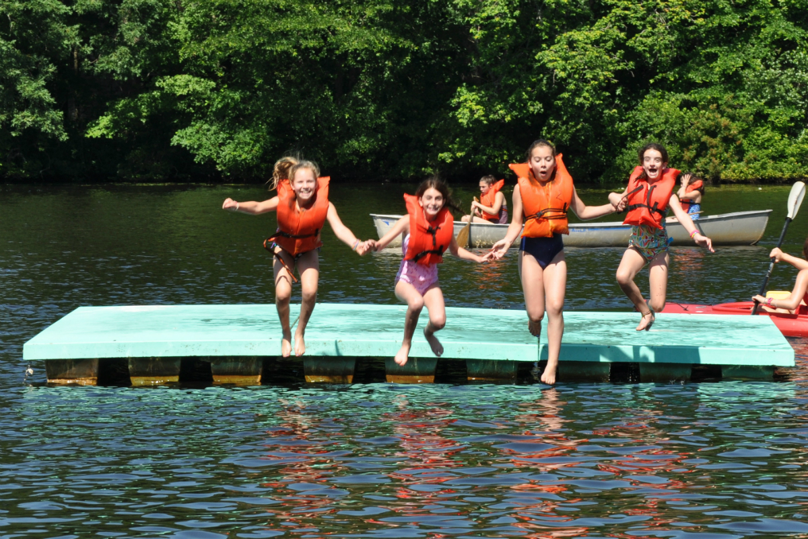
Susan Callum
Barbara Stevens
Camp Pembroke
Massachusetts
Notes:
Julia:
Data2 Donors is:
A new program of JCamp 180, run with monthly webinars by Kevin and myself.
This year we are fully booked – so apply next year.
The following camps are in the program this year: List?
Data2 Donors is A six month systematic and supportive approach to moving from dusty records to growth in Alumni outreach and onto major donor fundraising.
Kevin:
We will pay for your data to be run through 3 separate datasets to further enhance the data:
NCOA – update recent address changes
AlumniFinder – update more distant address changes
WealthEngine – capacity information
Julia:
Good data management
Qualified major donor prospect list ready for campaign fundraising

Slide 16
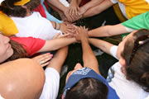


Karen Bernstein
Danny Weiss
Capital Camps and
Retreat Center
Maryland
Notes:
Julia:
Data2 Donors is:
A new program of JCamp 180, run with monthly webinars by Kevin and myself.
This year we are fully booked – so apply next year.
The following camps are in the program this year: List?
Data2 Donors is A six month systematic and supportive approach to moving from dusty records to growth in Alumni outreach and onto major donor fundraising.
Kevin:
We will pay for your data to be run through 3 separate datasets to further enhance the data:
NCOA – update recent address changes
AlumniFinder – update more distant address changes
WealthEngine – capacity information
Julia:
Good data management
Qualified major donor prospect list ready for campaign fundraising

Slide 17
10,000+ contacts
  Pull lists (Reduce to 1,000+)
  Review the lists (Reduce to 100+)
  Qualify the lists with volunteers (Reduce to 50+)
  Conduct more research (Reduce to 20)
  Create Donor Profiles
  Plan Donor Strategy (Reduce to the first 10)
top 20 prospects

Slide 18
Gift Pyramid
One $100K
Some $1K
Many, many $100 gifts from Camp Fans

Slide 19
Gift Pyramid
One $100K
Some $1K
Many, many $100 gifts from Camp Fans
Alumni Outreach
Annual Appeal Letters
Golf Outing
Reunions
Special Events

Slide 20
Gift Pyramid
One $100K
Some $1K
Many, many $100 gifts from Camp Fans
Board Giving
Special Projects
Asks

Slide 21
Gift Pyramid
Major Donor Fundraising
Lead gifts in Capital Campaigns
One $100K
Some $1K
Many, many $100 gifts from Camp Fans

Slide 22
Gift Pyramid
Ladder of Engagement
to Greater Philanthropy

Slide 23
Major Gifts Cycle
Identify
Pull reports
Segment
Qualify
Capacity
Cultivate
Interests
Bring closer
Research
Involve
Motivation
Relationship
Ask
Thank
Steward

Slide 24
Major Gifts Cycle
Identify
Pull reports
Qualify
Capacity
Cultivate
Interests
Bring closer
Segment
Involve
Motivation
Relationship
Research
You Are Here
Ask
Thank
Steward

Slide 25
10,000+ contacts
  Pull lists
  Review the lists
  Qualify the lists with volunteers
  Conduct more research
  Create Donor Profiles
  Plan Donor Strategy
top 20 prospects

Slide 26
Example of Pulling a Reports
Filter in DPO using:
P2G Score,
Total Amount Given Lifetime,
Total Number of Lifetime Gifts,
Camp Alumni

Slide 27
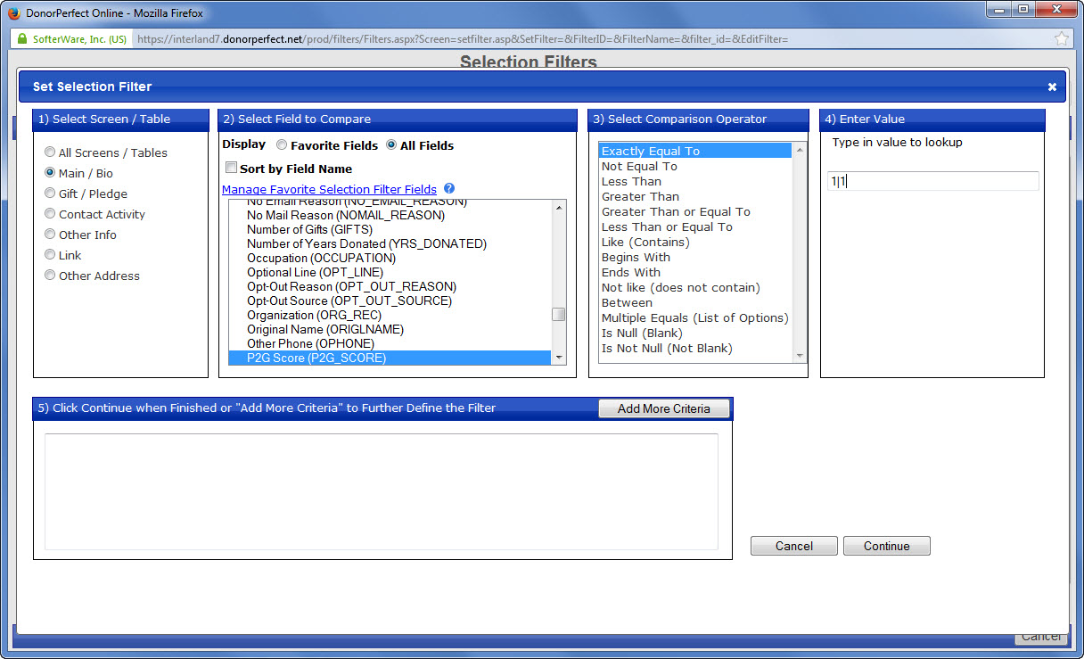
P2G Scores

Slide 28
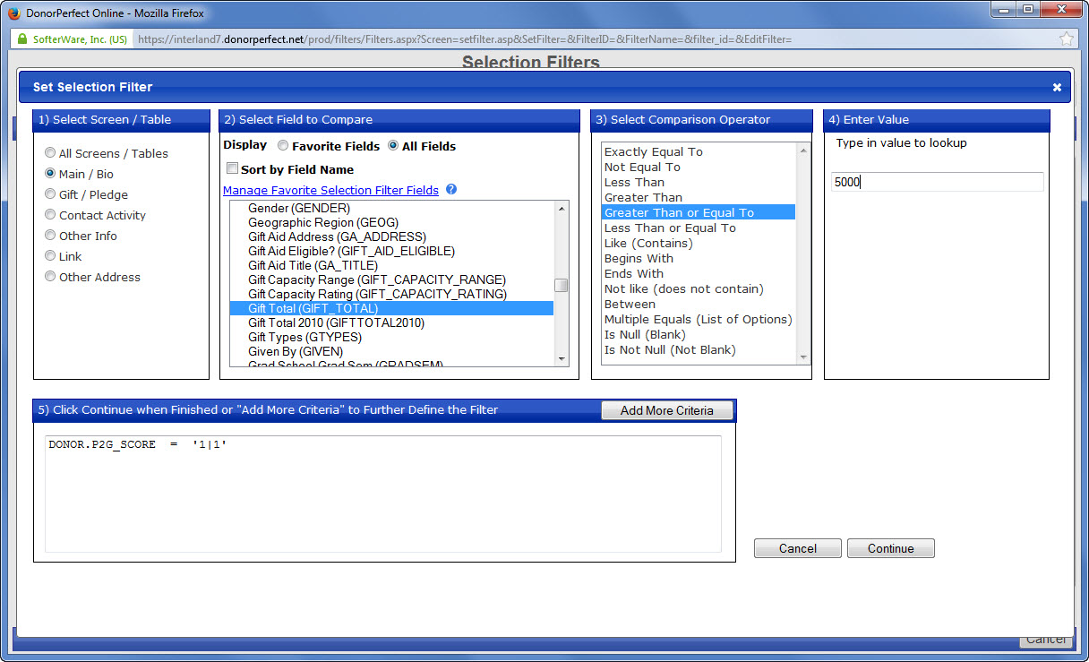
Total Lifetime Giving

Slide 29
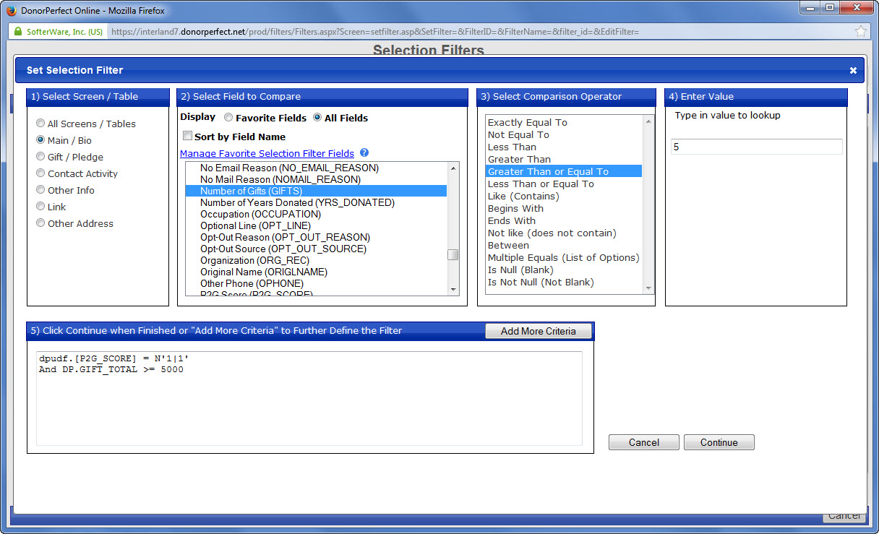
Number of Lifetime Gifts

Slide 30
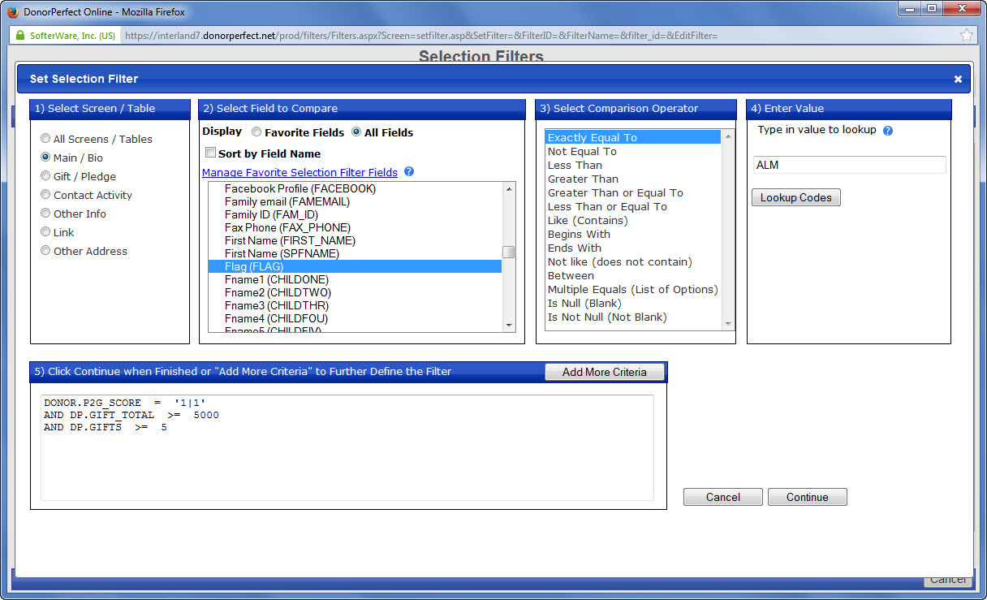
Flagged as Alumni

Slide 31
Sample Prospect List
P2G | First Name | Last Name |  | All Donation Amount | All Donations Number | Last Donation Date | Last Donation Amont | Notes
1/0 | Lori | Gold | CA | $17,000.00 | 13 | 1/7/14 | $4,500.00 | Already paying for Basket ball court
1/1 | John | Goldman | CT | $480.00 | 20 | 1/15/14 | $10.00 | Need to know more
1/1 | Karen | Davis | CT | $1,270.00 | 2 | 12/31/13 | $1,000.00 | Parent of Camper with Special needs
1/2 | Diane | Auckman | WA | $6,431.54 | 10 | 12/31/13 | $1,000.00 | Past Camp Doctor
1/1 | Neil | Ness | CA | $5,000.00 | 1 | 9/6/10 | $5,000.00 | Grinspoon Match for Dinning Hall
1/0 | Monica | Dover | VA | $6,202.50 | 2 | 4/12/10 | $6,150.00 | Who is she?
1/3 | Kimberly | Rubin | CA | $19,669.18 | 37 | 11/26/13 | $300.00 | Eventually may give but suspect not at this time
1/0 | Andrew | Silverman | CT | $4,500.00 | 3 | 3/15/13 | $1,500.00 | Alum, Kids going to computer camp.

Slide 32
Add Your Notes Here
P2G | First Name | Last Name |  | All Donation Amount | All Donations Number | Last Donation Date | Last Donation Amont | Notes
1/0 | Lori | Gold | CA | $17,000.00 | 13 | 1/7/14 | $4,500.00 | Already paying for Basket ball court
1/1 | John | Goldman | CT | $480.00 | 20 | 1/15/14 | $10.00 | Need to know more
1/1 | Karen | Davis | CT | $1,270.00 | 2 | 12/31/13 | $1,000.00 | Parent of Camper with Special needs
1/2 | Diane | Auckman | WA | $6,431.54 | 10 | 12/31/13 | $1,000.00 | Past Camp Doctor
1/1 | Neil | Ness | CA | $5,000.00 | 1 | 9/6/10 | $5,000.00 | Grinspoon Match for Dinning Hall
1/0 | Monica | Dover | VA | $6,202.50 | 2 | 4/12/10 | $6,150.00 | Who is she?
1/3 | Kimberly | Rubin | CA | $19,669.18 | 37 | 11/26/13 | $300.00 | Eventually may give but suspect not at this time
1/0 | Andrew | Silverman | CT | $4,500.00 | 3 | 3/15/13 | $1,500.00 | Alum, Kids going to computer camp.

Slide 33
Major Gifts Cycle
Identify
Pull reports
Segment
Qualify
Capacity
Cultivate
Interests
Bring closer
Research
Involve
Motivation
Relationship
You Are Here
Ask
Thank
Steward

Slide 34
What do you need to know?
Capacity – to make a major gift
Motivation – Why they care and why they are positioned to give generously if asked
Relationship – to camp or the people currently connected to camp

Slide 35
Reduce to 100+:
Involve Volunteers and Senior Staff to review your lists
Prep before the meeting:
Segment the list(s) – include some notes
Invite Volunteers & Senior Staff to review
Seek a host for the meeting at their home
Explain that you are seeking help to get to know your camp donors better
Speak about the “Case for Support”
Ask for just one meeting
Notes:
Work now to find every possible dusty old record of past participants at camp and get these entered into your data base
Find every possible old photo and get them scanned
Set up on-line tools to let people enter in their updated information
Establish a volunteer group that will work to help you get back in touch with lost Alumni
Design a welcome packet and a welcome system
Segment your donor list

Slide 36
Types of people you might involve
Current Camp Director
Current Major Donors
Board Members
Past Campaign Chairs
Alumni Association Chair
Past Board Members, Past Camp Directors
Past Honorees
Jewish Communal Leaders
Notes:
Work now to find every possible dusty old record of past participants at camp and get these entered into your data base
Find every possible old photo and get them scanned
Set up on-line tools to let people enter in their updated information
Establish a volunteer group that will work to help you get back in touch with lost Alumni
Design a welcome packet and a welcome system
Segment your donor list

Slide 37
Volunteers to Qualify a long list:
Setting for the meeting
  Unrushed – evening or weekend
  In someone’s home or other relaxed, quiet, private setting
  Inspired – review why this is so important (Campaign)
  Friendly
  Confidential
  Explain what happens with this information
Notes:
Work now to find every possible dusty old record of past participants at camp and get these entered into your data base
Find every possible old photo and get them scanned
Set up on-line tools to let people enter in their updated information
Establish a volunteer group that will work to help you get back in touch with lost Alumni
Design a welcome packet and a welcome system
Segment your donor list

Slide 38
At the Meeting:
Assign someone just to take notes
Someone to ask the questions and to keep the conversation moving along
House gift for the host
After Meeting:
Thank your volunteers
  Flowers?
  Handwritten Card?
  Follow-up phone call – “Would you like to stay involved in this campaign as a volunteer?”
Return information to the database!
Notes:
Work now to find every possible dusty old record of past participants at camp and get these entered into your data base
Find every possible old photo and get them scanned
Set up on-line tools to let people enter in their updated information
Establish a volunteer group that will work to help you get back in touch with lost Alumni
Design a welcome packet and a welcome system
Segment your donor list

Slide 39
Questions to ask
Prospect
What is the Connection to camp
Who do they know best?
What interests them?
Why give now?
Alumni? Parent? Grandparent?
Camp Director? Bunkmate? Rabbi?
Sports? Jewish Values? Special Ed?
Older? Sold business? Boost child’s experience?

Slide 40
When Qualifying a donor, you are trying to figure out:
The right person to ask
the right person
for the right project
for the right amount
in the right place
at the right time

Slide 41
The right person to ask
the right person
for the right project
for the right amount
in the right place
at the right time
Relationship
Motivation
Capacity
Cultivation before asking

Slide 42
People Give to People
Camp
Camp
Director
Parent
Past Staff
Board President
Board Members
1960’s Alum
Bunk Mate

Slide 43
People Give to People
Camp
Camp
Director
Parent
Past Staff
Board President
Board Members
1960’s Alum
BunkMate
Each makes their own meaningful gift first
“Would you please consider joining me in support of Camp?”

Slide 44
Capacity – to make a major gift
Motivation – Why they would care enough to give generously? What about the timing?
Annual, Capital, Legacy?
Relationship – to camp and to people currently connected to camp

Slide 45
Intelligence
Human Insights
On-line Research
Capacity
Motivation
Relationship

Slide 46

Down to 50:
Donor Prospect Research (only if needed)
Learning to understand what you see among the sea of information
Run name through WealthEngine – poke around
Google donor’s name
Look into public websites
Learn more about wealth, work, or interests
Business sold, estimated market value
More than one address
Consolidate findings into a few paragraphs and add to database
More Resources on Knowledge Center
Notes:
Work now to find every possible dusty old record of past participants at camp and get these entered into your data base
Find every possible old photo and get them scanned
Set up on-line tools to let people enter in their updated information
Establish a volunteer group that will work to help you get back in touch with lost Alumni
Design a welcome packet and a welcome system
Segment your donor list

Slide 48
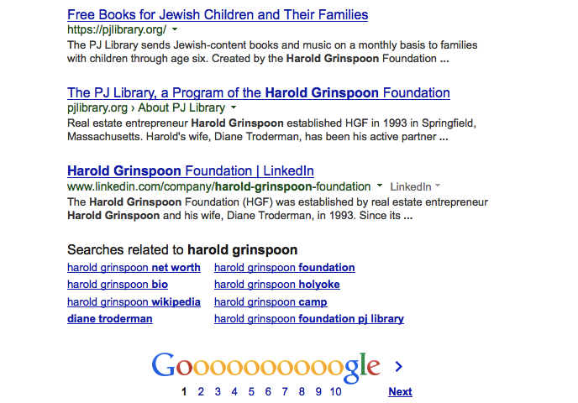
Googling Harold Grinspoon

Slide 49
Googling Harold Grinspoon
net worth of around $4 billion

Slide 50
Creating in-depth donor profile
Name, Spouse name
Addresses
Age
Children’s names
Past giving history (Annual, Capital, Legacy)
Family members connections to camp
Source of wealth
Philanthropic interests other than camp
Connections / Circle of Friends
  Attach profile in your Donor Database

Slide 51
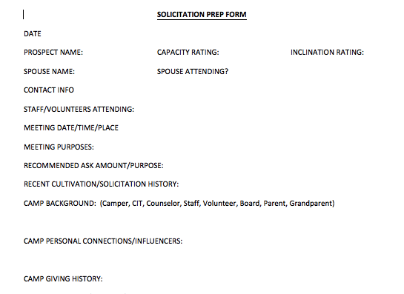
D2D sample on website

Slide 52
Creating a simplified donor list to share with Campaign Lay Leaders
Name, Spouse name
Addresses
Summary of giving history to camp (Annual, Capital, Legacy)
Family members’ connections to camp
Short narrative notes

Slide 53
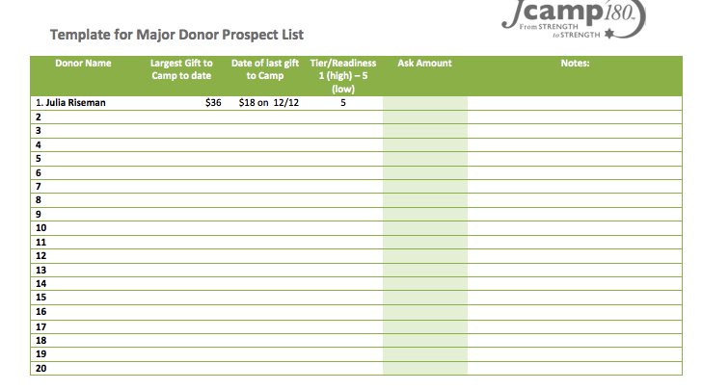
D2D template on website

Slide 54
Major Gifts Cycle
Identify
Pull reports
Segment
Qualify
Capacity
Cultivate
Interests
Bring closer
Research
Involve
Motivation
Relationship
Ask
Thank
Steward

Slide 55
This Month in D2D
Pull Reports
  Reduce Lists
Add notes
Review Lists with volunteers and senior staff
  Reduce Lists again
Conduct Prospect Research
  Reduce lists some more
Create Donor Profiles
Prep for March Meeting with 20 prospects

Slide 56
Next Month in D2D
Creating Action plans for top prospects
Creating a calendar of “moves” for each
Training and support for volunteers and staff to help with cultivation and asks
Using conversations to enrich your data (i.e., returning new notes to your database)
Prep Campaign Materials

Slide 57
Cultivation Strategy
Invite to camp
Visit Camp
Follow-up Coffee
Proposal
Solicit
March
June
August
September
November

Slide 58
Resources on the Webpage
Sample Donor Profile
Sample Donor Profile Template
Homework for March
Need instructions on how to flag your top 20?
Office Hours March 4th at 3 pm EST (w Julia)

Slide 59
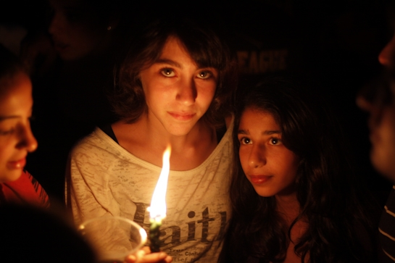
Discussion

