Slide 1

Data2Donors:
DATA IN – WealthEngine
Notes:
Kevin: Welcome to No More Dusty Records.
Growing your base of support for recruitment and fundraising starts with a commitment to unearth old and dusty records and get as many entered correctly into your database.
Our latest Webinar - "No More Dusty Records" - will show you how to find and reconnect with your alumni and other constituents.
This Webinar will start in just a minute

Slide 2
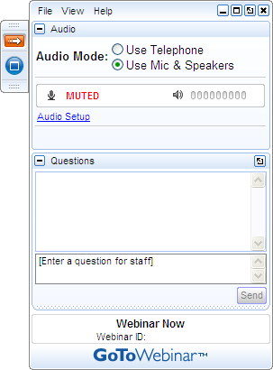
Get Involved
A) Grab Tab – Click red arrow to open/close Control Panel. Click square to toggle Viewer Window between full screen/window mode. Click mic icon to mute/unmute your audio.
B) Audio Pane – Select audio format. Click Audio Setup to verify Speakers & Microphone.
C) Questions Pane – Attendees can submit questions and review answers.
D) Type your question and click Send to submit it to the presenters.
A →
B →
C →
D →
Notes:
Kevin:
Before we start – let’s just review the use of this webinar interface.
To minimize the control panel so you can see the full screen, click the red arrow icon in the Grab Tab, which is Letter A on the slide. To open the control panel again so you can submit questions or comments, simply click on that arrow again.
Letter B is the Audio Pane. That’s where you can switch from listening in via your phone or your computer’s speakers.
Letter C is the Questions Pane. This is where you can submit questions (which you’ll type in letter D and hit Send to submit to us here at our new office) and view the questions you’ve already submitted.
At one or more points today, we will be asking you to send us a message with your own ideas – so please test it right now with a message in the Questions Pane, such as “hello” so you can get accustomed to using it.
If you have any technical issues, please submit them via the Questions Pane as well.
Ok, I’ll turn it back over to Julia to get started.

Slide 3
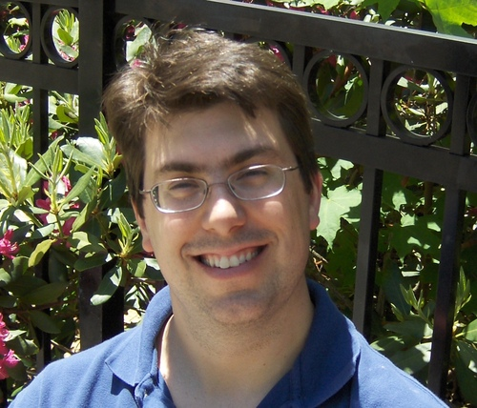
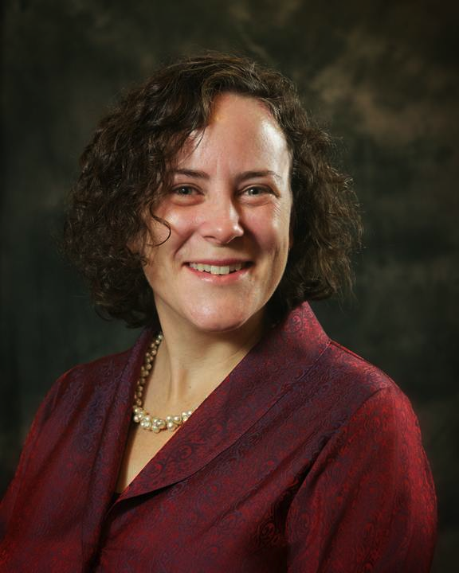
Julia Riseman and Kevin Martone
Julia@hgf.org
Kevin@hgf.org
Notes:
Julia: Happy New Year, everyone. I am Julia Riseman, Mentor, at Jcamp 180 working with camps across North America since 2008 – providing consulting services on Strategic Planning, Strong Governance, and, my personal passion, Fundraising.
I enjoy working with Kevin Martone – a great partner.
Kevin: Thanks. I am the Technology Program Manager here at JCamp 180. I consult with our affiliated camps to help them use technology to support their fundraising and outreach efforts, including donor databases, social media, eNewsletters, and more.
Julia: Together Kevin and I dreamed up this webinar, along with a six month course, Data2Donors which a number of you are now enrolled. We’ve build this session around our learning working with over 100 Jewish Camps.
It isn’t complicated – but important work to get done.

Slide 4
Agenda
Announcements
WealthEngine Data in
Looking Ahead
WealthEngine Representative
Notes:
Julia:
I’m going to tell you NOW what you will learn in this webinar.
We’re going to share with you a real world example to the TRUE dollar value of unearthing your old donor records – and the intense amount of money you will never realize should you continue to do nothing with your dusty records. If this doesn’t convince your Leadership to invest in inputting dusty records – then …. (um) let’s talk off line.
Then we’re going to review places to look for your old and dusty records – and you’re going to brainstorm your own list.
Kevin is going to tell you how to handle incomplete data
And we’re both going to rush through information on how to move imcomplete information into good, current, and up-to-date contact information for all the alumni and friends of camp.
We’ll end with a discussion and questions

Slide 5
Announcements
All future Webinars at 1 pm
February Webinar: Least confident about your work with volunteers
Still looking for input from Tamarack, Kinder Ring, and Pembroke (see recording of last week’s webinar and email me your answers)
Notes:
Julia:
I’m going to tell you NOW what you will learn in this webinar.
We’re going to share with you a real world example to the TRUE dollar value of unearthing your old donor records – and the intense amount of money you will never realize should you continue to do nothing with your dusty records. If this doesn’t convince your Leadership to invest in inputting dusty records – then …. (um) let’s talk off line.
Then we’re going to review places to look for your old and dusty records – and you’re going to brainstorm your own list.
Kevin is going to tell you how to handle incomplete data
And we’re both going to rush through information on how to move imcomplete information into good, current, and up-to-date contact information for all the alumni and friends of camp.
We’ll end with a discussion and questions

Slide 6

Observations about Data Import
  New fields, relatively simple import
FindWealth8 logins for your Camp
Time with Kevin?
Notes:
Work now to find every possible dusty old record of past participants at camp and get these entered into your data base
Find every possible old photo and get them scanned
Set up on-line tools to let people enter in their updated information
Establish a volunteer group that will work to help you get back in touch with lost Alumni
Design a welcome packet and a welcome system
Segment your donor list

Slide 7

Facebook: Camp Sabra
Notes:
Julia:
So here’s the road map:

Slide 8

Data2Donors Ahead:
Review WealthEngine Results
Pull Reports on Giving Histories
Identify your best prospects
Have Volunteers & Senior Staff review the list (narrow)
Research top prospects
Create donor profiles for top prospects
Prep your campaign materials
Invite volunteers to training in March
Notes:
Work now to find every possible dusty old record of past participants at camp and get these entered into your data base
Find every possible old photo and get them scanned
Set up on-line tools to let people enter in their updated information
Establish a volunteer group that will work to help you get back in touch with lost Alumni
Design a welcome packet and a welcome system
Segment your donor list

Slide 9
Vicki Claussen
Director of Partner Relations
WealthEngine
vclaussen@wealthengine.com
Notes:
Work now to find every possible dusty old record of past participants at camp and get these entered into your data base
Find every possible old photo and get them scanned
Set up on-line tools to let people enter in their updated information
Establish a volunteer group that will work to help you get back in touch with lost Alumni
Design a welcome packet and a welcome system
Segment your donor list

Slide 10

Questions?

Slide 11
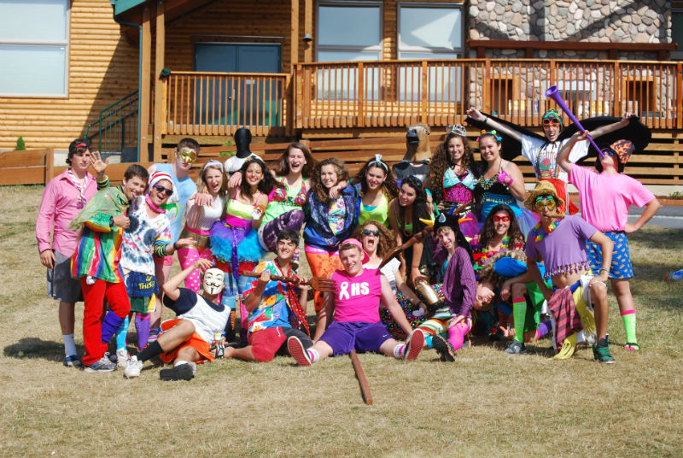
Barbara Gordon
B’nia B’rith Camp
Oregon
Notes:
Julia:
Data2 Donors is:
A new program of JCamp 180, run with monthly webinars by Kevin and myself.
This year we are fully booked – so apply next year.
The following camps are in the program this year: List?
Data2 Donors is A six month systematic and supportive approach to moving from dusty records to growth in Alumni outreach and onto major donor fundraising.
Kevin:
We will pay for your data to be run through 3 separate datasets to further enhance the data:
NCOA – update recent address changes
AlumniFinder – update more distant address changes
WealthEngine – capacity information
Julia:
Good data management
Qualified major donor prospect list ready for campaign fundraising

Slide 12
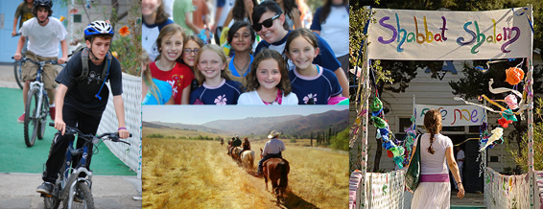
Lesley Plachta
Sarah Donner
Camp Alonim
California
Notes:
Julia:
Data2 Donors is:
A new program of JCamp 180, run with monthly webinars by Kevin and myself.
This year we are fully booked – so apply next year.
The following camps are in the program this year: List?
Data2 Donors is A six month systematic and supportive approach to moving from dusty records to growth in Alumni outreach and onto major donor fundraising.
Kevin:
We will pay for your data to be run through 3 separate datasets to further enhance the data:
NCOA – update recent address changes
AlumniFinder – update more distant address changes
WealthEngine – capacity information
Julia:
Good data management
Qualified major donor prospect list ready for campaign fundraising

Slide 13
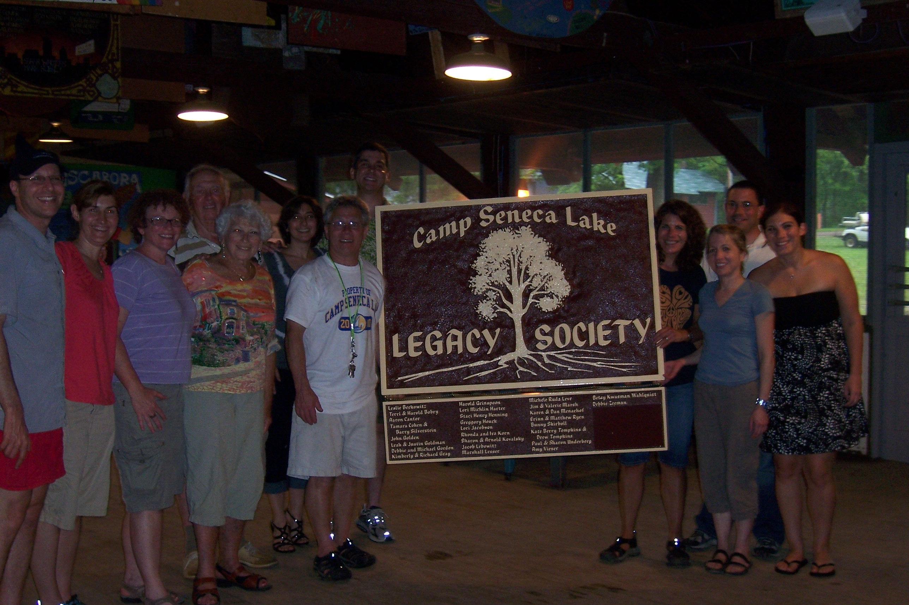
Staci Hiller
Camp Seneca Lake
New York
Notes:
Julia:
Data2 Donors is:
A new program of JCamp 180, run with monthly webinars by Kevin and myself.
This year we are fully booked – so apply next year.
The following camps are in the program this year: List?
Data2 Donors is A six month systematic and supportive approach to moving from dusty records to growth in Alumni outreach and onto major donor fundraising.
Kevin:
We will pay for your data to be run through 3 separate datasets to further enhance the data:
NCOA – update recent address changes
AlumniFinder – update more distant address changes
WealthEngine – capacity information
Julia:
Good data management
Qualified major donor prospect list ready for campaign fundraising

Slide 14
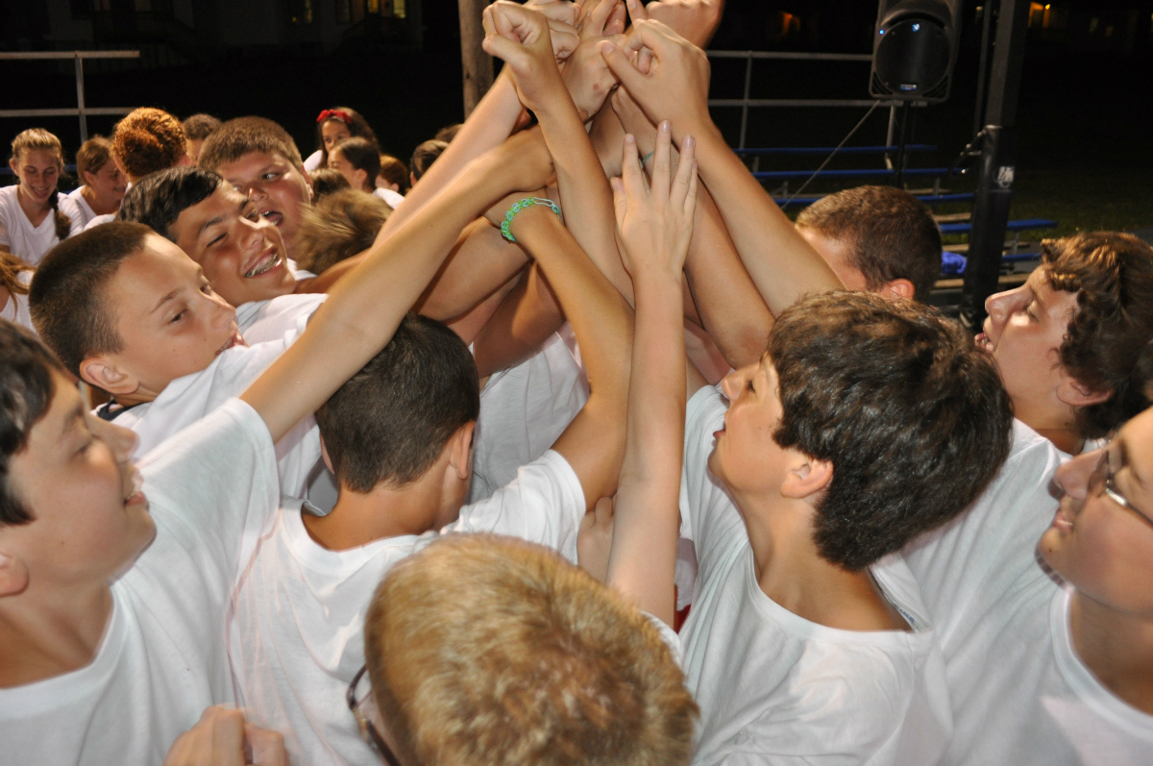
Ellen Goldstein
Marty Krupnick
Marc Rauch
Camp Kinder Ring
New York
Notes:
Julia:
Data2 Donors is:
A new program of JCamp 180, run with monthly webinars by Kevin and myself.
This year we are fully booked – so apply next year.
The following camps are in the program this year: List?
Data2 Donors is A six month systematic and supportive approach to moving from dusty records to growth in Alumni outreach and onto major donor fundraising.
Kevin:
We will pay for your data to be run through 3 separate datasets to further enhance the data:
NCOA – update recent address changes
AlumniFinder – update more distant address changes
WealthEngine – capacity information
Julia:
Good data management
Qualified major donor prospect list ready for campaign fundraising

Slide 15

Susan Callum
Camp Pembroke
Massachusetts
Notes:
Julia:
Data2 Donors is:
A new program of JCamp 180, run with monthly webinars by Kevin and myself.
This year we are fully booked – so apply next year.
The following camps are in the program this year: List?
Data2 Donors is A six month systematic and supportive approach to moving from dusty records to growth in Alumni outreach and onto major donor fundraising.
Kevin:
We will pay for your data to be run through 3 separate datasets to further enhance the data:
NCOA – update recent address changes
AlumniFinder – update more distant address changes
WealthEngine – capacity information
Julia:
Good data management
Qualified major donor prospect list ready for campaign fundraising

Slide 16

Jef Nobbe
Camp Solomon Schechter, Washington
Notes:
Julia:
Data2 Donors is:
A new program of JCamp 180, run with monthly webinars by Kevin and myself.
This year we are fully booked – so apply next year.
The following camps are in the program this year: List?
Data2 Donors is A six month systematic and supportive approach to moving from dusty records to growth in Alumni outreach and onto major donor fundraising.
Kevin:
We will pay for your data to be run through 3 separate datasets to further enhance the data:
NCOA – update recent address changes
AlumniFinder – update more distant address changes
WealthEngine – capacity information
Julia:
Good data management
Qualified major donor prospect list ready for campaign fundraising

Slide 17



Karen Bernstein
Danny Weiss
Capital Camps and
Retreat Center
Maryland
Notes:
Julia:
Data2 Donors is:
A new program of JCamp 180, run with monthly webinars by Kevin and myself.
This year we are fully booked – so apply next year.
The following camps are in the program this year: List?
Data2 Donors is A six month systematic and supportive approach to moving from dusty records to growth in Alumni outreach and onto major donor fundraising.
Kevin:
We will pay for your data to be run through 3 separate datasets to further enhance the data:
NCOA – update recent address changes
AlumniFinder – update more distant address changes
WealthEngine – capacity information
Julia:
Good data management
Qualified major donor prospect list ready for campaign fundraising

Slide 18
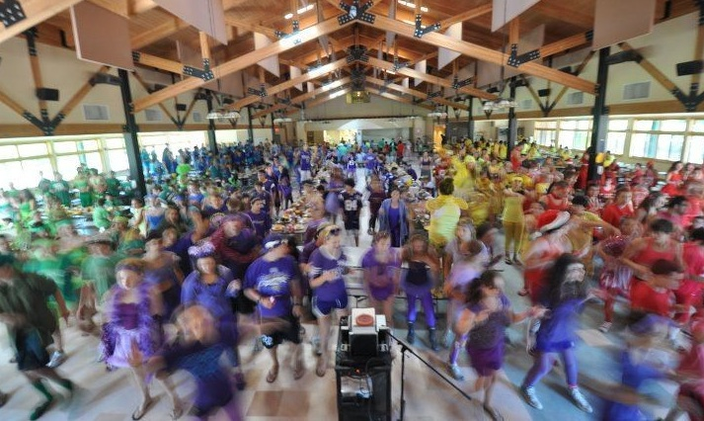
Wendy Clyman
Herzl Camp
Wisconsin
Notes:
Julia:
Data2 Donors is:
A new program of JCamp 180, run with monthly webinars by Kevin and myself.
This year we are fully booked – so apply next year.
The following camps are in the program this year: List?
Data2 Donors is A six month systematic and supportive approach to moving from dusty records to growth in Alumni outreach and onto major donor fundraising.
Kevin:
We will pay for your data to be run through 3 separate datasets to further enhance the data:
NCOA – update recent address changes
AlumniFinder – update more distant address changes
WealthEngine – capacity information
Julia:
Good data management
Qualified major donor prospect list ready for campaign fundraising

Slide 19

Gabe Neistein
Tamarack Camps
Michigan
Notes:
Julia:
Data2 Donors is:
A new program of JCamp 180, run with monthly webinars by Kevin and myself.
This year we are fully booked – so apply next year.
The following camps are in the program this year: List?
Data2 Donors is A six month systematic and supportive approach to moving from dusty records to growth in Alumni outreach and onto major donor fundraising.
Kevin:
We will pay for your data to be run through 3 separate datasets to further enhance the data:
NCOA – update recent address changes
AlumniFinder – update more distant address changes
WealthEngine – capacity information
Julia:
Good data management
Qualified major donor prospect list ready for campaign fundraising

Slide 20
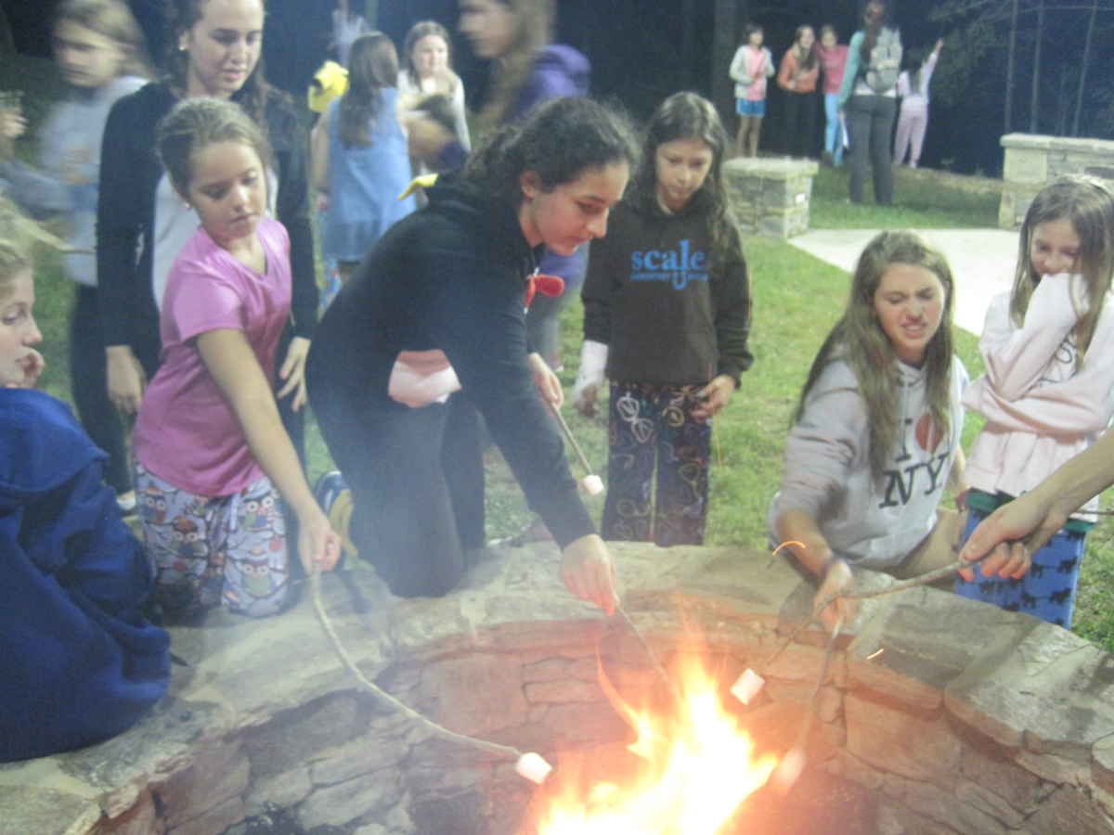
David Weiss
Camp Judaea
North Carolina
Notes:
Julia:
Data2 Donors is:
A new program of JCamp 180, run with monthly webinars by Kevin and myself.
This year we are fully booked – so apply next year.
The following camps are in the program this year: List?
Data2 Donors is A six month systematic and supportive approach to moving from dusty records to growth in Alumni outreach and onto major donor fundraising.
Kevin:
We will pay for your data to be run through 3 separate datasets to further enhance the data:
NCOA – update recent address changes
AlumniFinder – update more distant address changes
WealthEngine – capacity information
Julia:
Good data management
Qualified major donor prospect list ready for campaign fundraising

