Slide 1
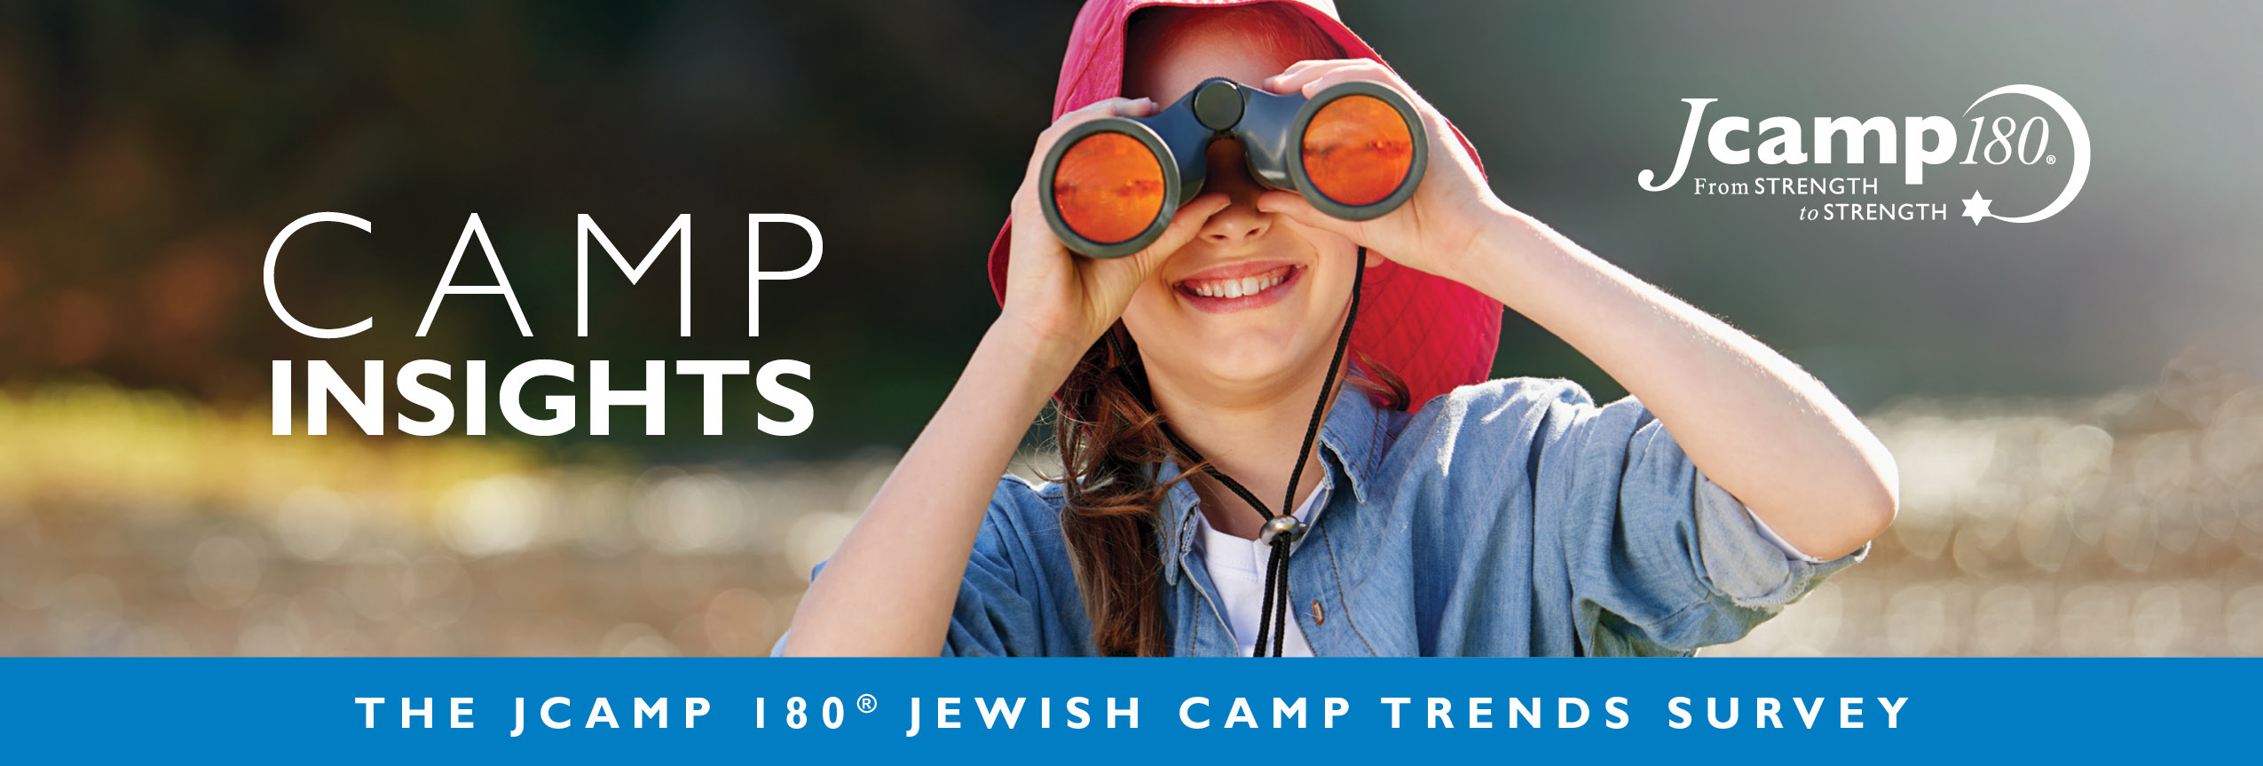
2021 Jewish Camp Insights
Report from the 2021 JCamp 180 Annual Trends Survey And Discussion Guide for Camp Boards
Notes:
Note: You can find the full 2021 JCamp 180 Camp Insights report here: https://jcamp180.org/camp-insights-2021

Slide 2
Camp Board Discussion Tool
Notes:
The goal of THIS presentation is to share the findings of the Trends Survey, help us think more specifically about how these trends affect OUR camp, and guide a discussion to help us with both strategic and tactical decisions.

Slide 3
WHY A JCAMP 180 TRENDS SURVEY
Focus on broader societal trends + emerging solutions
Help camps prepare for the future
We carry views of the future that impact our decisions today
Anticipating the future enables better response today & tomorrow
Collective perceptions provide more value than any of us on our own
Complements the Camp Census
Notes:
3 years ago, JCamp 180 launched what has become an annual survey of Jewish camping leaders. They did this to understand what camps view as the most significant societal trends affecting them. Their reason was simple – they believe that better anticipation of the future helps make better decisions today - and that the process of doing a survey, seeing the results and sharing multiple perspectives - will help camps surface key issues and solutions to better shape the future of our camp.
A richer understanding of camp perceptions helps JCamp 180 to better serve the field.
This report complements the annual Camp Census data collected and reported on by the Foundation for Jewish Camp. The 2021 Camp Census report from the Foundation for Jewish Camp can be found here: https://jewishcamp.org/camp-professionals/field-growth/camp-census/

Slide 4
AGENDA FOR TODAY’S SESSION
Recap Report Highlights
Takeaways
Questions for YOUR Board/Camp Committee to consider
Notes:
We will cover the following in this discussion:
We’ll recap highlights/background of the Camp Insights Report.
We’ll discuss some key takeaways for the entire field of nonprofit Jewish camp.
We’ll discuss questions that will help us think about what these trends and findings mean for OUR camp.

Slide 5
Who Participated
Total Respondents | Professionals | Volunteers | Total
Overnight Camps/Organizations | 96 (50%) | 52 (27%) | 148 (77%)
Day Camps/Organizations | 24 (13%) | 4 (2%) | 28 (15%)
Movements and other supporting camp organizations | 9 (5%) | 6 (3%) | 15 (8%)
Total | 129 (68%) | 62 (32%) | 191 (100%)
A total of 116 camping organizations responded
Notes:
Overall, 191 people completed the survey from 116 camping organizations. 3/4 were from overnight camps and about 15% from day camps and 8% from movement and other camping organizations. All in all, about 2/3 were professionals and 1/3 were volunteers. Half of the whole sample were overnight camp professionals.
Over the first 2 years, the response patterns across day and overnight camps, professionals and volunteers were remarkably consistent. This year they look pretty consistent as well, but there may be some more differences we are going to analyze further. Given the broad similarity, our findings refer to the overall sample.
Let’s now jump to the results.

Slide 6
Average Ratings of Trends
Please rate the extent to which the trend below creates significant opportunities or challenges for your camp over the next five years
1- Not Significant 2- Slightly Significant 3- Somewhat Significant 4-Significant 5- Very Significant
# | Trend | Average Rating
1 | High levels of anxiety and mental health challenges amongst campers | 4.4
2 | High levels of anxiety and mental health challenges amongst summer staff | 4.3
3 | Pressure on young adults to earn income and build their resumes | 4.2
4 | Continuing implications stemming from COVID-19 | 3.8
5 | Competitiveness of the summer recreational and educational marketplace | 3.7
6 | Focus on diversity, equity and inclusion for LGBTQ+ people | 3.5
7 | Competition for fundraising dollars from other charities | 3.4
8 | Pervasiveness of digital technology, internet, and social media | 3.4
9 | Economic hardship and income and job loss | 3.4
10 | Helicopter or “Snowplow” Parenting | 3.4
Notes:
As a reminder the survey asked about 24 trends. Here are the 10 trends rated as creating the most significant opportunities or challenges for camp over the next five years
Let’s start with the 10th most highly rated trend. It was helicopter or snowplow parenting and its average score of 3.4 fell between “somewhat significant” and “significant” as you can see on the legend at the top. Indeed, Economic Hardship, Pervasiveness of Digital Technology, Competition for fundraising, and focus on Diversity Equity and Inclusion for LGBTQ+ people scored similarly. In general, these and the top 5 trends were rated in or close to the top 10 in previous years, covid or no covid.
The fifth most important trend was competitiveness of the summer recreational market. The 4th rated trend – and no surprise - was the continuing implications stemming from Covid – with both trends having tangibly higher ratings than the previous group.
The top 3 trends are the same as they have been during the last 3 years and are rated, on average, somewhere between significant and very significant. These include Pressure on young adults to earn income and build their resumes, and high levels of anxiety and mental challenges among staff and campers.

Slide 7
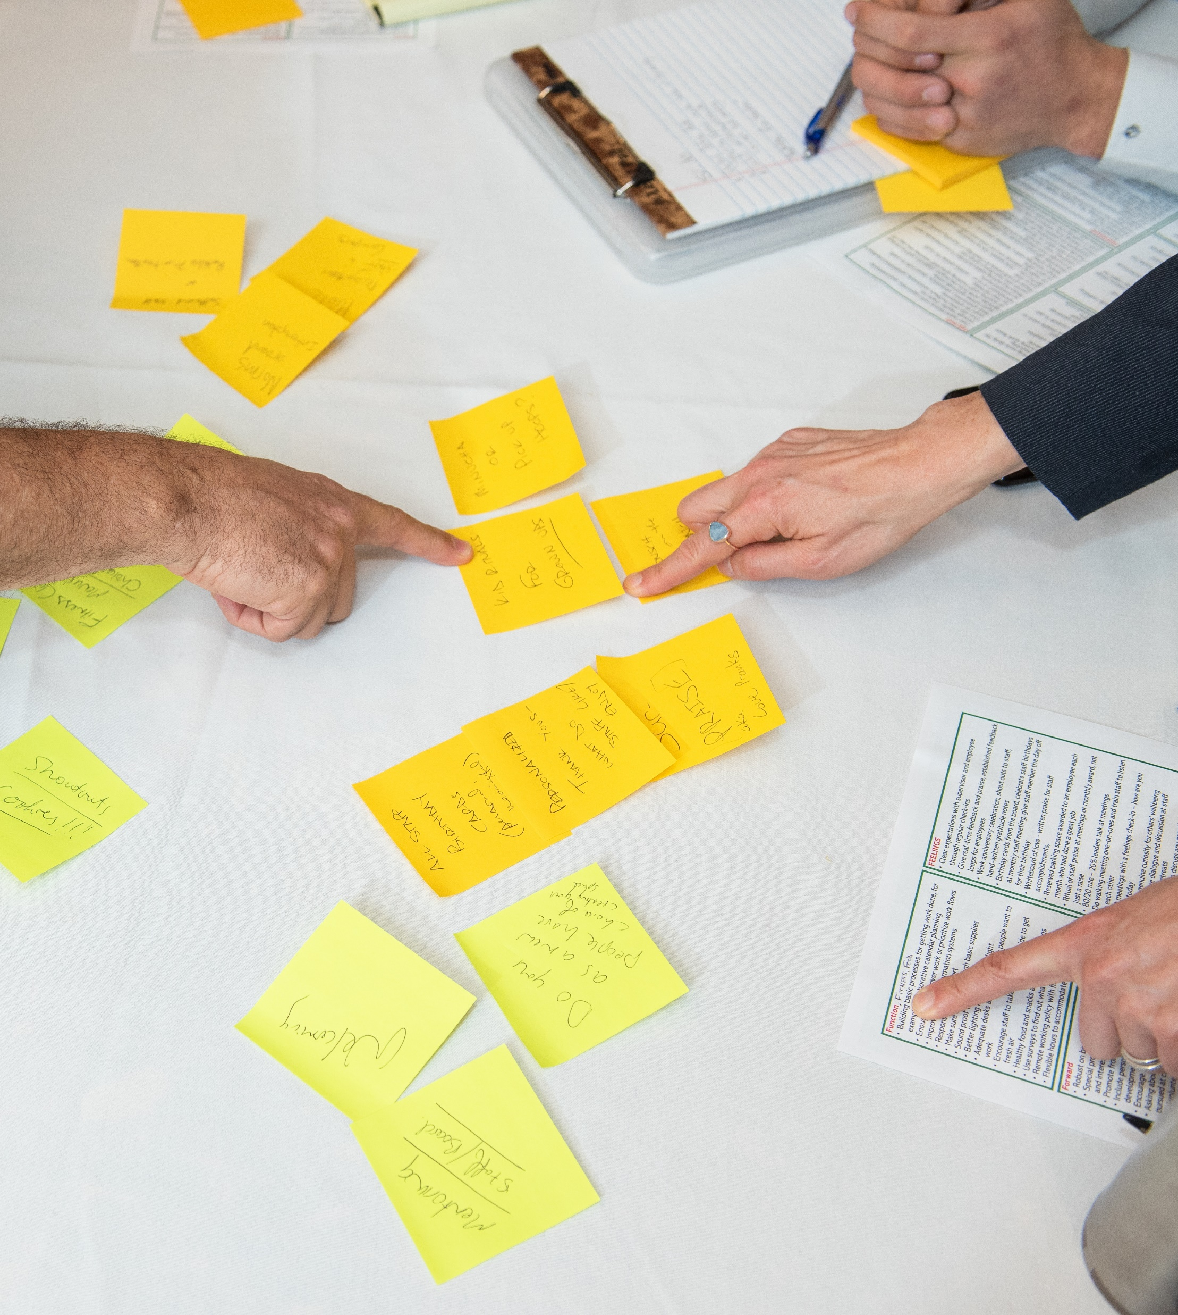
How Camps are Responding to Top Three Trends
How would you describe your camp’s response to this trend?
What solutions or approaches have you found to be successful (or promising to consider) in responding to the following trend?
Notes:
The survey also asked camps to prioritize the top 3 trends that affect them, and for each of those trends to indicate how effectively they felt they were responding. The survey also asked what solutions or approaches they have found to be successful or seem to be promising to consider.
Since most trends were rated by some respondents in the top 3, we have quite a bit of data. For today we are going to focus on solutions participants identified for the top trends.

Slide 8
MENTAL HEALTH OF CAMPERS and STAFF

Slide 9
MENTAL HEALTH OF CAMPERS and STAFF
Solutions implemented or considered
Hire mental health professionals for campers: MESH experts, therapists, psychologists, wellness staff, etc.
Facilitate camper remote access to campers’ own therapists
Strengthened pre-camp screening/info collection, during camp check in and follow up
Increased training for senior and other staff
Secure mental health specialized support for staff
Enhance staff well-being, e.g., hours, programming
Notes:
Once again mental health challenges of both campers and staff were rated in the top 3 trends.
Not surprisingly, camps implemented or are considering a range of solutions, almost all of which include hiring more staff. Camps used more than a dozen ways to describe these additional staff. This included MESH experts, mental health professionals, psychologists, social workers or wellness staff. I imagine there could be valuable sharing on which of these types of professionals work best in a camp setting.
A number of camps said they made private, comfortable spaces available for the many campers which needed to connect to their in city therapists during the summer
A number of camps also indicated they had or needed to strengthen pre-camp screening to understand camper and family needs and tp conduct more systematic follow up during and post-camp
Virtually everyone responding to these questions talked about the need for more staff training to help with campers.
There were very similar approaches being taken to staff mental health issues, with a number saying they were hiring dedicated support for staff. Many camps talked about enhancing well-being of staff, for example, through training on self-care and reduction of staffing hours.
Note: This article in eJewishPhilanthropy discusses the mental health challenges faced by camps:
https://ejewishphilanthropy.com/wellness-now-a-staple-for-campers-and-counselors/

Slide 10
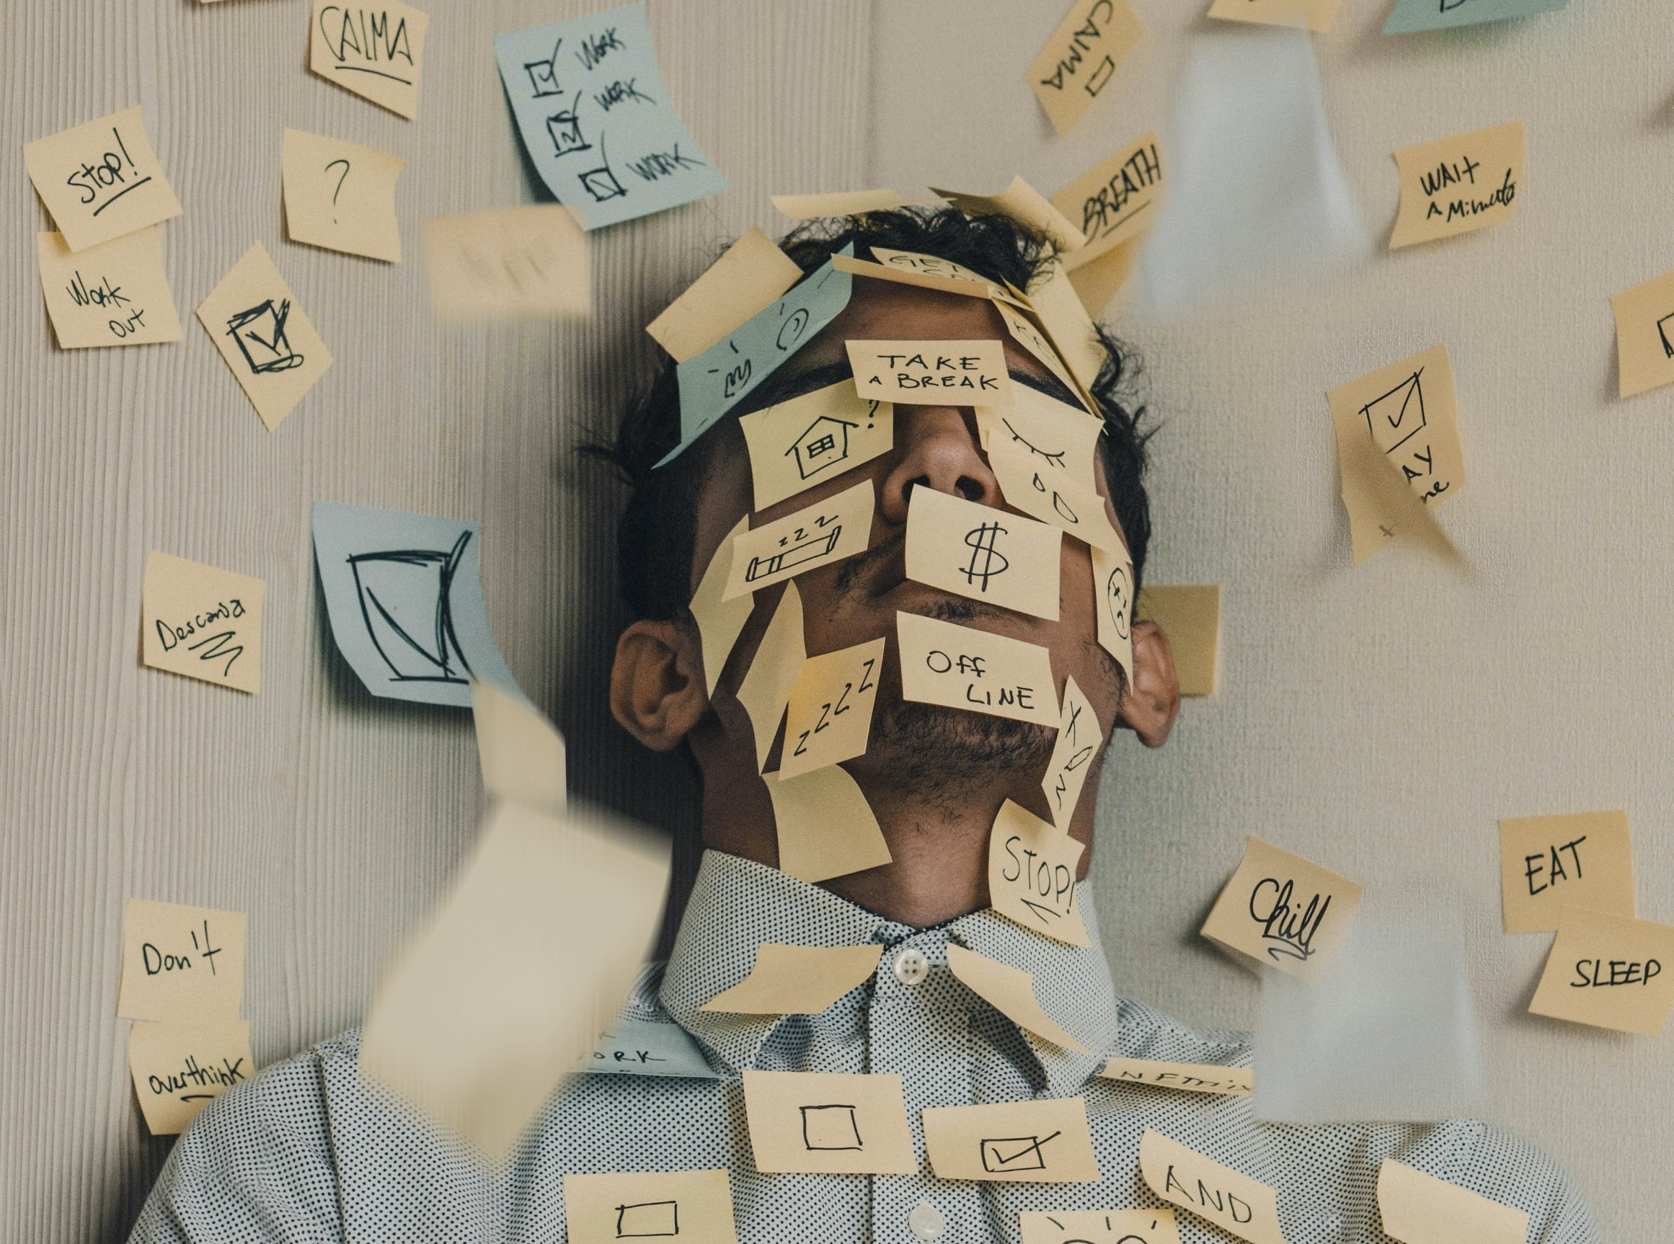
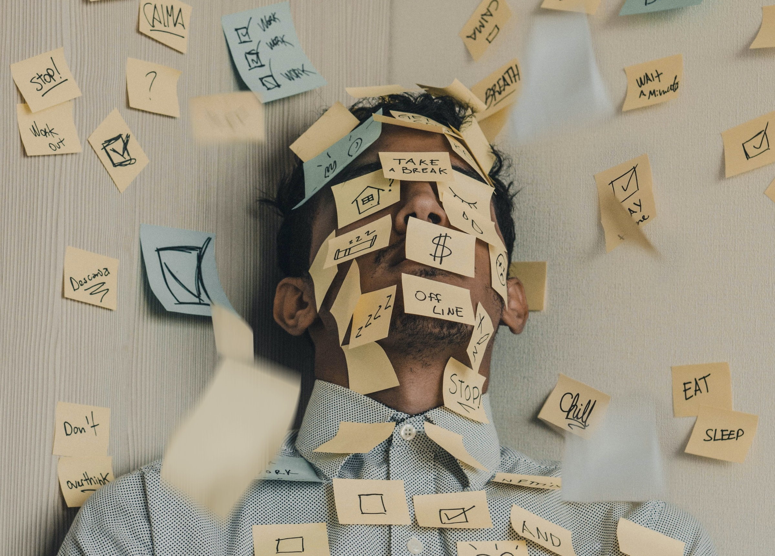
PRESSURES ON YOUNG ADULTS TO EARN INCOME AND BUILD THEIR RESUMES
Photo by Luis Villasmil on Unsplash

Slide 11
PRESSURES ON YOUNG ADULTS TO EARN INCOME AND BUILD THEIR RESUMES
Solutions implemented or considered
Create camp internship opportunities
Increase salaries, often significantly, and offer incentives for older staff
Provide college recommendation letters
Engage summer staff to help solve staffing issues
Educate potential staff and families that “camp is a real job that assists in building resumes”
https://www.acacamps.org/resource-library/jobs-recruitment/project-real-job
Notes:
Pressures on Young Adults to earn income and build their resumes also has been a consistently top rated trend. 60% of the respondents who placed this as a top 3 trend indicated they were not effective at responding to it – this was the highest percent of any of the trends.
Camps implemented or, perhaps more likely are looking to implement a number of solutions. These include
The provision of camp internship opportunities and college recommendation letters.
Increasing salaries, especially incentives for older staff, was a major theme.
Educating summer staff and families about the role that camp plays in building resumes was also frequently cited.
And some camps mentioned engaging summer staff to help come up with solutions.

Slide 12
COMPETITIVENESS IN SUMMER RECREATIONAL MARKETPLACE

Slide 13
COMPETITIVENESS IN SUMMER RECREATIONAL MARKETPLACE
Solutions implemented or considered
Better understand marketplace as basis for differentiating/enhancing offerings
Learn how to tell our story/sell our value proposition
Add variety, specialization, and new “bells and whistles”
Increasing flexibility: scheduling, different session-length models and start times
Offer more year-round and family programming
Notes:
Competitiveness in the Summer Recreational marketplace also was a highly rated trend. Many camps talked about the need to really understand their marketplace as the basis for differentiating their services and learning how to better communicate their value proposition.
Camps also talked about competing through injecting variety in the programming, increasing specialization, and continually adding bells and whistles.
Many camps also indicated they were looking at increasing the flexibility of scheduling and sessions, while a number had or were considering offering more year round family programming.

Slide 14
FOCUS ON DIVERSITY, INCLUSION, AND EQUITY FOR LGBTQ+ PEOPLE

Slide 15
FOCUS ON DIVERSITY, INCLUSION AND EQUITY FOR LGBTQ+ PEOPLE
Solutions implemented or considered
Proactively affirming LGBTQ+ campers to ensure that “camp is a safe and welcoming home…regardless of sexuality and gender identity”
Investing in all-gender cabins and bathrooms
Incorporating DEI into pre-camp training
Creating DEI working groups that include campers, staff, alumni, board members, and professional staff
Notes:
Focus on Diversity Inclusion, and Equity for LGBTQ+ People was the 6th ranked trend. It has been rated increasingly more significant over each of the past 3 years. A number of camps have implemented or are seriously considering solutions such as.
Setting policy to proactively affirm LGBTQ+ campers to ensure that “camp is a safe and welcoming home…regardless of sexuality and gender identity”
Investing in all-gender cabins and bathrooms
Incorporating Diversity inclusion and Equity (DEI) into pre-camp training
Creating DEI working groups that include campers, staff, alumni, board members, and professional staff

Slide 16
COMPETITION FOR FUNDRAISING DOLLARS FROM OTHER CHARITIES
Photo by Pickawood on Unsplash

Slide 17
COMPETITION FOR FUNDRAISING
DOLLARS FROM OTHER CHARITIES
Solutions implemented or considered
Leveraging the Covid experience
Communicate camps’ ongoing vital role demonstrated through Covid
Steward the many new donors
Leverage online tools to reach donors around the world
Tap into families that have done well during covid
While continuing to
Build relationships with parents, alumni, grantors, and other potential donors
Strengthen their culture of philanthropy
Notes:
Competition for Fundraising Dollars from Other Charities has been a top-rated trend for the past three years. This year camps have implemented and certainly are considering several solutions.
A number revolve around:
Leveraging the Covid experience, including
Communicating camps’ ongoing vital role in outdoors and community as demonstrated through covid
Stewarding the many new donors and foundations who have come on board during these times
Leveraging online tools to reach donors around the world
Tapping into families that have done well during covid
In addition, camps are continuing or planning to:
Build relationships with parents, alumni, grantors and other potential donors
Strengthen their culture of philanthropy

Slide 18
Board Discussion: Questions to Consider for OUR Camp
What these top trends and interventions mean for OUR Camp:
Which of these broader trends are most relevant to our camp today?
What is the top solution(s) our camp may need to further pursue in 2022 and beyond?
What would help us to better explore or implement these solutions?
What’s working/not working in the approaches we have taken?
Are there other promising approaches we should consider?
What might be the obstacles and how can we overcome them?
How does our culture support or inhibit effective responses to these trends?
Let’s take 5-7 minutes of individual work time to formulate answers and then discuss as a group.
Notes:
This group of questions is focused on what these top trends and the interventions other camps are considering or implementing mean for OUR camp.
Allow participants to consider these questions for 5-7 minutes individually and then facilitate a group discussion

Slide 19
Board Discussion: Other Considerations for OUR Camp
Local Conditions:
What are the most important additional local/camp-specific trends to consider?
Long-Range Thinking:
Which trends will be most relevant for our camp in 2025 and beyond?
Resources and Next Steps
What other resources does our camp need to effectively respond?
What are our next steps?
Notes:
These additional questions will help us consider the following for our camp:
What are the most important additional local/camp-specific trends to consider?
Which trends will be most relevant for our camp in 2025 and beyond?
What other resources does our camp need to effectively respond?
What are our next steps?

Slide 20
Questions or Feedback on this Tool? Contact us!
Michael Miloff, Project Lead
michael@miloff.com
Sarah Eisinger, Director, JCamp 180
seisinger@hgf.org
Notes:
Reminder: You can find the full 2021 JCamp 180 Camp Insights report here: https://jcamp180.org/camp-insights-2021
Note: JCamp 180 would be glad to follow up with camps on any aspects of the Camp Insights Report and how your camp can use these materials to explore these trends and potential responses. Feel free to reach out to Sarah Eisinger, Director of JCamp 180 (seisinger@hgf.org), or Michael Miloff, Camp Insights Report Project Lead (michael@miloff.com).
You can also contact JCamp 180 at jcamp180@hgf.org.

