Slide 1


Part 3: Understanding Key Issues with Financial Management
Financial Literacy Series
Gina McDonald, CPA, Lead Consultant

Slide 2
“RE”-Introductions & initiative overview

Slide 3

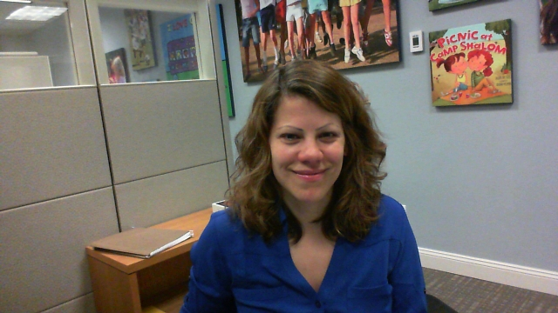
Financial Literacy Webinar Series
Part 1: Understanding Financial Statements and Reports
March 20, 2018
Tara Acker
Mentor
tacker@hgf.org

Slide 4
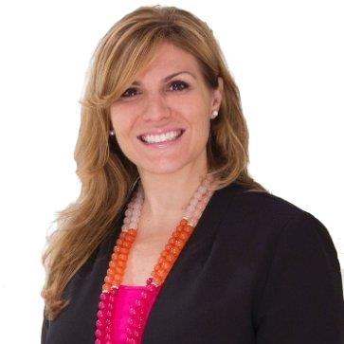

Welcome & Introductions
Today’s Presenter
Gina McDonald
Lead Consultant, FMA

Slide 5
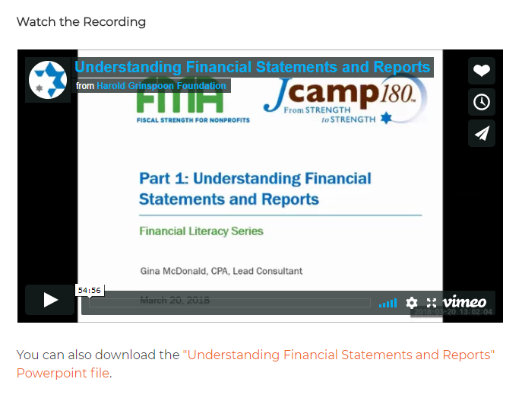
Welcome & Introductions
If you missed Parts 1 & 2 …
https://jcamp180.org/professional-development/financial-literacy

Slide 6
Agenda
Essential IRS Classifications
Strategic Financial Management Overview
  Levels of Financial Management
  Board’s Role
  Policies and Procedures and Internal Controls
Effective Dashboards for Performance Management
Q&A
!
Notes:
Fine tune this

Slide 7
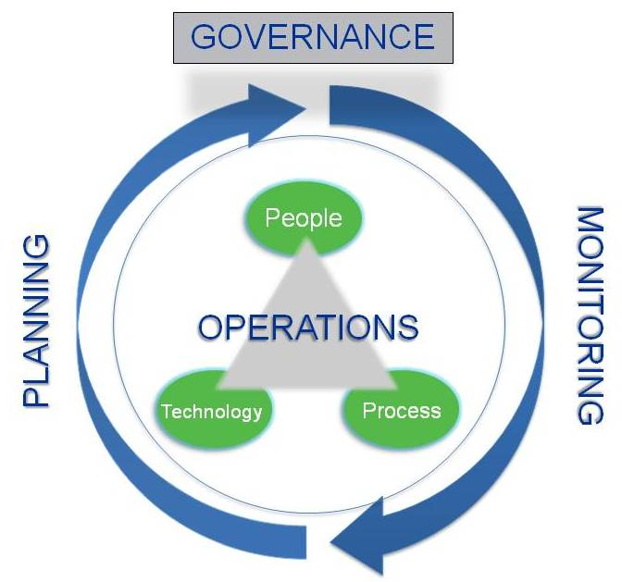
Strategic Financial Management

Slide 8
financial management overview

Slide 9
Levels of Financial Management
Level | Function
Strategic | Lead and support organizational financial planning and monitoring
Managerial | Ensure that the finance office is effectively carrying out its operational responsibilities
Transactional | Perform day-to-day accounting functions, data entry, and administrative tasks.
SHARED RESPONSIBILITY
Adapted from Jeanne Bell Peters and Elizabeth Schaffer, Financial Leadership for Nonprofit Executives: Guiding Your Organization to Long-term Success © 2005

Slide 10
Financial Monitoring for Camp Staff
Financial Decision-Making Meetings: Action Steps
Form the team: Include key representatives from Senior Camp Staff (Camp Director, Asst. Director, Facilities Director, Kitchen Manager, Finance)
Establish a meeting calendar with specific dates, times, and topics for discussion/decision
Ensure the right data and reports are available 2-4 days prior to the meeting for review by participants
Take note of agreed upon action steps and circulate immediately after the meeting

Slide 11

Financial Monitoring for Camp Board
Strategic Financial Management
Lead and support organizational financial planning and monitoring
Planning - starts with budget process
Monitoring – continuous process to
reality-test assumptions
Board’s monitoring activities can START
at the Finance Committee level . . .

Slide 12
Financial Monitoring for Camp Board
Board Monitoring can START at Finance Committee:
Finance Committee
Full Board
Monitors and responds to the financial realities of the organization as presented by the Executive Director/CFO, in cooperation with the Treasurer
Reviews financials in detail and meets frequently
Fiduciary responsibility, which requires understanding overall financial position
Duty of care, which includes safeguarding assets
Cannot delegate responsibilities to a committee in place of individual responsibility

Slide 13
Financial Monitoring for Camp Board
Where does the Board /Committees begin?
Understand whether policies and procedures are documented and up-to-date
Inquire as to adequacy of controls . . .

Slide 14
Financial Management- Internal Controls
Control activities are achieved through:
Policies
  Resolutions adopted by the Board
Procedures
  Specific tasks & measures
Internal Controls are the culmination of both

Slide 15
Financial Management-Internal Controls
Internal Controls are designed to prevent and detect:
(2 main types of fraud)
Good controls
Timely, Accurate Financial Reports
Fraudulent Financial Reporting
Misappropriation of Assets

Slide 16
Financial Management-Internal Controls
Identity risk specific to your Camp
Petty Cash
Payroll
A/P
Design Policies, Procedures & Controls to mitigate risk

Slide 17
Financial Management-Internal Controls
Policies, Procedures and Controls
Policy
Procedure
Spending policy limiting camp management approval to $10,000
Dual approval required for invoices over $10,000 prior to being entered into A/P
Control – periodic random selection of invoices over $10K to ensure procedure is followed

Slide 18
Goals – Internal Controls
Cash Receipts & Revenue
Cash Disbursements & Expenses
Payroll
All cash is timely deposited
Revenue is properly recorded, including pledges receivable and considering donor restrictions
Deferred camp revenue is not prematurely recorded as revenue
All payables are recorded timely
Only approved expenses are paid – spending authority levels
Petty cash is adequate controls and at an appropriately level
Only approved changes are allowed in payroll system (pay rate changes, etc.)
All payroll is approved by supervisor before being paid
Signatory levels

Slide 19
Question BREAK

Slide 20
Dashboards & Performance Management

Slide 21
What is Performance Measurement?
Performance Measurement definitions from the experts:
  Continuous tracking of data with the objectives of learning, accountability and continuous improvement
Key Performing Indicators (KPI) involve articulating what an organization is trying to accomplish and then identifying the most meaningful and useful indicators of success.
Regular measurement of the results (outcomes) and efficiency of services or programs
Sources (from top to bottom): Measurement as Learning: What Nonprofit CEOs, Board Members, and Philanthropists Need to Know to Keep Learning, The Bridgespan Group, April 2011; The Balanced Scorecard (www.balancedscorecard.org); Performance Measurement: Getting Results, Harry Hatry, The Urban Institute Press, 2006

Slide 22
What is Performance Measurement?
The Performance Measurement Cycle:
Define
Monitor
Evaluate
Refine
Implement
Tie what you measure to intended impact
Identify areas for improvement and develop a plan
Be consistent in data entry and interpretation
Establish mechanisms to understand what is working and what isn’t
Track trends in metrics as well as process
Notes:
“The experiences of exemplars in the social sector offer the following five lessons that suggest how to get a productive performance measurement system up and running”
“Critical questions for each lesson:
Begin with the end in mind: Can we articulate, in one sentence, who or what ends our organization serves and what change we seek to create, when?
Anchor measurement in your theory of change: Can we tie each and every metric we collect to at least one decision that tests whether our theory of change is working?
Create a culture of measurement: Does the leadership of our organization (including the board) use data to make decisions? Have we created the right forums for staff at all levels to wrestle with the data and use it to drive improvements, all in real-time?
Ensure all contributors benefit: Have we identified each player that contributes to or uses the measurement system and how they gain value from it?
Get better at measurement over time: Has our organization mapped out how our measurement approach will get better as we mature and evolve?”
-all from Bridgespan article

Slide 23
What should we measure?
KPI’s - metrics used to assess performance
Successful Key Performance Indicators (KPIs) will:
  Represent business model drivers
  Reflect progress toward intended outcomes
  Guide priorities and decisions (“what gets measured gets done”)
The “Key” in KPIs is important: limit total KPIs to a number that can realistically be monitored
A set of KPIs isn’t forever: metrics should be periodically reassessed for efficacy and organizational alignment
Notes:
The total number of KPIs is dependent on level/scope
Explain business model

Slide 24
What should we measure?
KPIs can be defined across all areas of your Camp
Fundraising Goals
Cash Flow
Cost per Camper/Ratios
Staffing Levels
Enrollment
Pipeline/Retention
Financial Aid Levels

Slide 25
What will your Dashboard look like?
Dashboards should be presented in a user-friendly format:
  Create a “snapshot” of organization performance
  Display current status and trends
  Clearly show performance against defined targets
  Highlight out-of-the-ordinary results

Slide 26
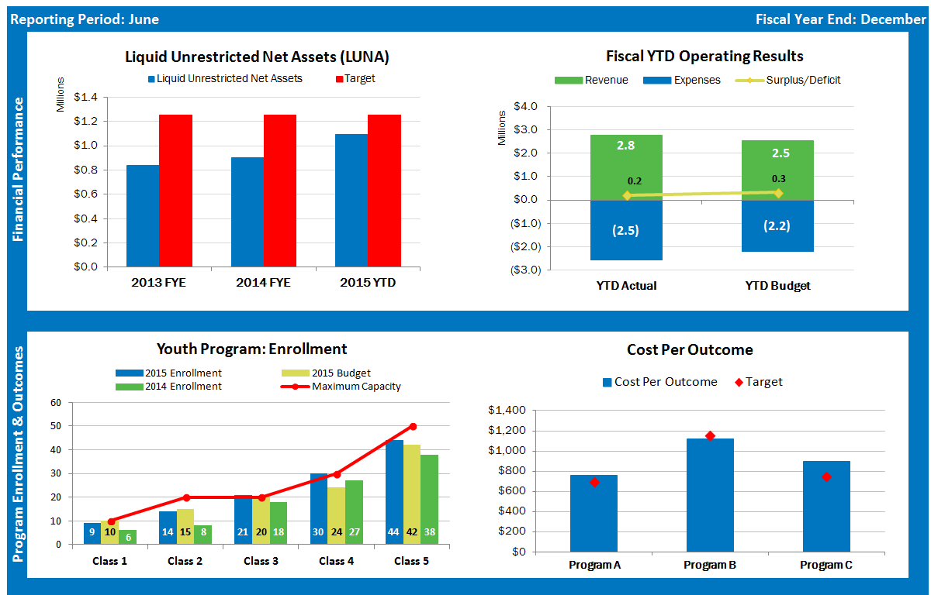
Performance Dashboard: Sample 1

Slide 27
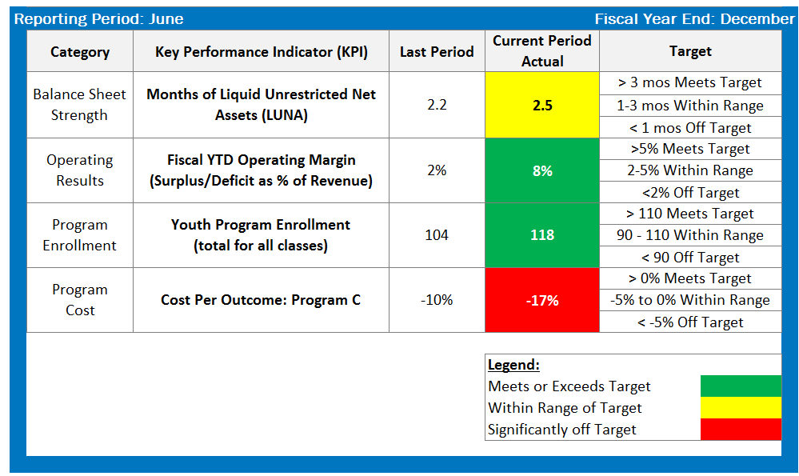
Performance Dashboard: Sample 2

Slide 28
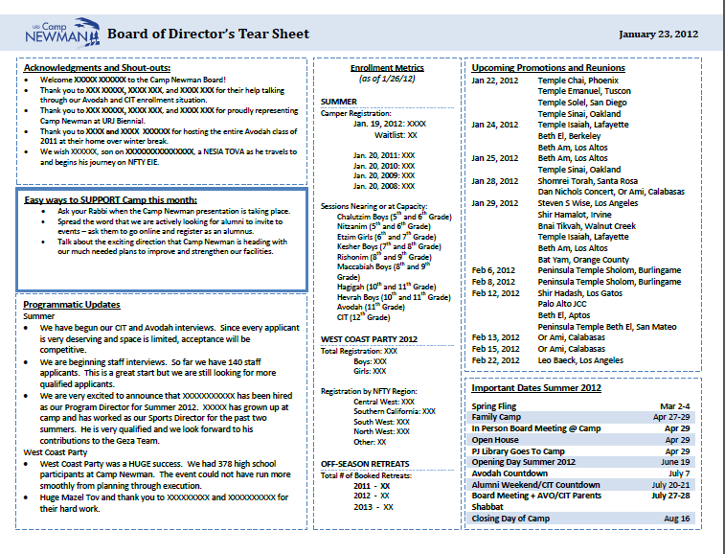

Slide 29
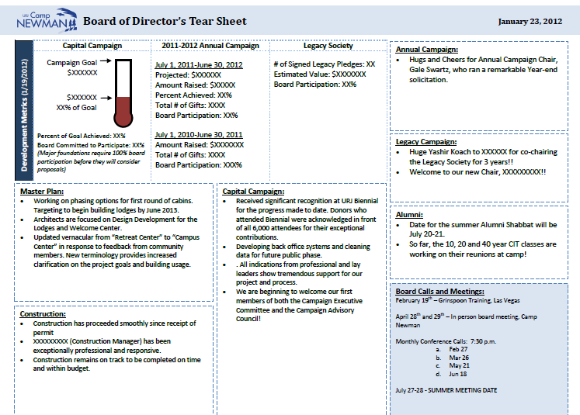

Slide 30
Reflection
STOP
START
CONTINUE
Notes:
From the start results, what are the projects that you will prioritize to implement?
Personal, not organizational

Slide 31
Questions?

Slide 32



Fiscal Management Associates, LLC
Established in 1999 to serve not-for-profit organizations around the country
Provides customized financial management, accounting, software, organizational development, human resources, and other consulting services
Works directly with organizations or through funder-supported management and technical assistance programs
FMA's mission is to empower not-for-profit organizations with the knowledge and skills to successfully serve their constituents and fulfill their missions
New York | Chicago | Oakland | LA
@FMA4Nonprofits
www.fmaonline.net
/FiscalManagementAssociates
linkedin.com/company/fiscal-management-associates-llc

