Slide 1
All Together Now A Matching Grant from the Harold Grinspoon Foundation

Slide 2
#AllTogetherNowforCampKinderRing
#AllTogetherNowforCampMorasha
#AllTogetherNowforURJCampNewman
All Together Now for Your Camp!
#AllTogetherNowforHDCampGilboa
#AllTogetherNowforCampTawonga
#AllTogetherNowForCampRamahBerkshires

Slide 3
Webinar Agenda
Welcome SARAH
Matching Grant Guidelines ERICA
-- Pause for Your Questions --
Strategies and tactics for raising funds now JULIA and DAN
Emerging Sources of Support for Overnight Camp JULIA
Update of Government Funding ARON
-- More of your Questions Answered --

Slide 5
jcamp180.org/all-together-now

Slide 6
Grant Overview
10 million dollar grant to 99 Jewish Overnight Camps
Must be affiliated with JCamp 180
Day camps are not included
Grant amount is calculated using information from 2019 Camp Census
Email will be sent to eligible camps by end of week including link to the rules, website, and application

Slide 7
Grant Rules
1:2 match of donations received March 30, 2020 – Dec. 31, 2020
1:1 match for camp fees and tuition converted to donations
Gifts of any amount will be matched
Gifts must be cash equivalent
Donations from any source (excluding government relief funding) are accepted
Grant funds are unrestricted, must be used for Camp
Gifts must be received by the camp prior to December 31, 2020

Slide 8
Non-Eligible Gifts
In-kind contributions (i.e., Discounts, art, real estate, non-cash gifts, etc.)
Regular allocations from Jewish Federations or similar agencies
Government relief funds associated with COVID-19 pandemic
Restricted gifts designated for specific purposes
Gifts submitted to another JCamp 180 matching grant program

Slide 9
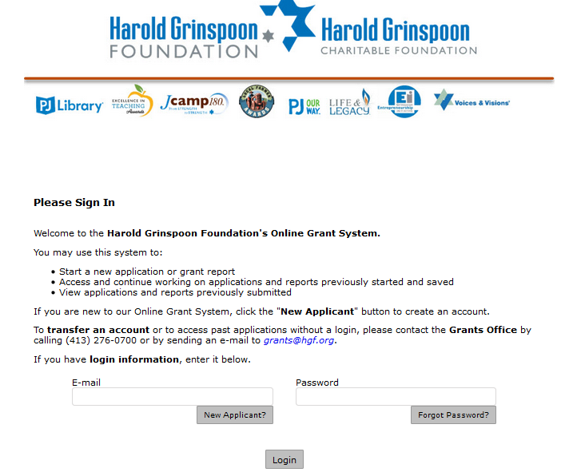
HGF Grants System

Slide 10
Donation Tracking

Slide 11
Summary
Link to apply online to be emailed soon
Apply, sign and return the Grant Agreement Letter which includes your camp’s grant amount
Use tracking spreadsheet to submit gifts
Payments will be processed within 10 business days once they reach $5,000 or more in eligible matching payments
Guidance on how to apply available on the website
jcamp180.org/all-together-now

Slide 12
Need help?
Your Camp Mentor or
Erica Ryan
operations@hgf.org
413-276-0794

Slide 13
Questions?
Smiling faces of Camp Wise in action!

Slide 14
Don’t let Jewish overnight camps
disappear
overnight

Slide 16
“My camp will close.
I need your help.
Just hear me out.”

Slide 18
Strategy and Tactics

Slide 19
Strategy and Tactics
April / May | June / Summer | Fall / December
Gather your volunteer team Define and engage your Inner Circle One or a few Major Gifts?
Major Gifts | Many Gifts | Finish line

Slide 20
Strategy and Tactics
April / May | June / Summer | Fall / December
Gather your volunteer team Define and engage your Inner Circle One or a few Major Gifts? | Parents can donate camp deposits Alumni and Friends SUMMER Ways you can help Become a monthly donor Each one, call one Connect with an old camp friend Legacy member Make a donation Convert scholarship funds
Major Gifts | Many Gifts | Finish line

Slide 21
Strategy and Tactics
April / May | June / Summer | Fall / December
Gather your volunteer team Define and engage your Inner Circle One or a few Major Gifts? | Parents can donate camp deposits Alumni and Friends SUMMER Ways you can help Become a monthly donor Each one, call one Connect with an old camp friend Legacy member Make a donation Convert scholarship funds | Return to Inner Circle Peer-to-peer fundraising among fans Help us get to the finish-line DECEMBER End-of-year Campaign
Major Gifts | Many Gifts | Finish line

Slide 22
Strategy and Tactics
April / May | June / Summer | Fall / December
Quiet Phase | Public Phase | End of Year Campaign + Celebration Phase
Major Gifts | Many Gifts | Finish line

Slide 23
Sample approach (from a mid-west camp)
List of all major donors (over $500) and past solicitors.
Call each one
Share insider details on how camp is preparing for COVID-19 and what we need from you
List all the challenges of camp open, camp closed, camp open for some of the summer
Discuss how cash flow works with camp
List all the ways that extra funds will be needed
List all the ways they can help

Slide 24
What they’ve learned so far
This is the right strategy. People feel connected, informed and committed to the cause.
People understand the issues and had their concerns answered in the conversation
Most need to hear why Jewish camp is more important then ever before, and a pressing concern worthy of support. And then they agree.
Even donors who are hit hard by economy feel invested in trying to help.
Next, based on conversations already done:
Need to start speaking of the business side of camp, such as
Clear, well-laid out strategy for ramping down operations and ramping them back up.
Demonstrate cost cutting efforts and provide rationale for the expenses we do not cut.
Need a cash flow chart with monthly needs – people want to be able to time giving to meet our needs and manage their own.

Slide 25
Recap
Set your goals weekly
Gather your volunteer team
Start with Inner Circle
Fearful? Get support from JCamp 180 Mentor
Get and Share resources with your peers
Weekly drop-in session on Tuesdays at 2pm
jcamp180.org/all-together-now
Jcamp180@hgf.org

Slide 26
3 P’s American Camp Association
Planning
CDC guidelines
Preparing
Support for virtual programming
Positioning
Lobbying for more govt. funds
National PR campaigns for camp

Slide 27
4 P’s
Planning
CDC guidelines
Preparing
Support for virtual programming
Positioning
Lobbying for more govt. funds
National PR campaigns for camp
Partnership
JCamp 180
Among all Jewish Camps
Jewish Philanthropists
Your Fans, Families, and Friends

Slide 28
JCamp 180 Supports for Your Campaign
Drop-in Sessions for peer sharing on Tuesdays 2 pm ET
Peer sharing of tips, tools, and tactics
Insight into what is working
Encouragement and Support
Marketing and PR resources
“Campaign in a Box” Talking points,
Press releases, social media strategies,
Knowledge Center, best practices, and more
JCamp 180 Mentor Coaching and Guidance
New Professional Development Offerings

Slide 30
Government Funding
jcamp180.org/gov
jewishtogether.org
Camps successfully submitting, one accepted by SBA. Has yours?
Include seasonal/summer staff in your one-year average monthly payroll calculation.
More funding and relaxation of rules anticipated
SBA loan funds available in 1-5 days
Next step: Be forgiven! (June 30)
Be in touch: aron@hgf.org

Slide 31
Next JCamp 180 Webinar
Projecting the Impact:
Review of the New JCamp 180 Modeling Template
2 PM Eastern Monday, April 13

Slide 32
Questions?

