Slide 1
Meet Your Match 8
Information Session
August 21, 2018
Mark Gold Kathleen Rodowicz
Director, JCamp 180 Grants Administrator
Mark@hgf.org Kathleen@hgf.org
413-276-0777 grants@hgf.org
413-276-0719

Slide 2
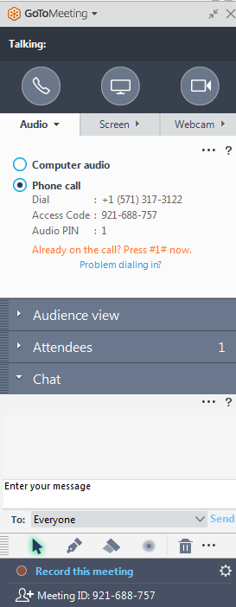
GoTo Meeting Logistics:
A →
A) Grab Tab – Click arrow to open/close Control Panel. Click square to toggle Viewer Window between full screen/window mode. Click mic icon to mute/unmute your audio.
B) Audio Pane – Select audio format. Click Audio Setup to verify Speakers & Microphone.
C) Questions Pane – Attendees can submit questions and review answers.
B →
C →

Slide 3
Agenda:
Introduce the JCamp180
Meet Your Match 8 grant
Step by step overview
Online grants administration
Questions and discussion

Slide 4
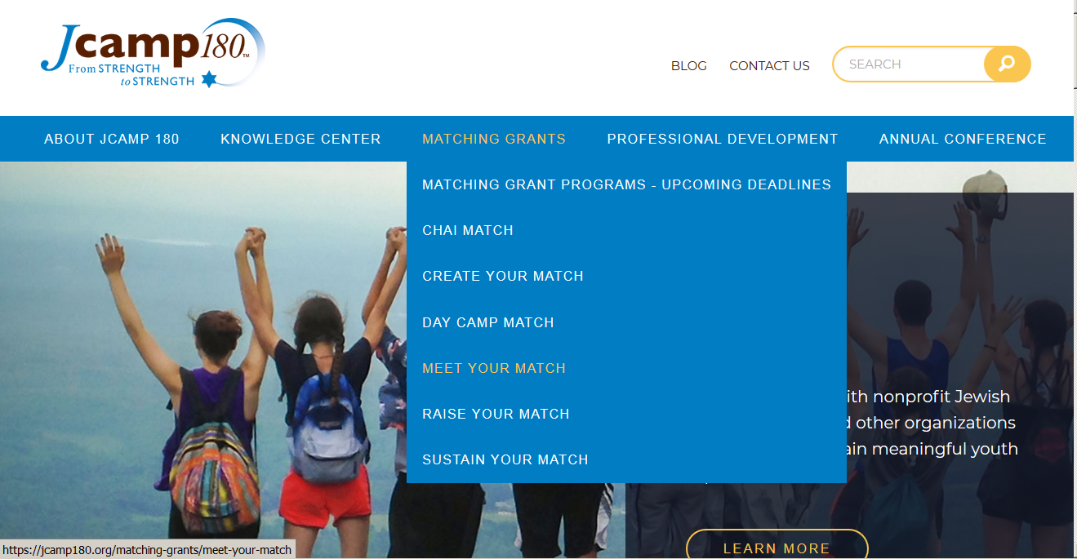
Follow-up:
Find today’s information on JCamp180.org

Slide 5
Follow-up:
Demonstration on how to access MYM 8 Information on JCamp180.0rg

Slide 6
JCamp180 Matching Grants:
JCamp180 has been offering matching grants for 14 years
  Documentation of pledges received by the camp is required to allow us to budget for future payments under our grants
  We require documentation of PAYMENTS for matching funds to be released
Matching grants have a fixed calendar
  One calendar for pledges
  Second calendar (usually longer) for payments to be received
  Please be aware of these date restriction

Slide 7
MYM 8
Campaign Goal:
Campaign Total of $300,000 or More……..
  Raise $225,000 in gifts of between $10,000 and $75,000 (or more) in private gifts.
  Receive $75,000 in matching funds from the Harold Grinspoon Foundation (HGF).

Slide 8
Fundraising Goal:
To successfully raise $300,000 you will need to solicit:
Minimum of 3 major donors at $75,000
Or up to 23 donors at the minimum matching amount of $10,000
Donors may give more than $75,000 but our program will only match 1:3 the first $75,000 of any one gift
We recommend always securing a few extra pledges as a safeguard

Slide 9
Program Overview:
Identify and solicit NEW major donors to partner with JCamp180
Gifts must be $10,000 or larger
  Pledged after 10/1/18 but before 9/30/2019
  Paid in full by 9/30/2021
Only first $75,000 of large gifts will be matched

Slide 10
MYM 8
Key Dates:
Timetable
Program Announcement | May 29, 2018
Earliest pledge / gift date | October 1, 2018
Last pledge date | September 30, 2019
Pledge reporting deadline | October 31, 2019
Final payments due date | September 30, 2021
Last payment reporting date | October 31, 2021

Slide 11
New donors?
The program’s intent is to grow your base of major donors
One donor cannot complete the match
Use restrictions are limited:
  Cannot be program specific funding
  May be directed to a capital improvement project or naming rights
Prior donors must give money above prior gift amount

Slide 12
New donors?
The program’s intent is to grow your base of major donors
One donor cannot complete the match
Use restrictions are limited:
  Cannot be program specific funding
  May be directed to a capital improvement project or naming rights
Prior donors must give money above prior gift amount
What does this mean?
A prior donor must give above prior gift level
If someone has given $5,000 per year, we assume that they could continue to do give at that level, so we want their gift over the NEXT three years (the life of this program) to be ABOVE the $15,000 they could have given during that time.

Slide 13
Who qualifies as a
MYM 8 donor?
Have not given annual gifts of $2,500 or more after 12/31/2015
  Prior donors of $7,500 or less (total over last three years) are considered first time donors if their three year pledge or gift to MYM 8 is $10,000
If they gave $2,500 or more after 12/31/2015 then only money ABOVE that gift amount given over the 2018-21 period is eligible to be matched (minimum $10,000 over three years)
  Example 1: Donor of $5,000 per year prior to 12/31/2015 must give $25,000 over three years 2018-2021 of which $10,000 gets matched
  Example 2: Donor of $10,000 in 2015, zero in 2016 and 2017 must give $40,000 over three years 2019-21 of which $10,000 gets matched

Slide 14
Who is a JCamp180 matching grant donor?:
An Approved Donor is:
  An Individual (alumni, parent, friend)
  A family (parents, siblings & children)
  A family foundation
  A business
  A “friends of” or pre-established 501(c)(3) group of alumni
An Approved Donor is NOT:
  Allocations, grants or designated funds from a Jewish Federation or national parent organization (Ramah, Chabad, etc.)
  JCCA allocations, grants or funds
  FJC grants or gifts
  A Foundation grant where applications were solicited (purpose specific)
  A group of alumni or friends who pool their gifts

Slide 15
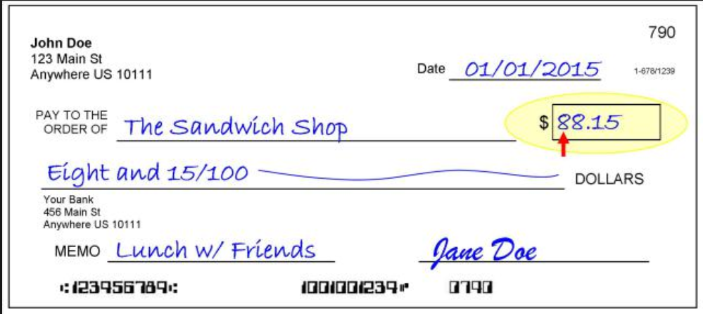
What is an approved JCamp180 Gift:
Eligible payments must be dated between
October 1, 2018 – September 30, 2021
It is:
Cash or cash equivalents
Stocks or bonds
Assets with market value
It is NOT:
Payment for events, raffles, sponsorships, etc.
In kind contributions
Discount in cost of goods or services
Non-liquid assets
  Land
  Art
  Gifts with liquidation restrictions

Slide 16
Program Overview
Gifts:
Twelve months to get pledges:
  Pledges (or gifts) must be received and documented to JCamp180 between 10/1/2018 and 9/30/2019
  Identify pledges to HGF within 30 days of receipt
36 Months for donors to pay pledges:
  Pledges must be paid in full by September 30, 2021
  Gift can be $3333 / year for 3 years
  Gifts may be paid in full in 1, 2 or 3 years
HGF matching funds are paid out when pledges are paid at the minimum level of $10,000.00

Slide 17
Program Overview
Gifts:
What does this mean?
Our foundation matches gifts of $10,000 to $75,000. Even if the pledge is between those amounts, we don’t make a matching payment until the funds you receive are over $10,000.
Example: $15,000 pledge paid over three years
Upon receipt of the pledge we “reserve” $5,000 in matching funds After the year 1 payment, ($5,000) we don’t pay you. After year 2 payment ($5,000) we release $3,333.33 in matching funds. After year 3 payment ($5,000) we release $1,666.67 in matching funds.
Twelve months to get pledges:
  Pledges must be received and documented to JCamp180 between 10/1/2018 and 9/30/2019
  Identify pledges to HGF within 30 days of receipt
36 Months for donors to pay pledges:
  Pledges must be paid in full by September 30, 2021
  Gift can be $3333 / year for 3 years
  Gifts may be paid in full in 1, 2 or 3 years
HGF matching funds are paid out when pledges are paid at the minimum level of $10,000.00

Slide 18
MYM 8
Program Sumary:
JCamp180 Funds
Camp Donor Funds
$75,000
$225,000
Campaign Total
$300,000

Slide 19
Campaign Restrictions:
Campaign funds must be designated for:
  Capital Improvements
    Construction of buildings or portions of buildings
    Major repairs or renovations to buildings,
    but NOT maintenance
  Improvements to grounds, but not normal upkeep
  Major pieces of equipment
  (capital items, not annual equipment purchases)
  Infrastructure construction or maintenance (water, sewer, etc.)

Slide 20
Grant Administration:
All JCamp180 grants are administered through our on-line Grants Administration system.
Requires that you create an account
Documents are to be uploaded through the website.

Slide 21
Grant Administration:
There are three steps you need to take to participate in JCamp 180 matching grants using our on-line grants administration system:
Create an account (only need to do this once)
Plan on doing this in the next 5 days
Process shown on next 5 slides
Register for MYM8 (once for each matching grant program)
Plan on doing this soon
Process shown on 3 subsequent slides
Submit pledges and payment support for reimbursement
Plan to do this every 3 months as pledges and gifts are received
Shown on 7 subsequent slides

Slide 22
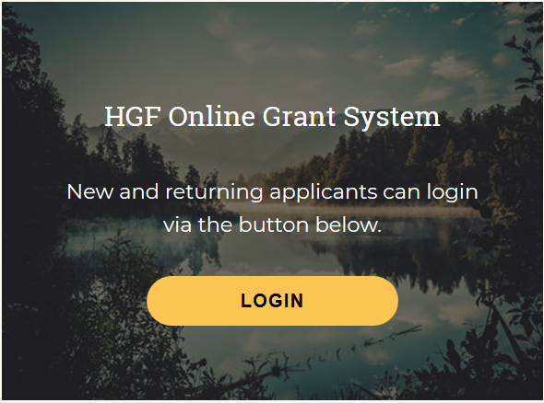
Grant Administration: How to create an account
  How to create an account
  on the on-line grant reporting system
  Open the home page of the JCamp 180 website: www.jcamp180.org
  Scroll to the bottom of the home page
  Click on the LOGIN button

Slide 23
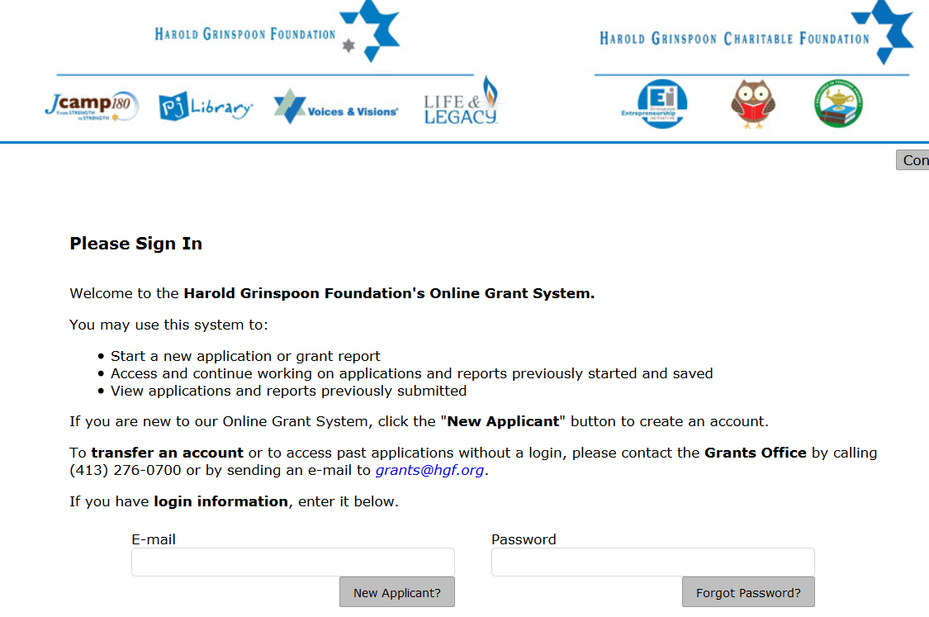
Grant Administration: How to create an account
Click on the “New Applicant” button

Slide 24
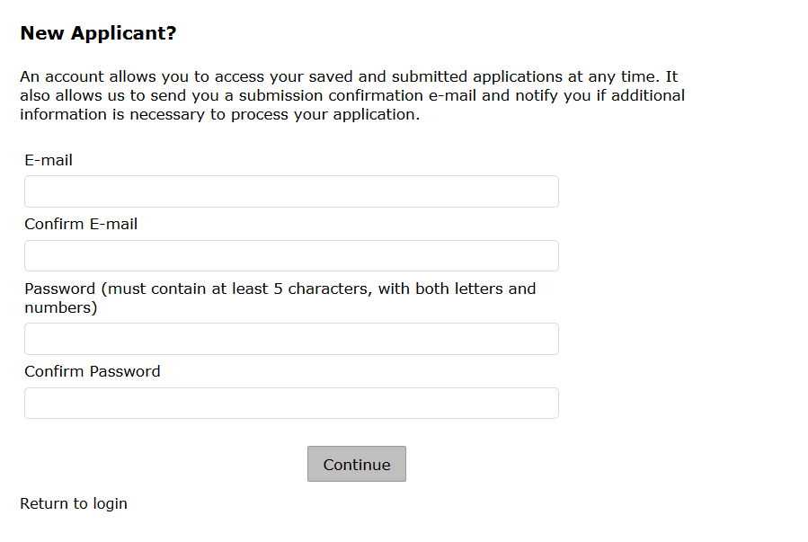
Grant Administration: How to create an account
Fill out the necessary fields and then click on the “Return to login” button.

Slide 25
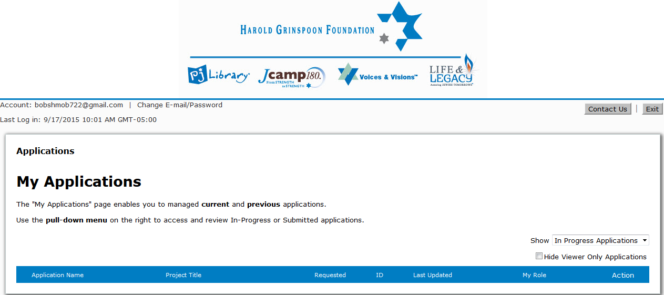
Grant Administration: How to create an account
  Congratulations on creating your new account!
  You will then be brought to the My Applications homepage:

Slide 26


Grant Administration: How to create an account
Please select “Exit” to log out of the online grants system

Slide 27
Grant Administration: How to register for MYM8
  How to register for MYM8
Start at the JCamp 180 web page: jcamp180.org
Select “Matching Grants” and then Meet Your Match on the drop-down list

Slide 28
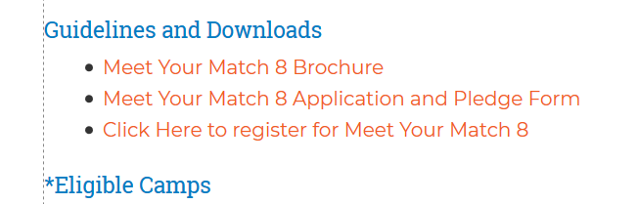
Grant Administration:
How to register for MYM8
On the Meet Your Match page
Scroll down and then click on the Meet Your Match 8 Icon
On the Meet Your Match 8 page, scroll down to the section on Guidelines and Downloads and click on the line
“Click Here to register for Meet Your Match 8”
Select the Meet Your Match 8 Link

Slide 29
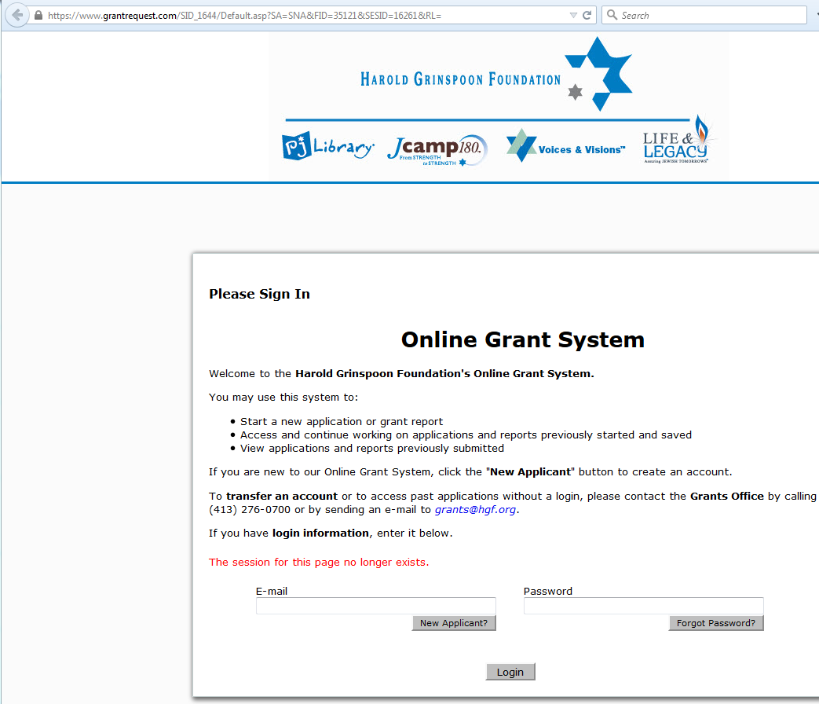
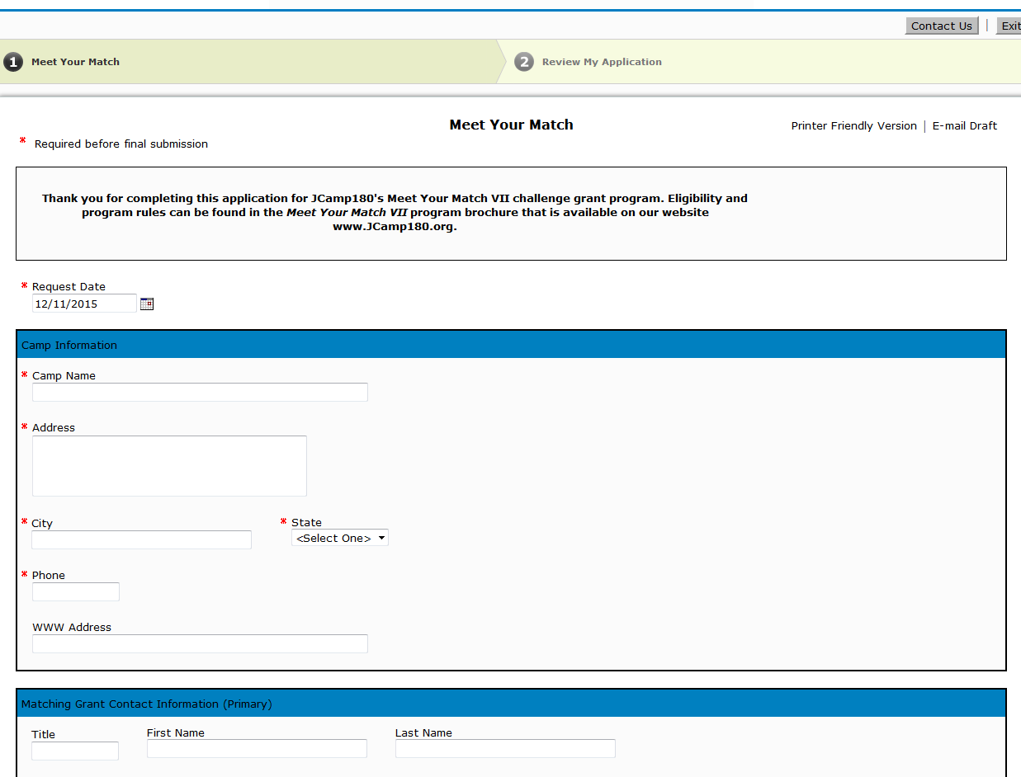

Grant Administration: How to register for MYM8
You will then be brought to the MYM8 registration page to be completed and submitted
Please log in using your account information

Slide 30
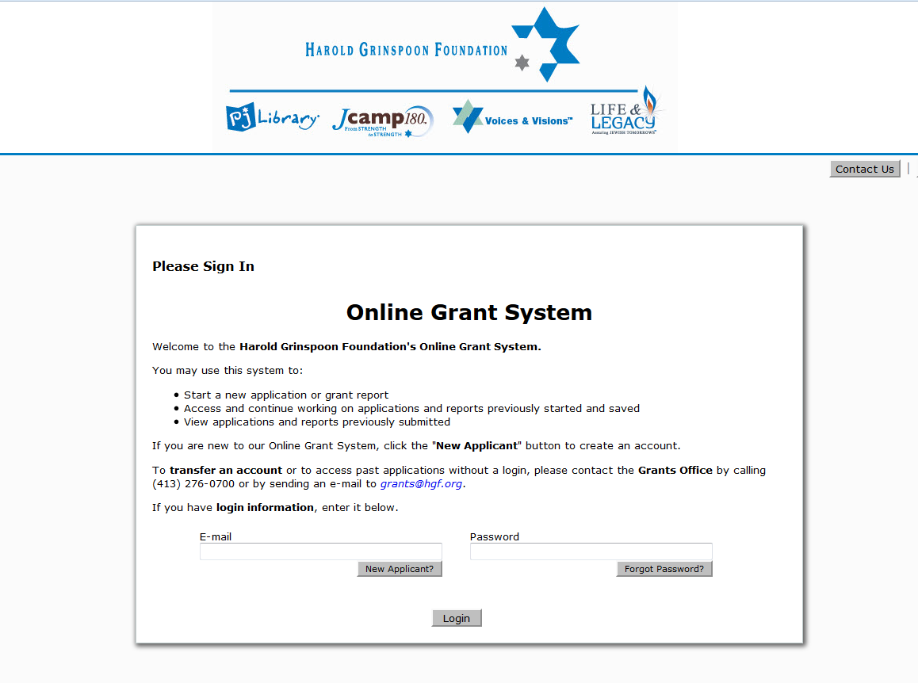
Grant Administration: How to submit pledges/payment support
  To submit pledges and payment support, please login to the Online Grant System:

Slide 31
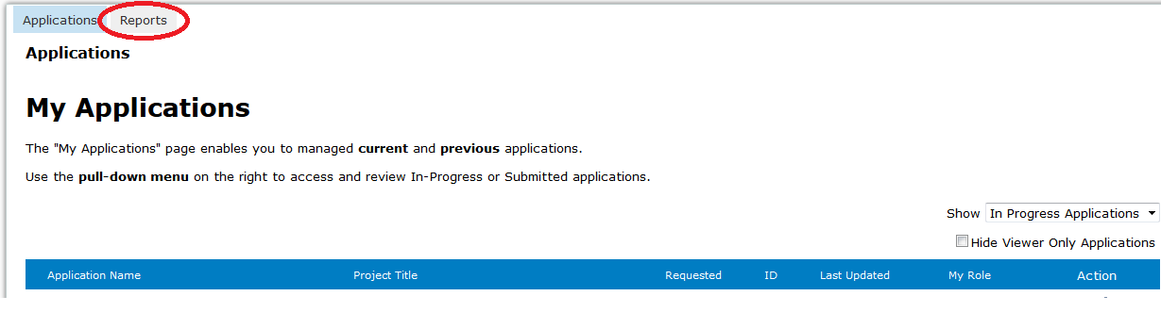
Grant Administration: How to submit pledges/payment support
To submit pledges & pledge payment support, please select “Reports”

Slide 32
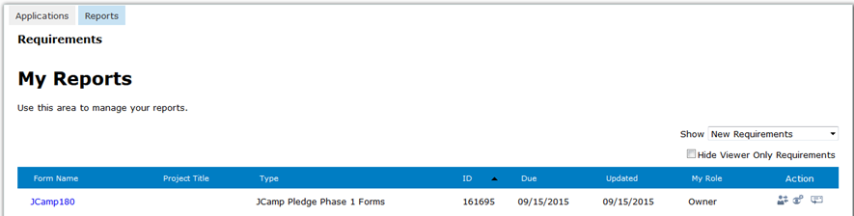
Grant Administration: How to submit pledges/payment support
Please click on the link to make a submission

Slide 33
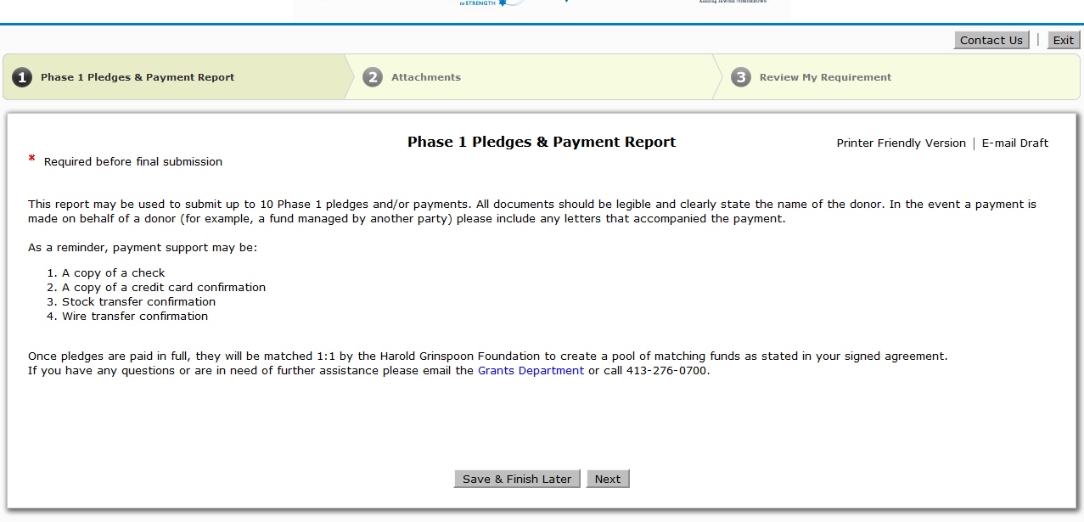
Grant Administration: How to submit pledges/payment support
Once you have clicked on the link, you will be brought to the first of three pages in which you will follow the step by step directions to upload and submit the documentation

Slide 34
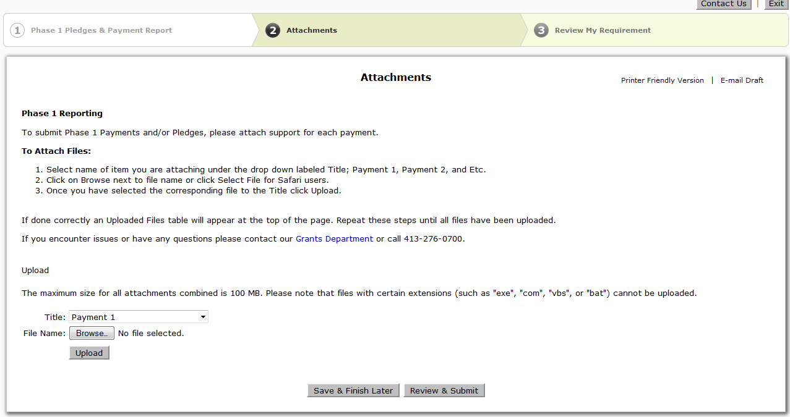
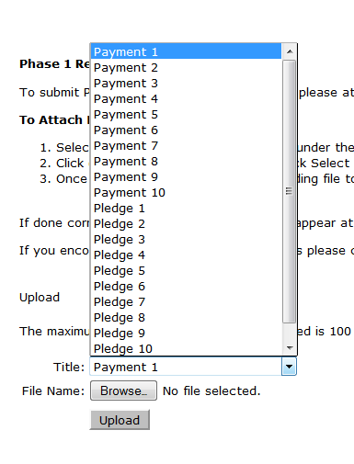
Grant Administration: How to submit pledges/payment support

Slide 35
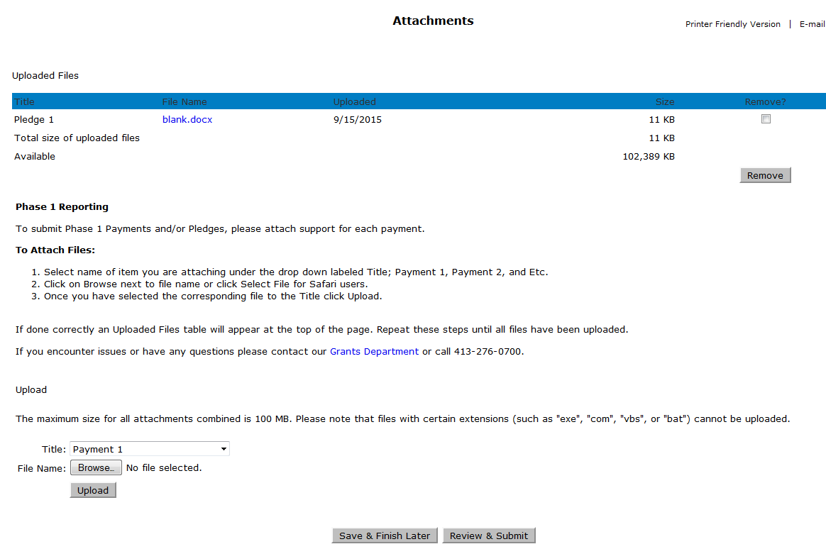
Grant Administration: How to submit pledges/payment support
Once you have uploaded the first document, it will appear up top
To attach another pledge form or payment support, please select another title, browse the file and finally select “upload”

Slide 36
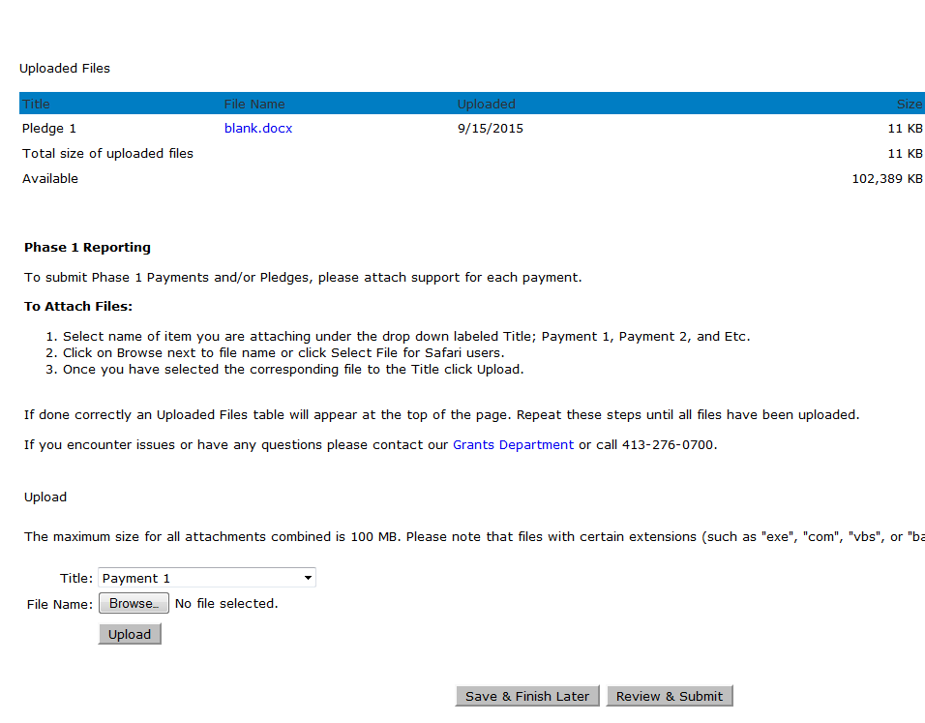
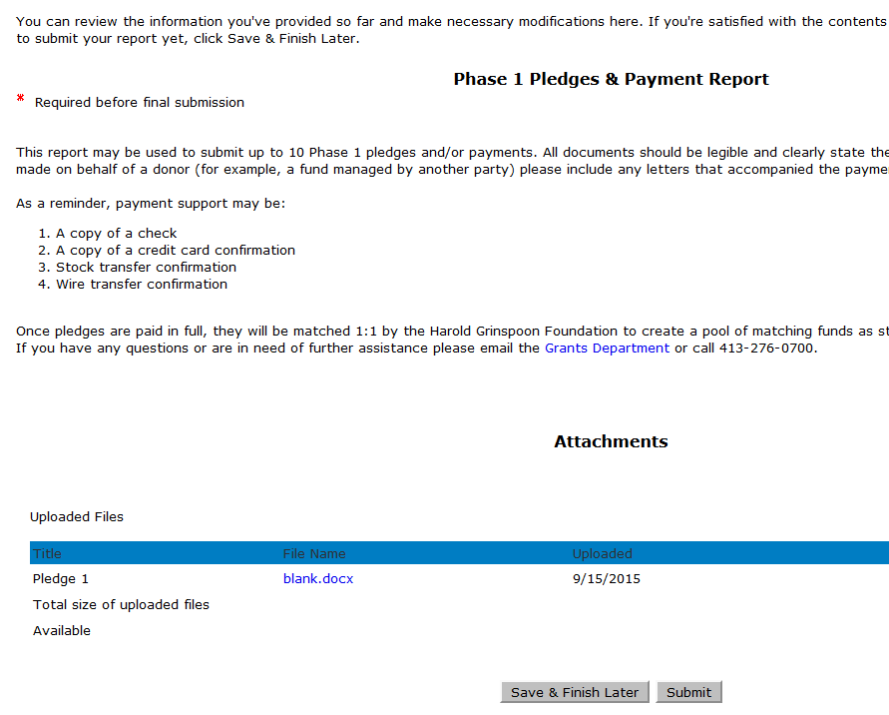
Grant Administration: How to submit pledges/payment support
Once you have uploaded all of the documentation to be submitted, please select “Review & Submit”
You will then be brought to the final page, where you will select “Submit” to send the documentation to the grants administration team for review

Slide 37
Grant Administration:
For any questions regarding the Online Grant System, please email us at Grants@hgf.org

Slide 38
Grant Administration:
A MYM8 donor information form must be submitted for each donor
Proof of payment of all gifts must be submitted
(see next slide for acceptable proofs of payment).
All submissions will be through our on-line system
(Please download and use donor reporting forms).
HGF reserves funds based receipt of documented pledges and pays out matching funds upon proof of gift payment at or above the minimum gift level.
Be aware of timelines for submitting proof of pledges and payments.

Slide 39
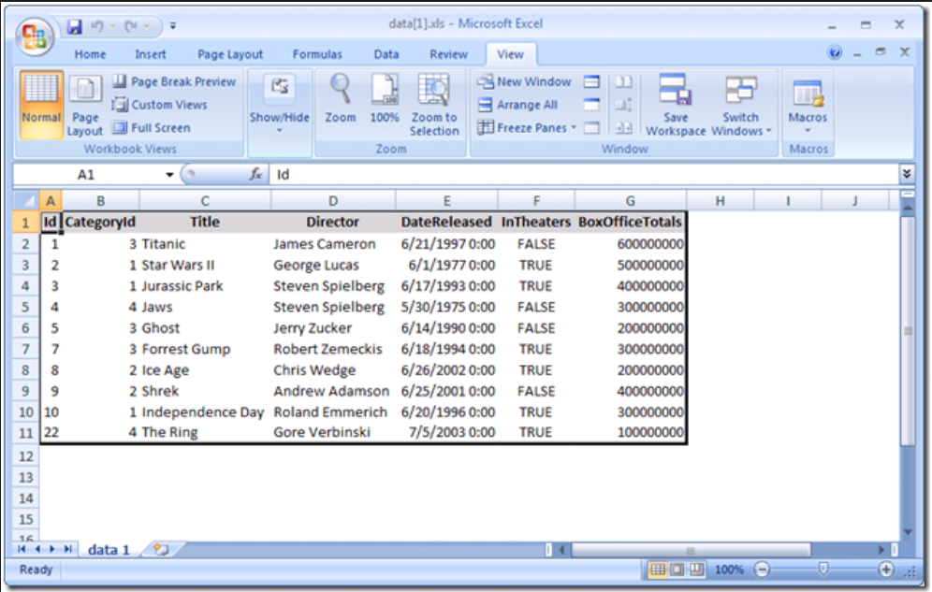
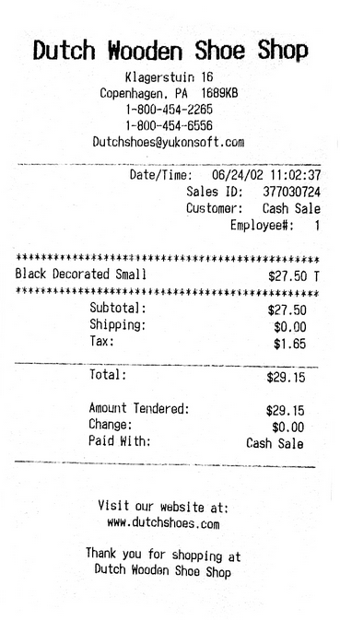
Proof of Payments
  Acceptable
    Credit Card Slip
Check Copy
Screenshot from camp’s accounting software
Not Acceptable
Copy of Credit Card
Word/excel document with list of donors with check numbers
Financial report in excel document

Slide 40
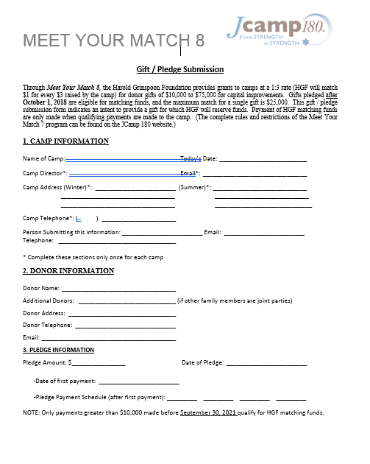
Donor Form:
The MYM 8 Gift Form can be downloaded from the MYM 8 program page on the JCamp 180 website.
You must fill out:
Gift Date
First/Family Name
Last Name
List Family (for family gifts)
Address
Gift Amount
Payment Schedule
Donor
Previous Donor Information

Slide 41
Questions:
Can the Campaign be larger than $300,000 ?
Can a few major donors fulfill the whole campaign quickly?
Yes. We ask that you be careful of how you describe the matching pool to donors.
Only the first $75,000 of large gifts is matched. If your campaign brings in three gifts of $100,0000, you will earn $75,000 from JCamp180. If you get a 4th gift of $100,000 you will still only earn $75,000 from JCamp180
Yes. You need a minimum of 3 gifts of $75,000 each to earn the entire $75,000 from JCamp180.
At the other extreme, you need 23 gifts at the minimum match level of $10,000 to earn the maximum JCamp180 match of $75,000.

Slide 42
Questions:
Why should we seek (and submit documentation for) more than the minimum number of pledges?
Should we be concerned about the timing of submitting pledges to JCamp 180?
Life happens. Sometimes pledges made with the best of intentions cannot be paid by the end of our campaign. By submitting documentation for more than the minimum required number of grants, you assure that if one or two do not get paid, you will still receive sufficient gifts to qualify for the entire JCamp180 match. YOU CANNOT REPLACE A PLEDGE after the 9/30/2019 deadline, so make sure you have submitted enough pledges to cover all our funds.
You should work with your donors so they do not submit a pledge until they are fully committed to fulfill that pledge. Pledges must be signed and dated after October 1, 2018 and before September 30, 2019. We ask that you submit pledges within 30 days after they are received so we properly reserve matching funds. All pledges must be signed by September 30, 2019 and submitted by October 31, 2019.
.

Slide 43
Your Questions:
QUESTIONS?

Slide 44
Meet Your Match 8
Information Session
August 21, 2018
Mark Gold Kathleen Rodowicz
Director, JCamp 180 Grants Administrator
Mark@hgf.org Kathleen@hgf.org
413-276-0777 grants@hgf.org
413-276-0719

