Slide 1
JCamp 180 & Camp Ramah in Wisconsin PLANNING & LAUNCHING AN ENDOWMENT CAMPAIGN
March 21, 2024

Slide 2
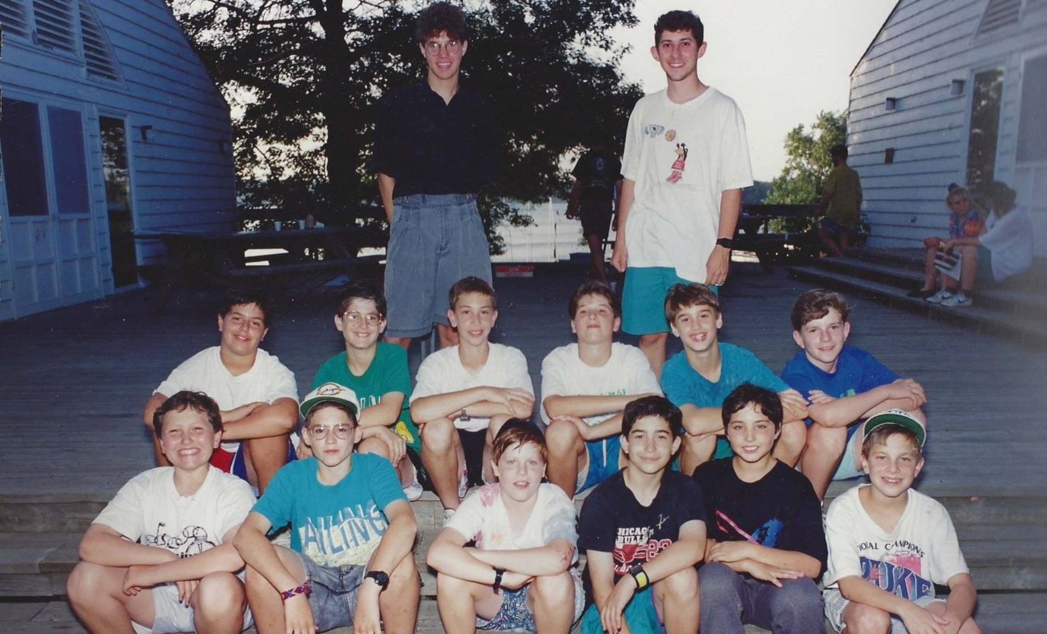
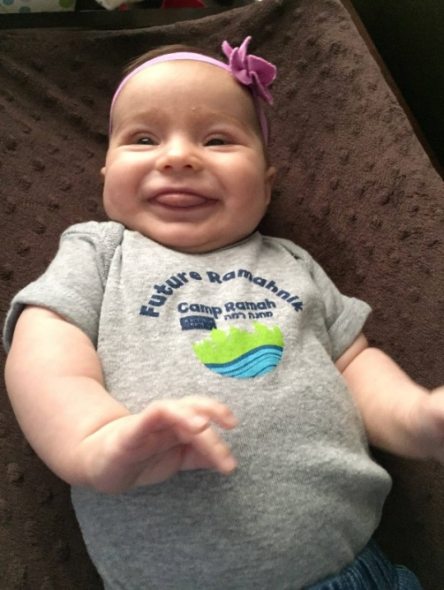
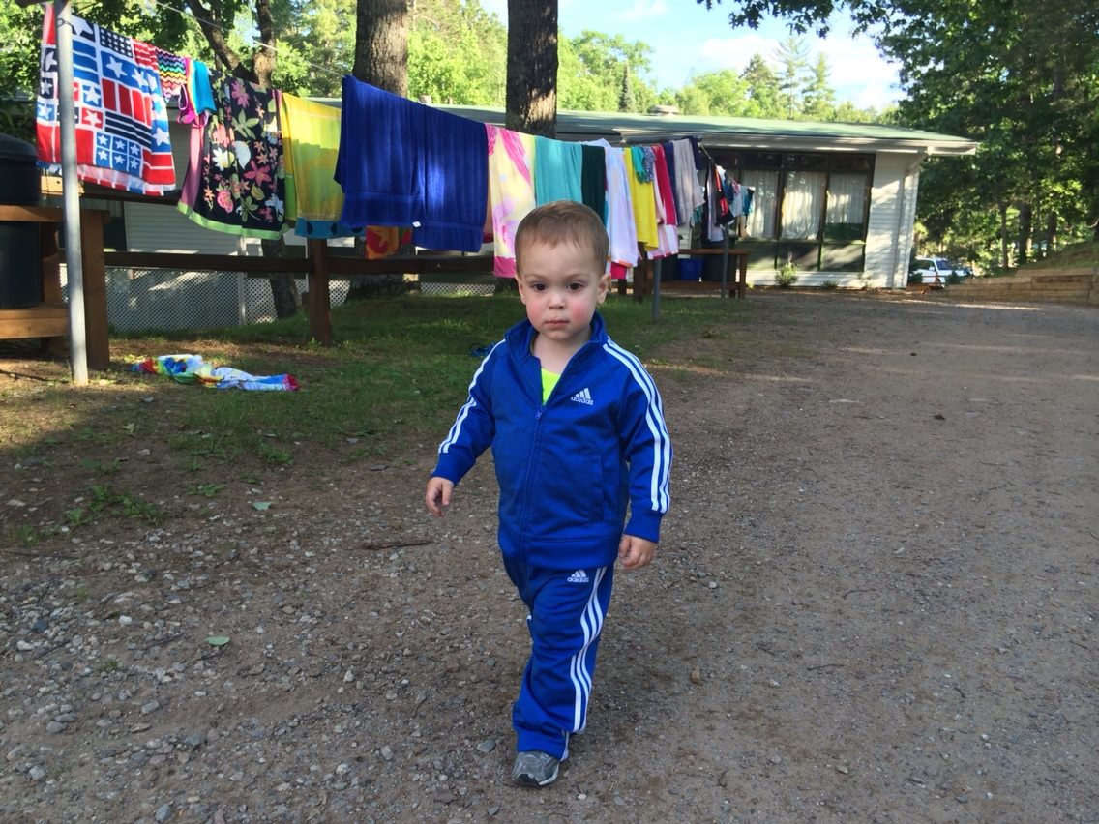
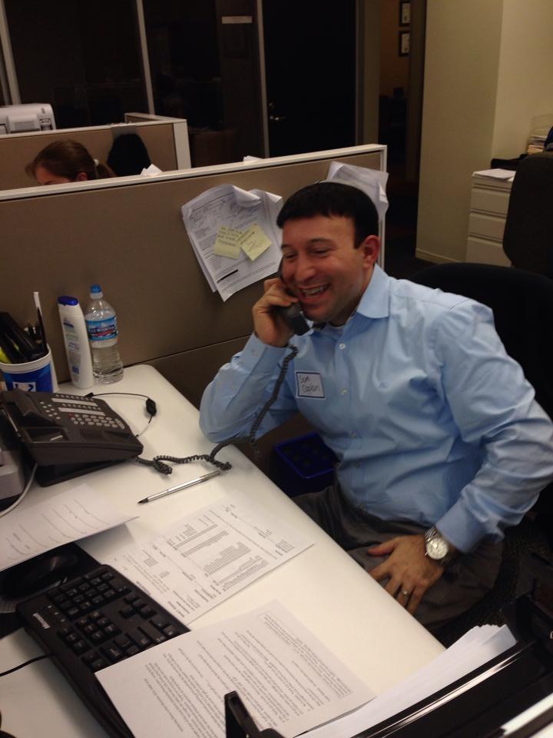
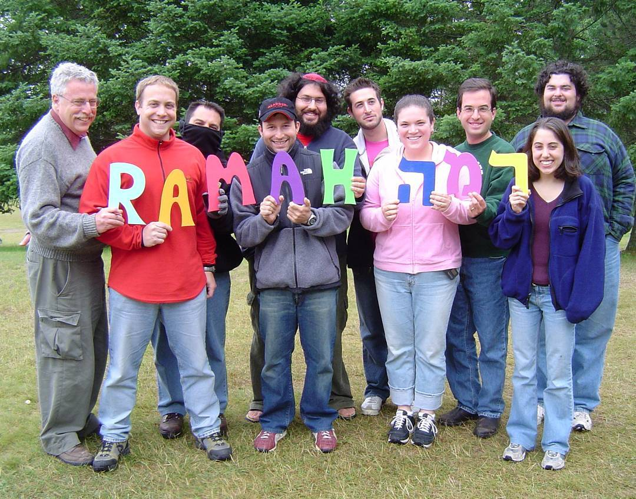
MY CAMP JOURNEY
Planning & Launching An Endowment Campaign

Slide 3
OUR PROCESS
Planning & Launching An Endowment Campaign
Start With Your Knowns
Goal Setting & Campaign Design
Building A Campaign Team
Identifying Donor Prospects
Strategies For Engaging Community
Now Is The Time

Slide 4
I. START WITH YOUR KNOWNS

Slide 5
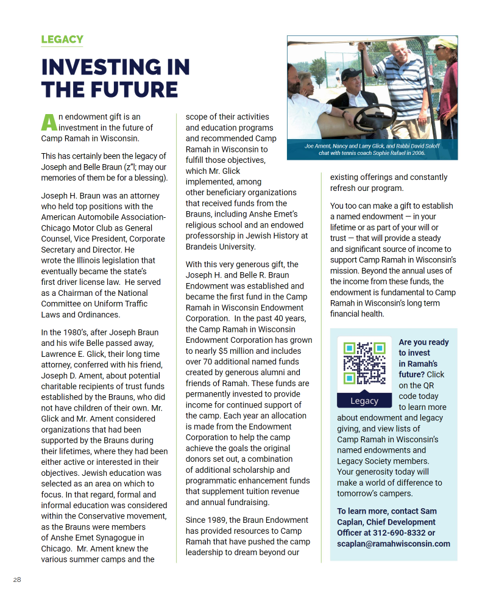
KNOW YOUR STARTING POINT
Planning & Launching An Endowment Campaign

Slide 6
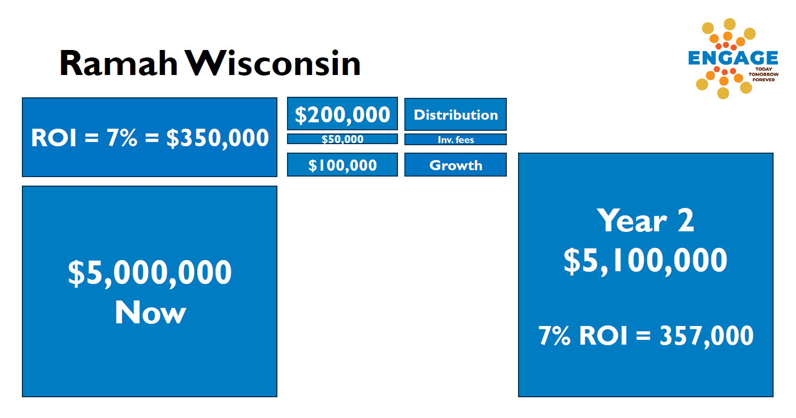
DEFINITIONS & THE BASIC MATH
Planning & Launching An Endowment Campaign

Slide 7
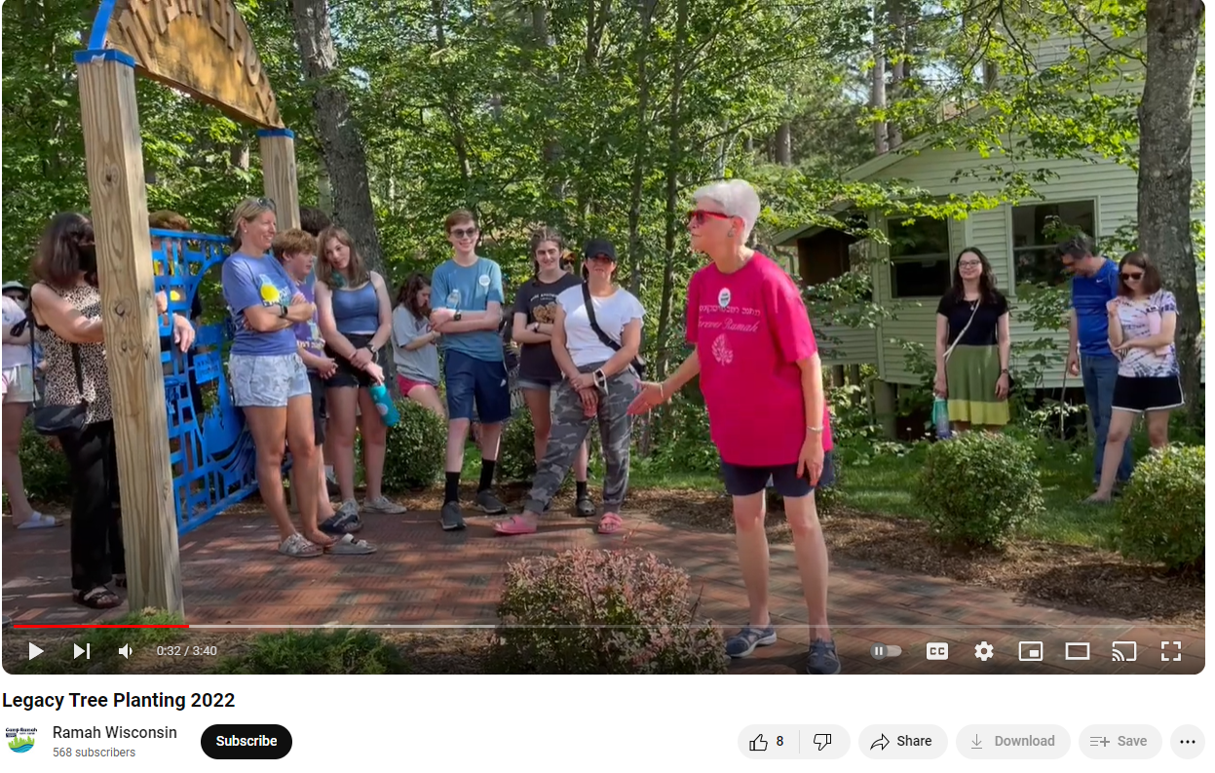
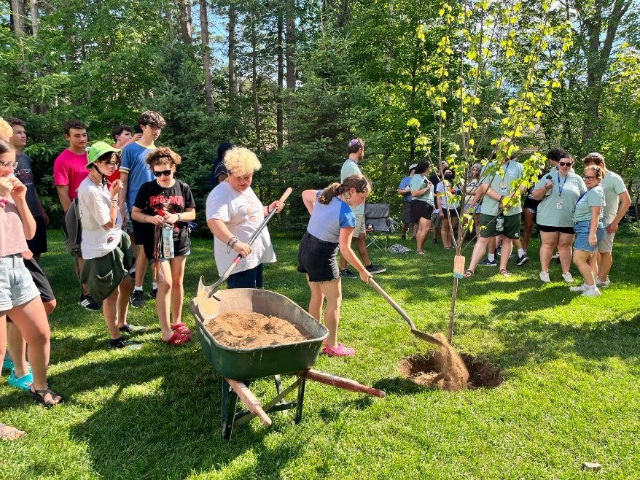
SYMBOLISM
Planning & Launching An Endowment Campaign

Slide 8
BEING READY FOR THE UNKNOWN UNKNOWNS
Planning & Launching An Endowment Campaign

Slide 9
ASK THE AUDIENCE
Planning & Launching An Endowment Campaign
(Kevin has a question)

Slide 10
A LONG RUNWAY
Planning & Launching An Endowment Campaign
HOW IT STARTED IN 1989
1 Endowment Fund $350,000 Value
CAMP RAMAH IN WISCONSIN ENDOWMENT TODAY
74
Named Endowment Funds
$7.9M
Value

Slide 11
NAMING & RESTRICTIONS
Planning & Launching An Endowment Campaign

Slide 12
II. GOAL SETTING & CAMPAIGN DESIGN

Slide 13
OBJECTIVE
Planning & Launching An Endowment Campaign
2 – 3X operating revenue is the gold standard
Define clear goals and objectives
No one-size-fits-all answer
Operational needs
Long-term sustainability

Slide 14
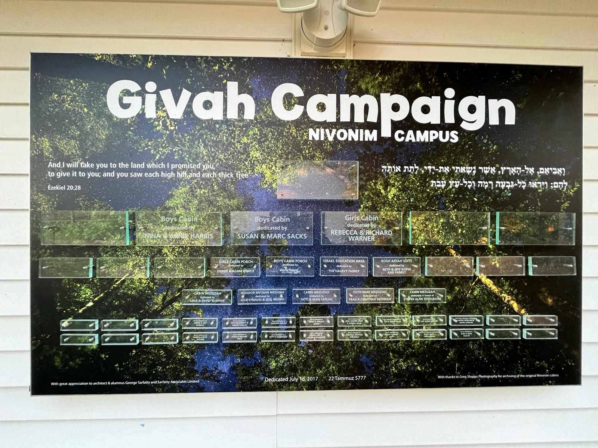
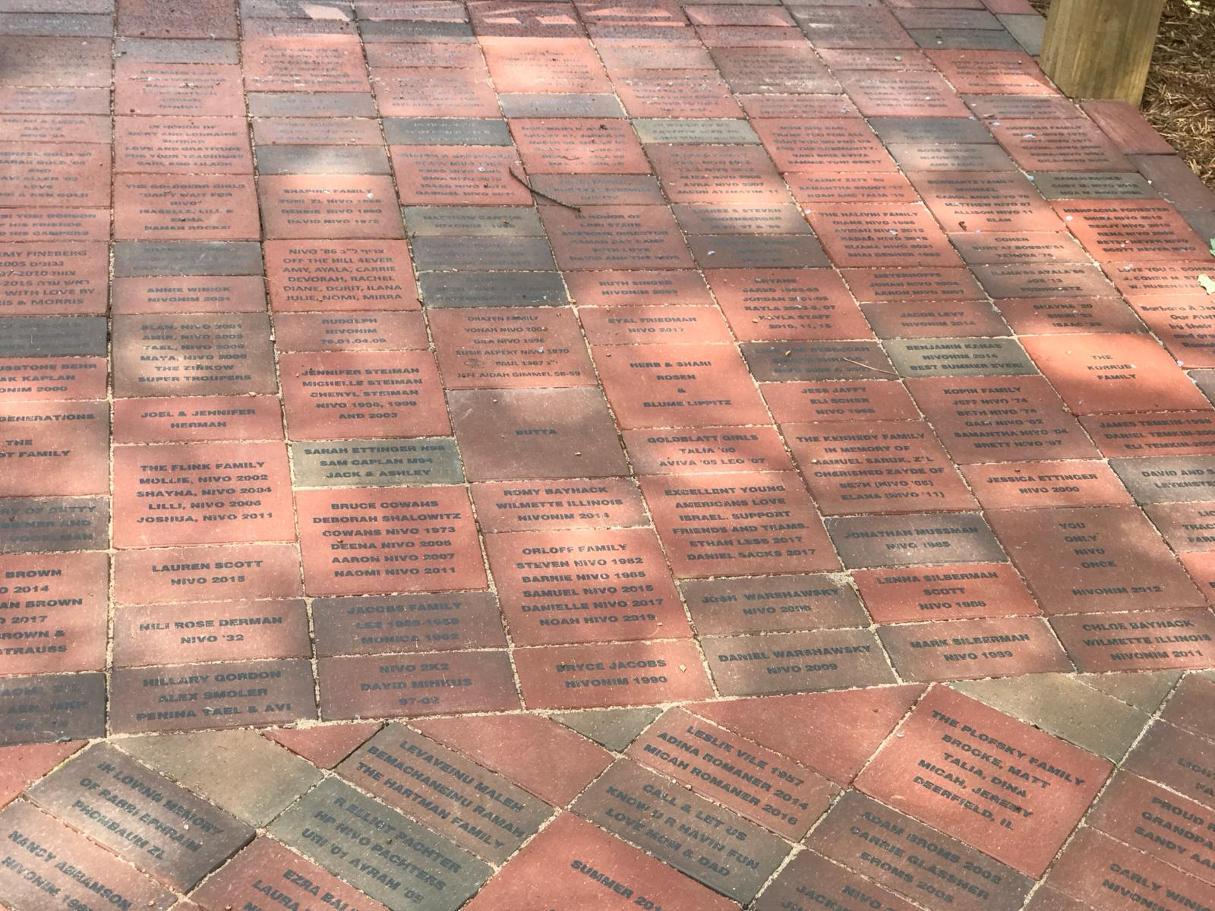
STANDALONE VS. COMPREHENSIVE CAMPAIGN
Planning & Launching An Endowment Campaign

Slide 15
III. BUILDING A CAMPAIGN TEAM

Slide 16
IT TAKES A VILLAGE
Planning & Launching An Endowment Campaign
IT TAKES A VILLAGE:
Professional Staff
Development Committee
Estate Planning Attorneys in Camp Circles
Endowment Board

Slide 17
IT TAKES A VILLAGE
Planning & Launching An Endowment Campaign
Endowment Accelerator Board buy-in
(Kevin has a question)

Slide 18
IV. IDENTIFYING DONOR PROSPECTS

Slide 19
MOTIVATING FACTORS
Planning & Launching An Endowment Campaign
Perpetual Giving
Prudent & Disciplined Fiscal Decision Making
Organizational Longevity

Slide 20
CASH GIFTS VS. PLANNED GIVING
Planning & Launching An Endowment Campaign
Naming Opportunities
Bequests, Life Insurance Policies & Trusts

Slide 21
CASH GIFTS VS. PLANNED GIVING
Planning & Launching An Endowment Campaign

Slide 22
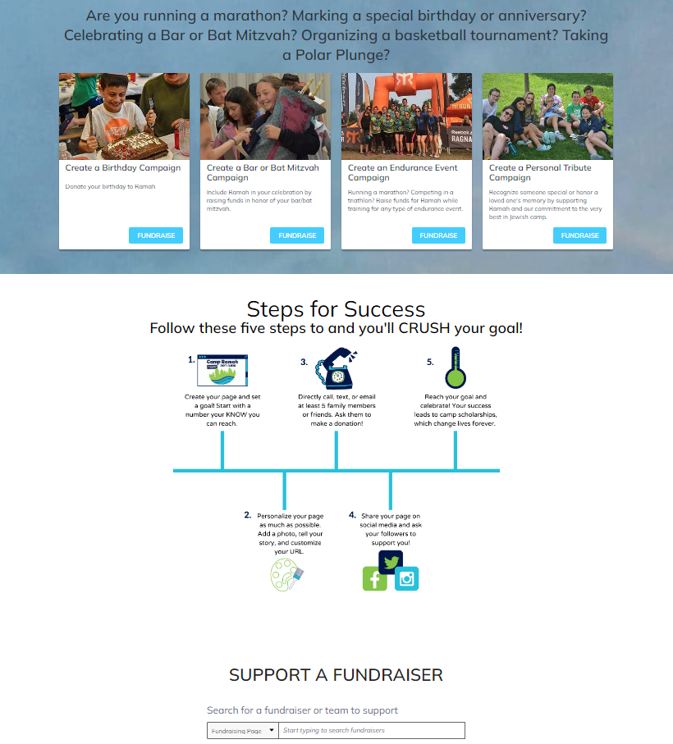
GROUPS
Planning & Launching An Endowment Campaign
Reunions
Memorial Gifts

Slide 23
V. STRATEGIES FOR ENGAGING COMMUNITY

Slide 24
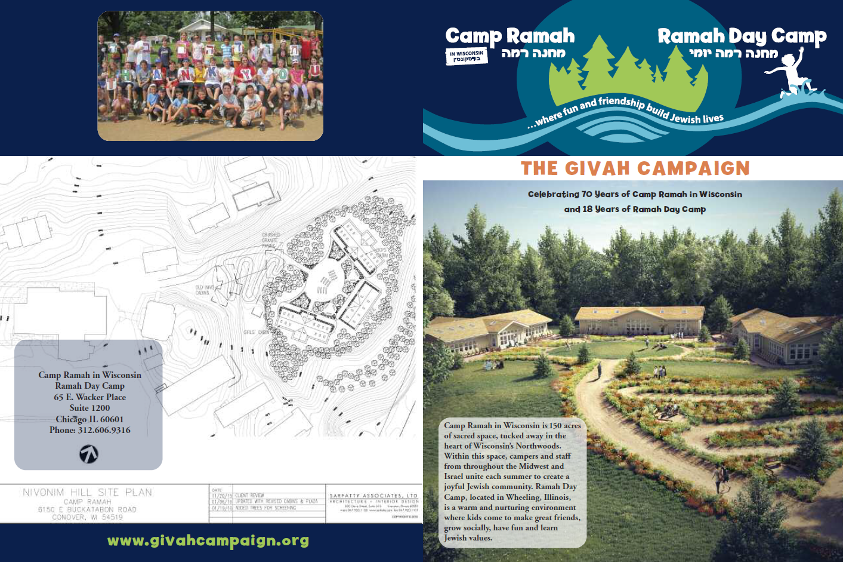
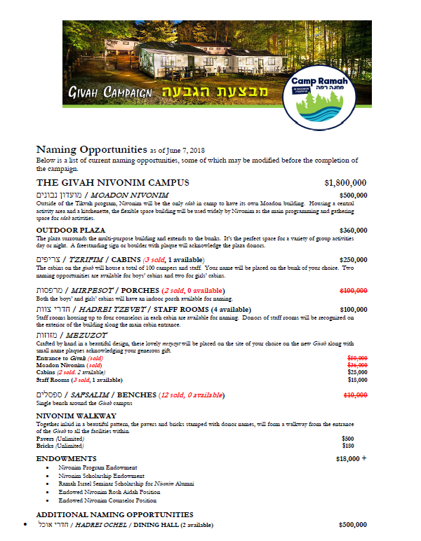
ENGAGING COMMUNITY
Planning & Launching An Endowment Campaign
Determine Communication Channels
Marketing Materials

Slide 25
ENGAGING COMMUNITY
Planning & Launching An Endowment Campaign

Slide 26
ENGAGING COMMUNITY
Planning & Launching An Endowment Campaign

Slide 27
VI. NOW IS THE TIME

Slide 28
NOW IS THE TIME
Planning & Launching An Endowment Campaign
Tel Aviv’s Hilton Hotel became the epicenter of frenzied activity this week as every public space in the building — the lobby, restaurant, seating nooks, empty halls and walkways — was used for conversations by the 600 attendees of the Jewish Funders Network’s four-day international convention, as well as dozens of people who just stopped by for meetings on the sidelines of the gathering, reports eJewishPhilanthropy’s Judah Ari Gross from the conference.
In his opening address, Andrés Spokoiny, JFN’s CEO, called for funders to “give boldly” and “dream big,” telling them that “this is the rainy day we've been saving for.”
He also recommended that Jewish funders “focus inwards,” noting that according to a recent study the majority of Jewish giving goes to secular causes. “We Jews rightfully pride ourselves on being universalists. We care about all humanity. But during this crisis, we saw that when push comes to shove, sadly, we are alone,” he said. “And that’s painful, but in a certain way, it’s liberating: The Band-Aid was pulled off, and now we know where we stand. So now is the time to live by the first part of that Hillel saying, ‘If I'm not for myself, who will be for me?’ And to be clear, every citizen of Israel, Arab or Jew, is part of us.’”
-eJP Your Daily Phil. March 19th, 2024

Slide 29
CONTACT US
Planning & Launching An Endowment Campaign
SAM CAPLAN
Chief Development Officer
scaplan@ramahwisconsin.com
JASON LITWACK
Endowment Corporation, Board Chair
jason.litwack@gmail.com

Slide 30
YOUR QUESTIONS?

Slide 31
What’s Next?
Sign up for Coaching
Endowment Policies - due to JCamp 180 on 10/31/24 through the grants portal
Final Endowment Webinar:
April 18
Building Relationships that Last a Lifetime
Tammy Dollin, Community Consultant, Life & Legacy

