Slide 1
Title

Slide 3
Agenda
Recap Scenario Planning
Present Framework for future planning
Discuss: Opportunities / Challenges / Implications
Discuss: Hot topics for Camps
What now? What next?

Slide 5
There is no data about the future… just stories
JewishTogether
Notes:
It’s tempting to predict. But even good predictions have embedded assumptions about how the world will work.
But anything you read a few months ago probably did not assume a global pandemic.
And everything you read now starts with “If we are able to do…”

Slide 6
Overview of scenarios
Maintains or improves
Exile
Manna
Economic transformation for some, fewer choices for others
Public health breakthroughs provide a path to recovery, for now
Mostly doesn’t return
Partly or mostly returns
Civic and social gathering
Financial Stability
Plagues
Tribes
Lingering struggle to survive in a highly fractured society
Small, collective risk taking to navigate an inconsistent world
Worsens
Notes:
Exile –
Already happening for those who have resources..
Extreme economic gaps widen and many people get left behind as economy improves.
Digital tech and wealth drive gaps

Slide 7
Where scenarios fit in creating strategy
Not so much in your control
External conditions / scenarios
Strategy
Capabilities and assets
Vision and values
Mostly in your control
Very much in your control

Slide 8
Rehearsing the future
Bet the farm
Start doing A
Start doing C
Stop doing D
Stop doing B
Given our vision and values,
and given our capabilities and assets,
what might we….
Start doing E
Start doing G
Stop doing H
Stop doing F

Slide 9
A portfolio of bets against the future
Bet the farm
CORE
HEDGE YOUR BETS
HEDGE YOUR BETS
MUST DO’S
Start something in a small way
Break a program into smaller steps, commitments
Partner to share the load/risk
Side bets
Side bets
HEDGE YOUR BETS
HEDGE YOUR BETS
Side bets
Notes:
Might be a partnership, might be reducing the size of an initiative for now
Some organizations might be in a better financial position than others to do more of this.
Individual org view vs. collective view

Slide 15
DRIVERS OF CHANGE | STAKEHOLDERS | CHALLENGES AND OPPORTUNITIES
Pervasive use of Online Video/Collaboration | Campers Staff Parents Donors Volunteers Partners | Enhance year-round programming, links to Israel and elsewhere Camp Office Parent, donor communication, camp tours Staff communication/some training
Fierce Competition for $ Explosion of Innovations |  | Enrollment competition from other summer and educational programs who offer new programs (e.g, blends including year-round) or slash prices From donors & funders who are hearing from many non-profits
Financial Strain/ Exacerbation of Inequity Empathy |  | Impact on enrollment, fundraising & financial aid Inequity may impact on programming and social justice profile of camp Budget management – a key
Mental Health/Development Concerns |  | Impact on campers, staff and potentially affect parents (which will affect kids) – implications for staffing, training, programming, budget.
Hygiene/distancing - still a factor |  | For reasons of public health regulation, family attitudes, may need some hygiene / distancing even if there is a vaccine/treatment
Growing diversity of views on risk and action |  | Important to remember and craft approaches for different perspectives/segments, not an average family, donor, Board member
Complexity and Uncertainty Balancing boldness and prudence |  | Ongoing adaption, monitoring and agility demands responsive governance, management, strategy and financial analysis

Slide 17
20 minutes
Discuss the Drivers of Change:
Opportunities and Challenges
&
Implications for Camp

Slide 21
20 minutes
Financial
Collaborations
Fundraising
Enrollment
Staff
Health
Any Group
Pick a Hot Topic
Change your name to that topic

Slide 23
What now? What next?

Slide 24
External conditions / scenarios
Strategy
Capabilities and assets
Vision and values

Slide 25
What now? What next?
Possible Scenarios
Most Likely
Other /“just in case”
Drivers of Change /Trends
Opportunities / Challenges
Implications
State assumptions
External conditions / scenarios
Strategy
Capabilities and assets
Vision and values

Slide 26
What now? What next?
External conditions / scenarios
Mission, Vision, Values
What is our business?
Measure Impact?
Strategy
Capabilities and assets
Vision and values

Slide 27
What now? What next?
External conditions / scenarios
Key Camp Functions
Finance / Cash Flow
Site and Facilities
Staff
Enrollment
Health and Safety
Etc.
Strategy
Capabilities and assets
Vision and values

Slide 28
What now? What next?
Strategy
Strategic priorities
Main bet / side bets
Monitor & Evaluate
Be Agile and Adapt over time
Be kind
External conditions / scenarios
Strategy
Capabilities and assets
Vision and values

Slide 29
Why?

Slide 30
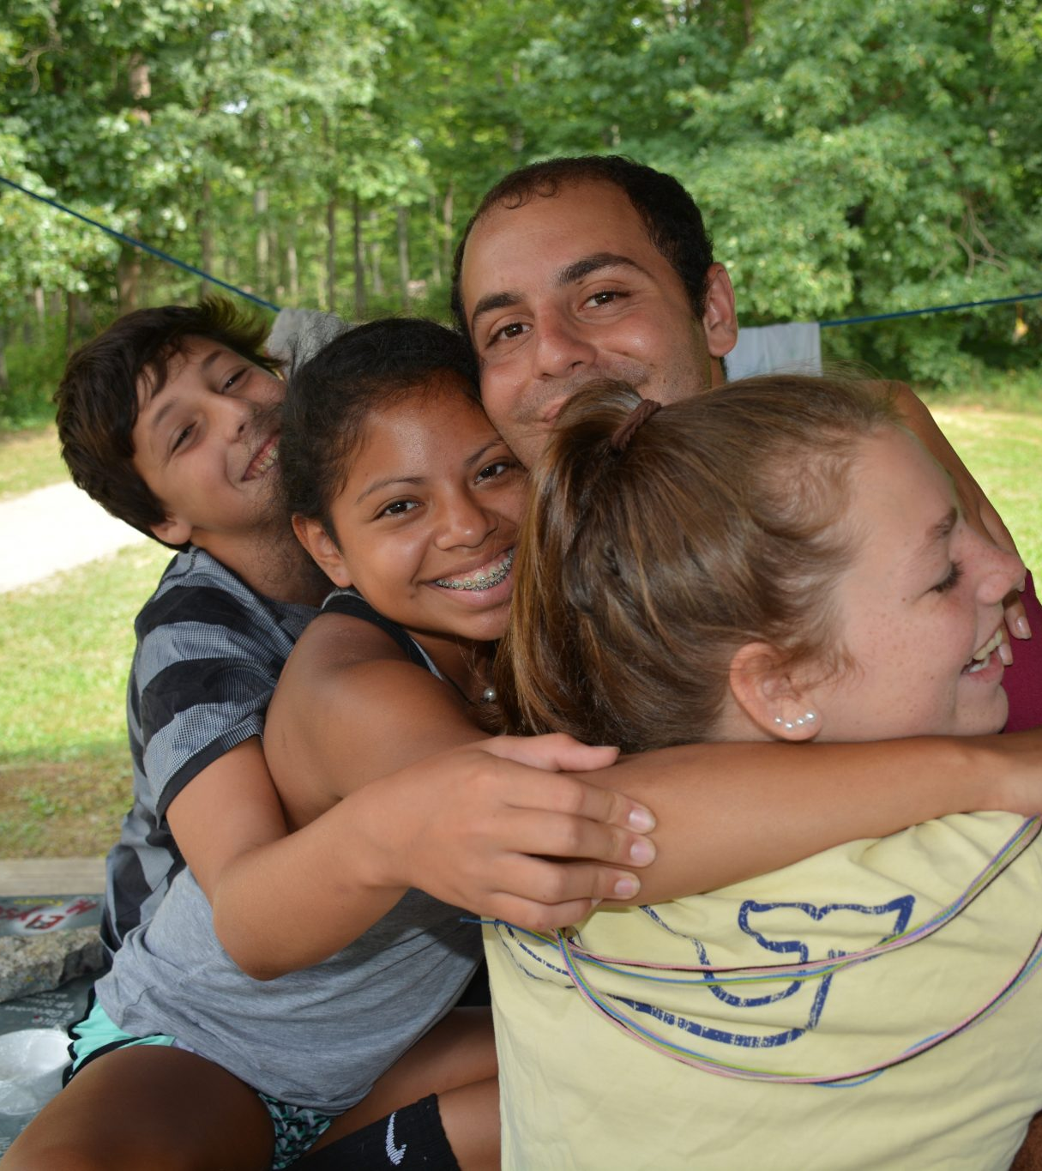

Slide 31
What should our Board and Senior Staff prioritize
over the next 24 months?
This program runs July 1 – August 5 will provide camps with a supported process to think about a course correction on their existing strategic plan given the COVID crisis and the closure of the 2020 season.
This program has two group meetings, customized coaching, and optional weekly drop-in sessions to help you and your Board with adaptive planning.
The Path Forward for Jewish Camps
Adaptive Planning Cohort
Registration open
www.jcamp180.org/adapt

Slide 32
October 18 – 20, 2020 Hold the date. Invite your Board.
Title Box

Slide 33
Title

