Slide 1
BB Camp
VIRTUAL CAMPFIRE & HAVDALAH
BB Camp Donor Update
April 13, 2020 – 4 pm

Slide 3
National & Local Resources
“Ayeka? Where are you?” The response is “Hineni – I am here.”
Centers for Disease Control and Prevention (CDC)
Oregon Health Authority (OHA)
American Camp Association (ACA)
Jewish Federation of North America (JFNA)
Jewish Community Centers Association (JCCA)
Foundation for Jewish Camp (FJC)
Harold Grinspoon Foundation JCamp 180 Program (HGF)
Jewish Federation of Greater Portland (JFGP)
State vs National/ Independent vs Movement

Slide 4
Funding Opportunities
Jewish Federation of Greater Portland (JFGP) Emergency Relief Grant Award ($13,500)
SBA PPP Loan/ Forgiveness
Redwoods Insurance Claim
Fundraising - donor pledge collections
Harold Grinspoon Foundation JCamp 180 Matching Grant, All Together Now
Foundation Jewish Camp Capital Campaign Loan and Northside Cabin Construction

Slide 5
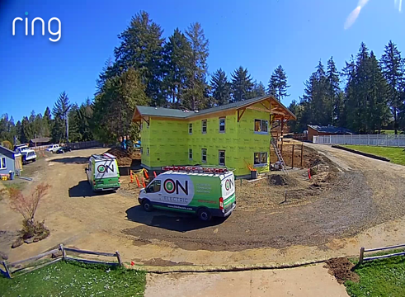
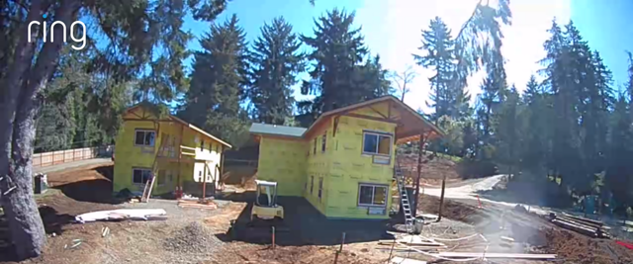
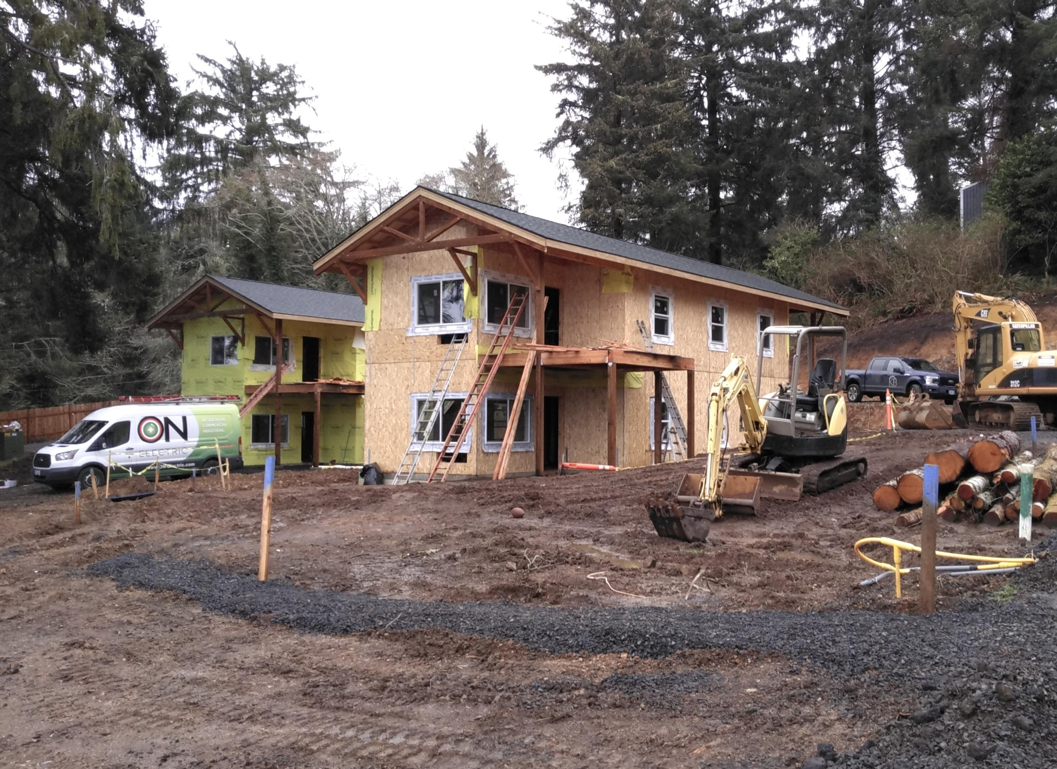
North Cabin Construction

Slide 6
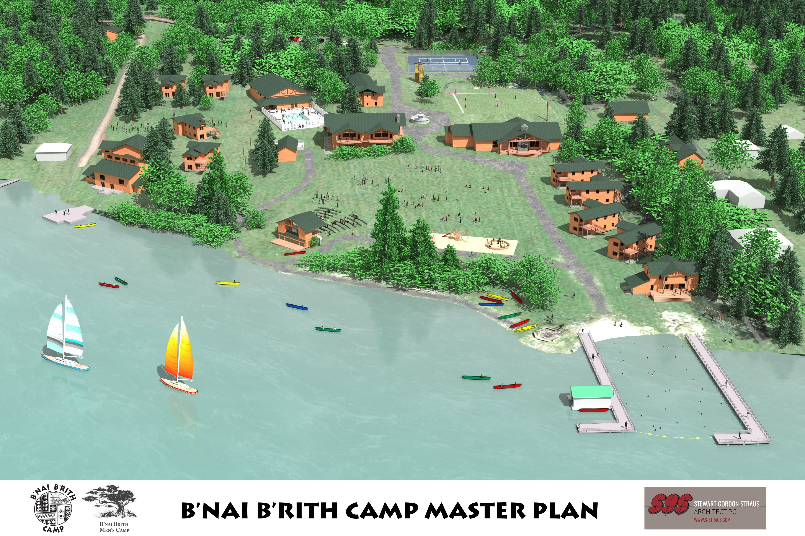

Slide 7
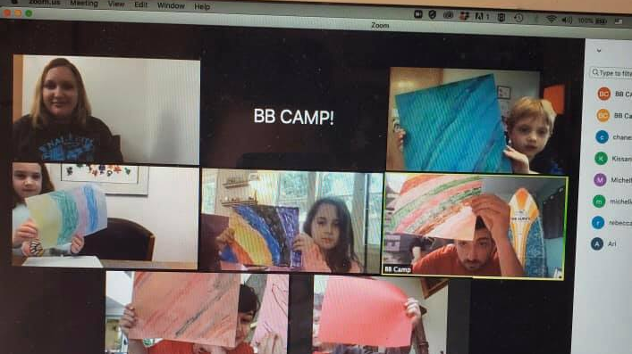
Virtual Youth Events

Slide 8
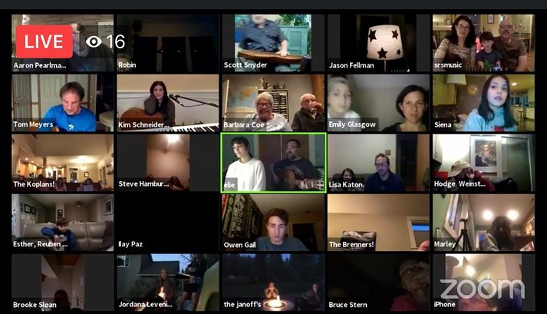
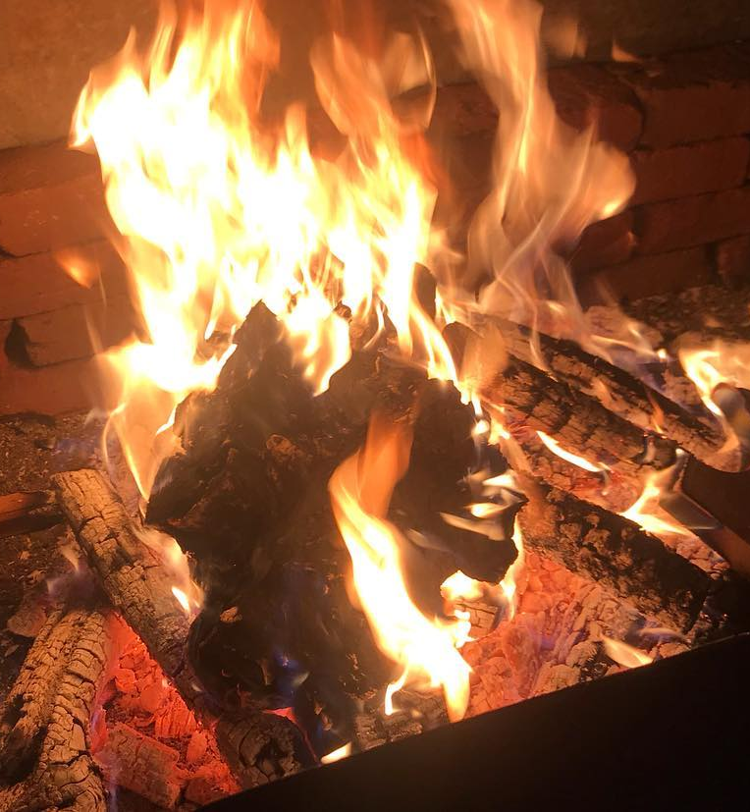
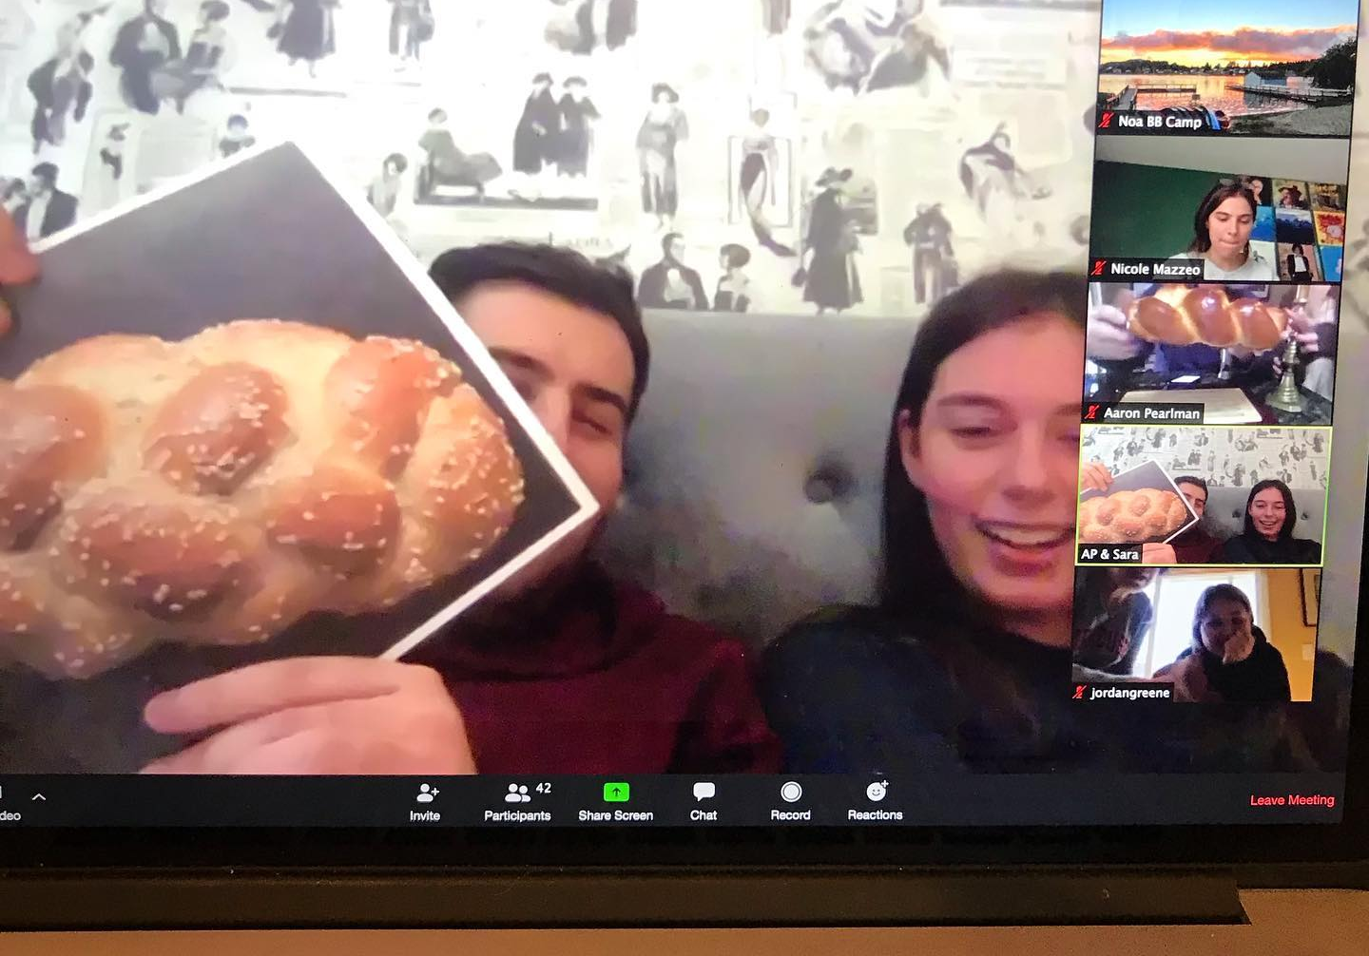
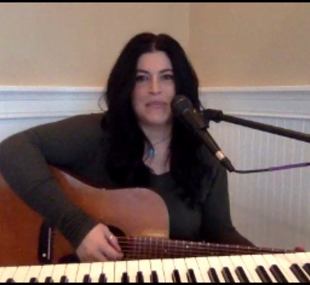
Family & Community Events

Slide 9
Summer Camps 2020 We Can’t Wait to See You Again
Things We Are Thinking About in Detail
Preparation and Plans
Communications to Families
Medical and Wellness Center Protocols
International Staffing/ Domestic Staffing
Visitors on Camp
Overnight/ Day Trips
Innovative Programming

