Slide 1



Slide 2

Thank, Engage, and Delight Camp Supporters this Summer – While Keeping Camp Safe!
April 28, 2021
Dan Kirsch
Mentor, JCamp 180
dan@hgf.org

Slide 3


Slide 4
AGENDA
Title Box
Donor Feels
Why Stewardship This Summer
Assumptions
Guest – Rabbi Isaac Saposnik, Camp Havaya
Lessons & Considerations
Simple Plan, Tips & Tools
Share - Give & Take. . . or Modify
Farewell

Slide 5
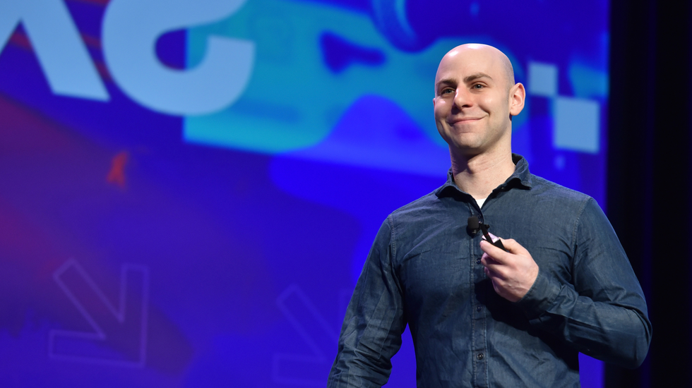

“The most meaningful way to succeed is to help others succeed.”
- Adam Grant

Slide 6
ASSUMPTIONS
Title Box
Stewardship Matters
Different This Summer
Outside Comfort Zone?
Donors = Curious
Also Donors = Understanding
Camp's Unique Advantages
Your Mileage May Vary

Slide 7
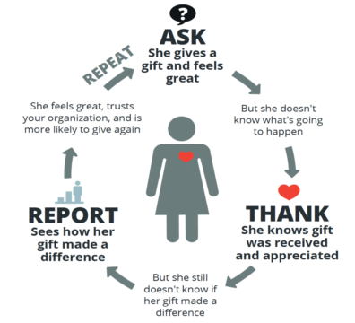

Slide 8
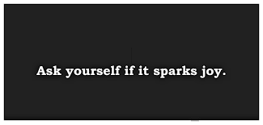

Slide 9
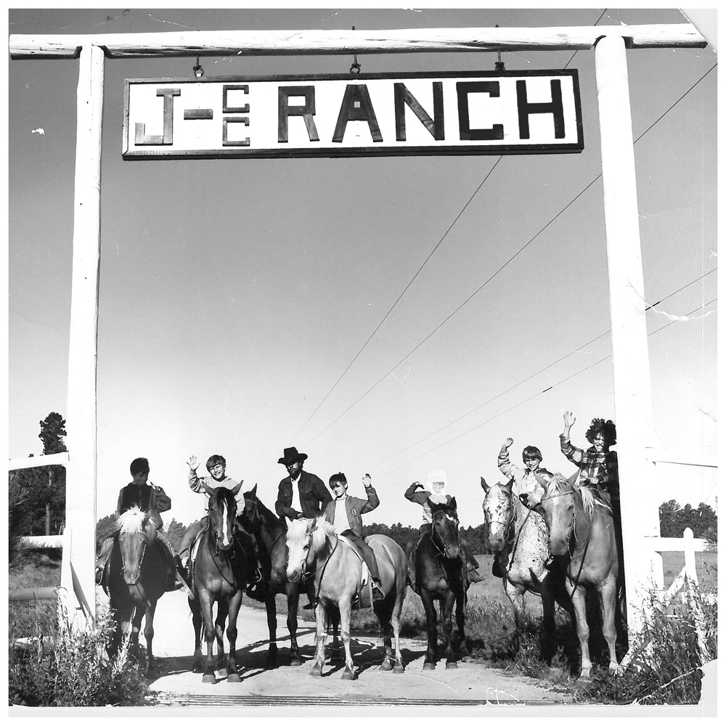

Slide 10
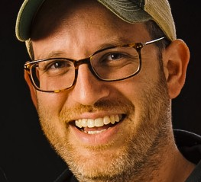

Rabbi Isaac Saposnik
Executive Director
Camp Havaya

Slide 11


Slide 12
CONSIDERATIONS
Title Box
Time & Timing
Technology
Team/Talent
Target Audiences
Camp Culture
Plan – including budget
Opportunity Costs
Others?

Slide 13
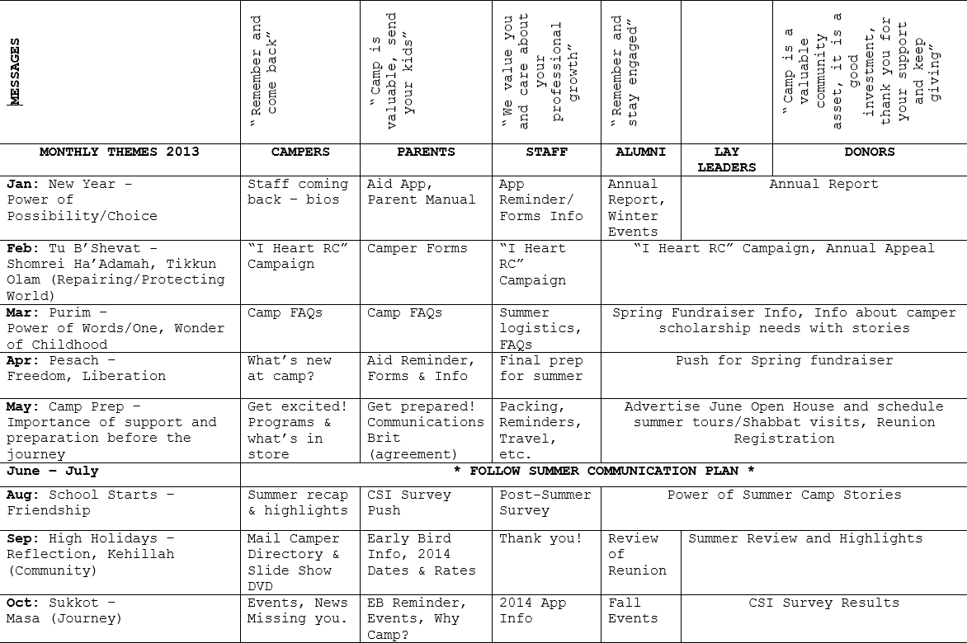
Year-Round Communications Calendar

Slide 14
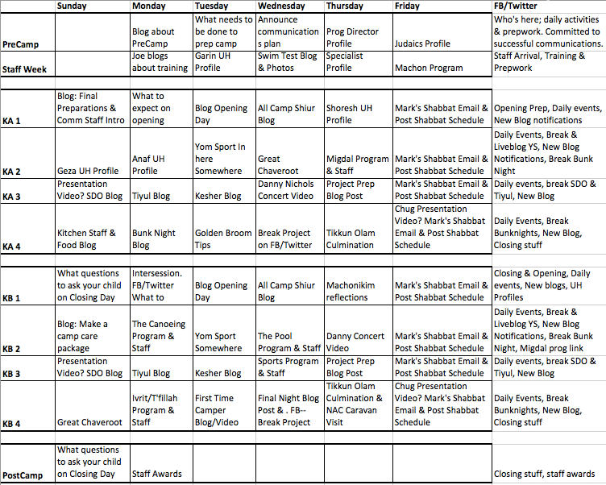
Summer Communications Calendar

Slide 15
Year-Round Communications Calendar

Slide 16
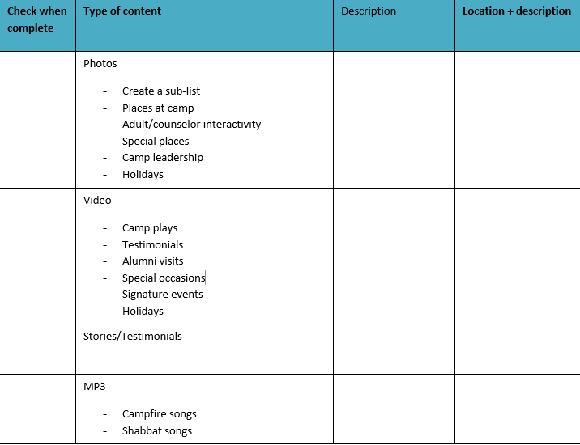
Summer Media Checklist

Slide 18


Slide 19

Summer of Opportunity + Discomfort
Report = Sparking Joy
Think Synch – LIVE from Camp Its. . .
Think Asynch – Year-Round from Camp
Plan, Plan, Plan
Fewer Better vs More Meh

Slide 20


Slide 21

What’s Next?
Have a great summer!

Slide 22
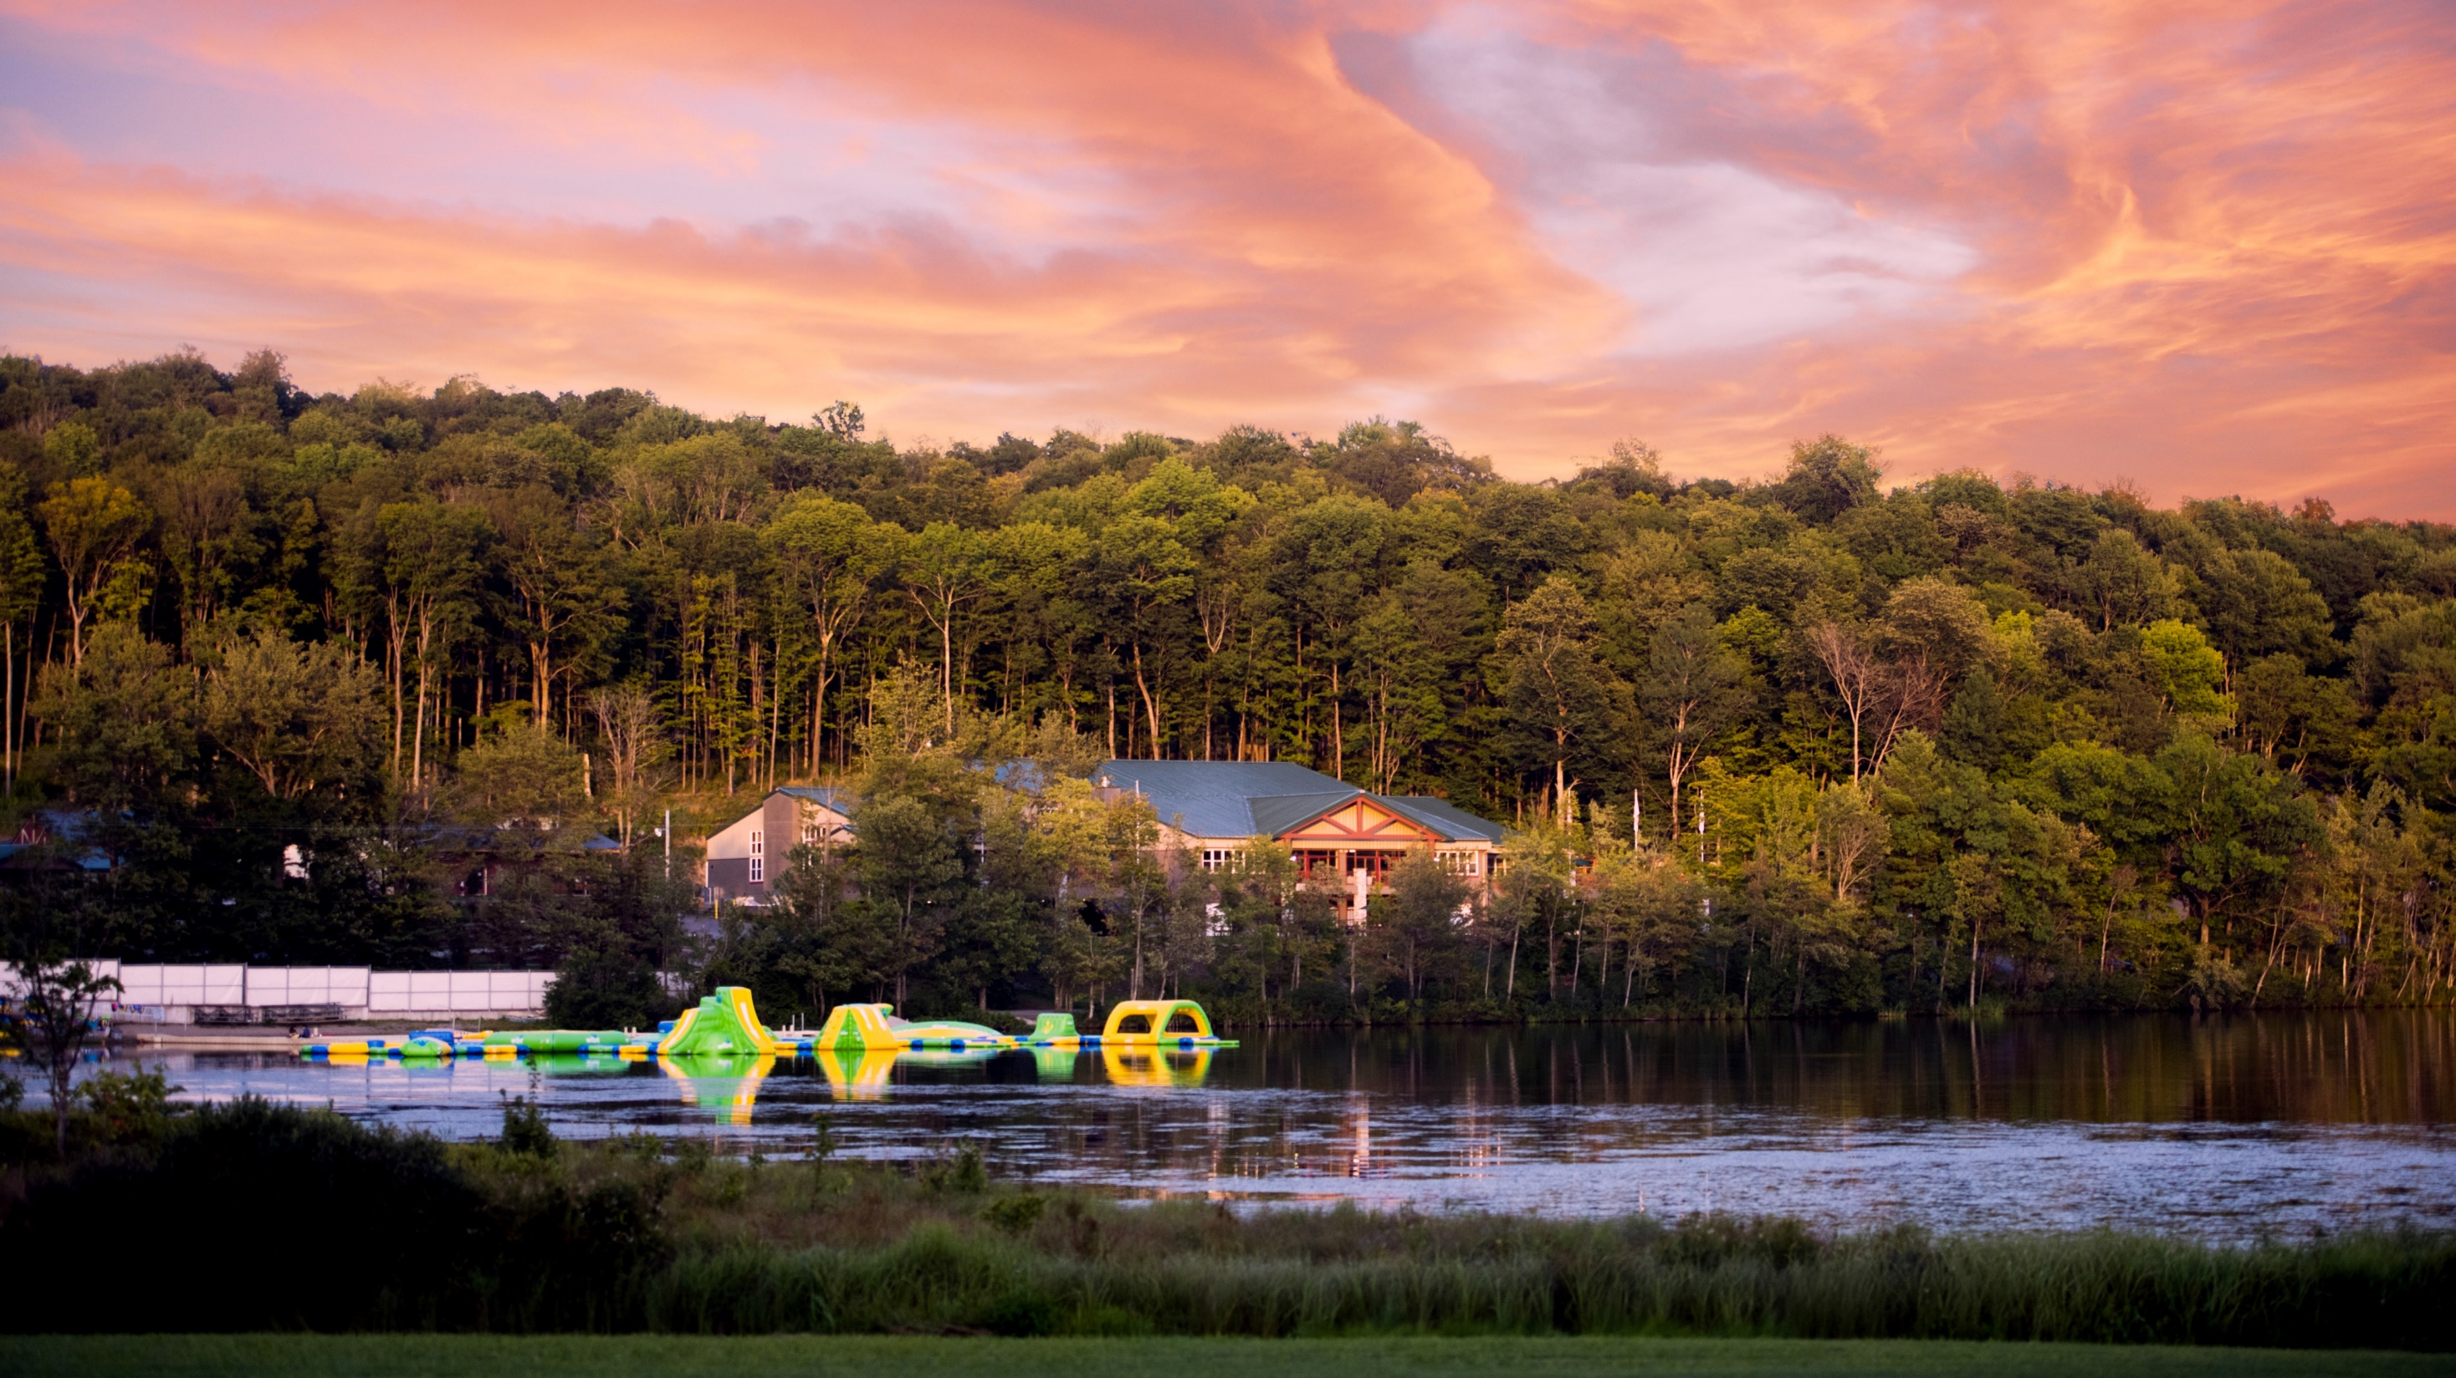
Thank you!

