Slide 1
Crossing Channels &
Landing Pages
4 Steps to Generate More Giving Online … and Off
September 27, 2011
Dan Kirsch Kevin Martone
Mentor Technology Program Manager
dan@hgf.org kevin@hgf.org
Grinspoon Institute for Jewish Philanthropy

Slide 2
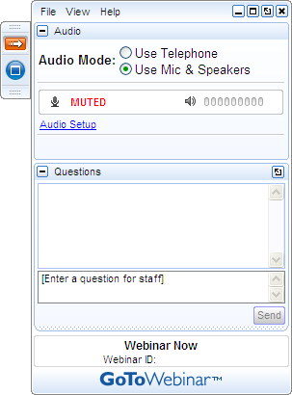
Get Involved
A) Grab Tab – Click red arrow to open/close Control Panel. Click square to toggle Viewer Window between full screen/window mode. Click mic icon to mute/unmute your audio.
B) Audio Pane – Select audio format. Click Audio Setup to verify Speakers & Microphone.
C) Questions Pane – Attendees can submit questions and review answers.
D) Type your question and click Send to submit it to the organizer.
A →
B →
C →
D →

Slide 3

Notes:
Why are we here?
What do we hope to accomplish?
Online giving Matters
What our camps told us

Slide 4
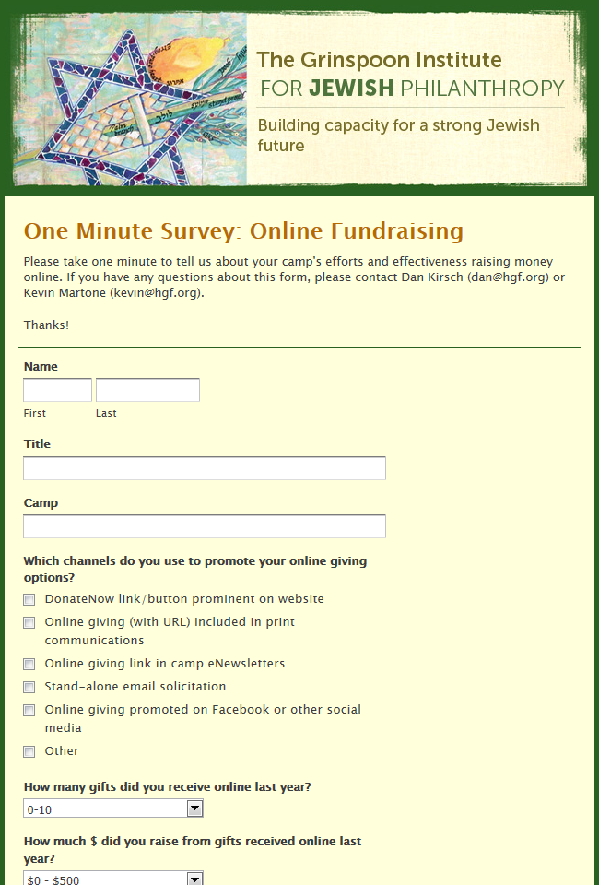
July 2011 GIJP Survey of Development Pros
I think there is MUCH more potential here . . . It is so easy to click and donate.
Our donors are used to mailing in their checks. Some are giving online like the younger ones.
I think we could simplify the donation-collecting section of our website.

Slide 5
July 2011 GIJP Survey of Development Pros
Number of Online Gifts Last Year
0 – 10 51+
Number Of Dollars Contributed Online
0 - $500 $10,000+

Slide 6
What the world is telling us - HEADLINES
Two-Thirds of Donors Plan to Cut Back on Giving This Fall
A Sharp Donation Drop at Big Charities
Most Charities Still Do Not Raise Much Money Via Social Media
Web-Savvy Supporters Help Make Online Giving an Expanding Bright Spot
Charities’ Fund Raising Barely Keeping Up with Lost Donations
Online Giving: Donors Are Younger, More Generous, and in a Hurry to Help

Slide 7
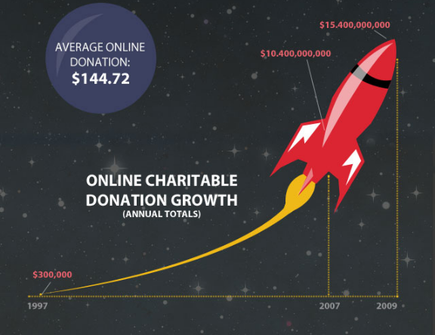
Notes:
Courtesy of Blackbaud
Online is the fastest growing channel for nonprofits.
Average online gift has grown from $67 in 2008 to $92 in 2010.
Every usable email address is worth $12.78 in online Giving

Slide 8
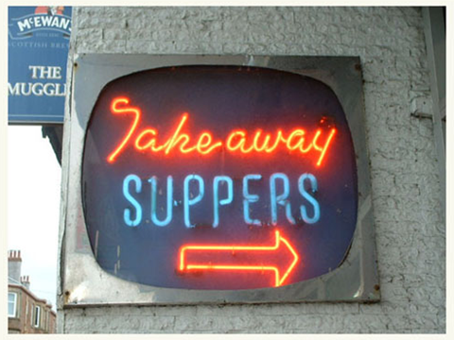
Key Takeaways
Why online giving matters
What factors affect online giving
Connections between influences on online giving and other giving – e.g. donor centricity, focus on story, using high tech for high touch, engagement.
Develop and leverage great content – messaging, stories, themes, & images – without having to re-create the wheel
Understand how different communications channels can support one another.
Ideas for things you can DO NOW to drive more traffic to your online giving site and improve the online giving experience for your donors when they land there.

Slide 9
Online….
and Off
More Giving
to Generate
4 Steps

Slide 10

Notes:
Driving Traffic to Your Site
http://photocarsonline.com/blog/2008/12/12/the-worlds-20-cities-with-the-worst-traffic-jams/

Slide 11
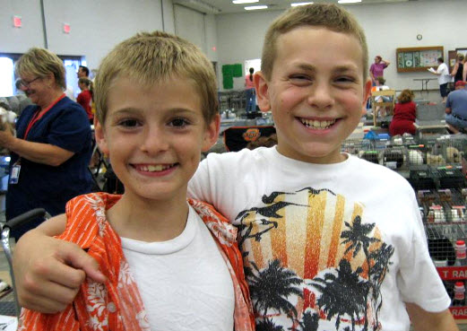
Notes:
Relationship Building

Slide 12
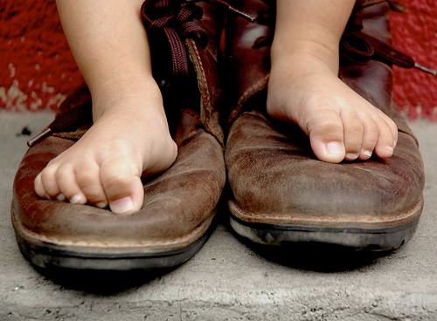
#1 – Be Donor Centric
Put Yourself in Your Donor’s Shoes
Notes:
http://www.flickr.com/photos/jeerujiah/3598303822/

Slide 13
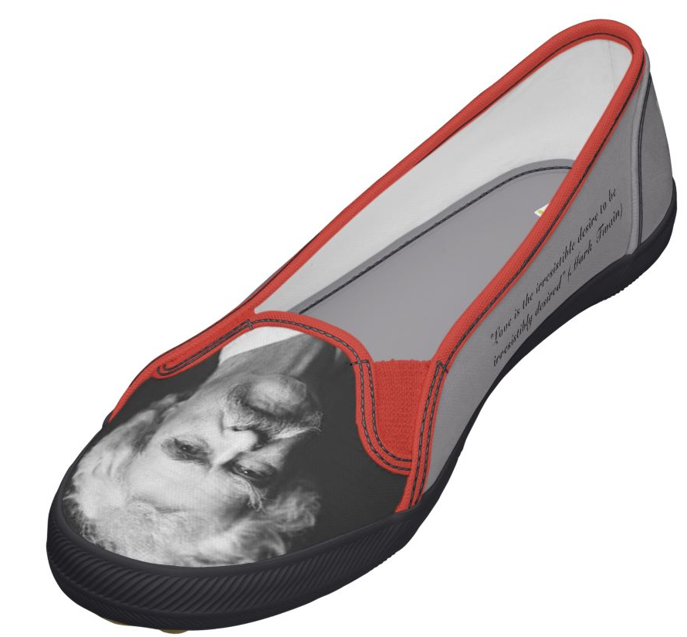
It ain't so much what we know that gets us into trouble. It's what we know that just ain't so.
- Mark Twain

Slide 14

Invite Feedback
=
Engage Donors
Appeal Letters
E-Newsletter
Website
E-mail
Social Media
Thank Yous
http://www.flickr.com/photos/karlrobin/4343097207/
Notes:
Ask donors to review your communicaitons

Slide 15
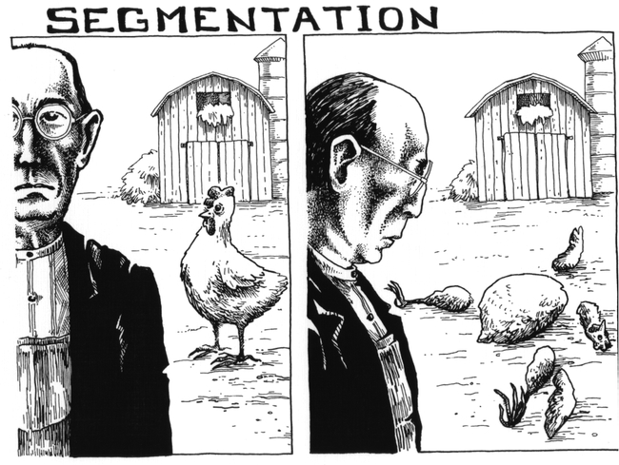
Make it Personal
Notes:
http://cognitrn.psych.indiana.edu/rgoldsto/projects/segmentation.html

Slide 16
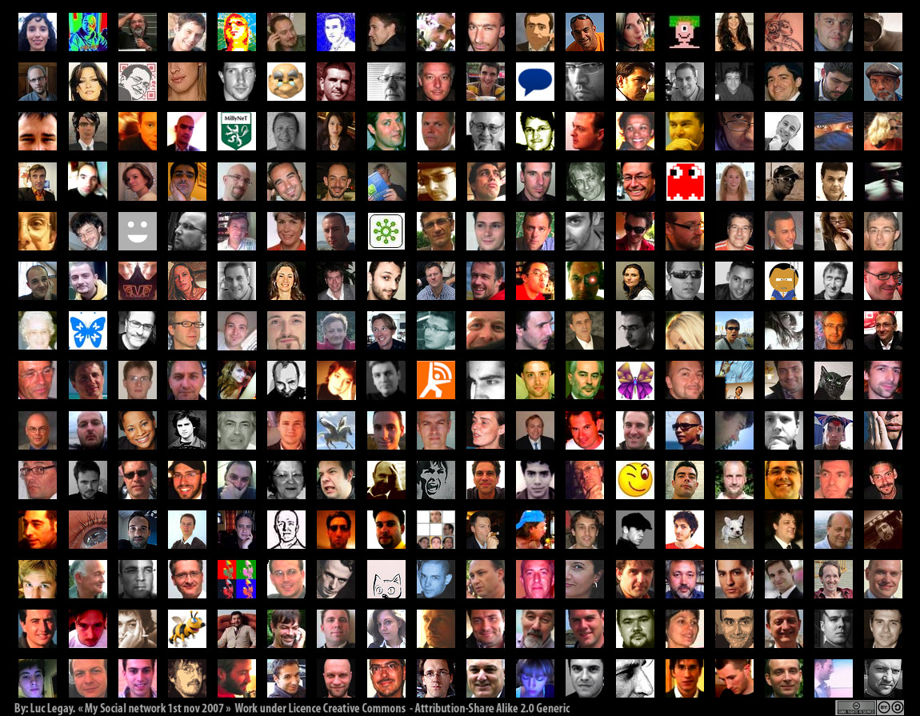
http://www.flickr.com/photos/luc/1824234195/

Slide 17
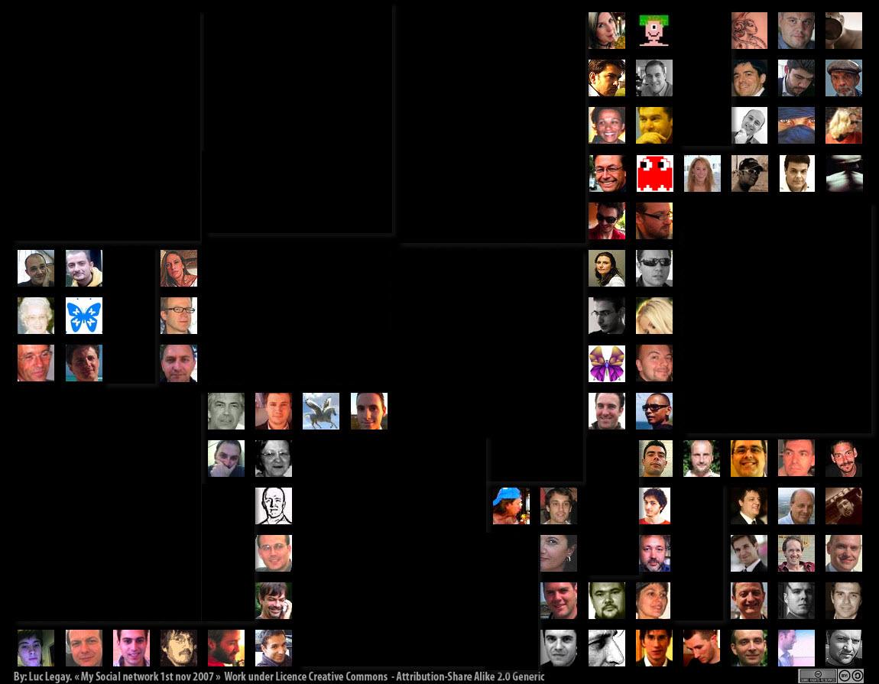
Possible Segmentations
Donor/Non-Donor
LYBUNT
“Major” Donor/Prospect
Alumni
Parent/Grandparent
Legacy Society Members
Reunion Attendees
Camp “Couples”

Slide 19

Love Your Data

Slide 20

Read your communications as if you were a donor. Do a “you” test on your appeals and other messaging.
Better yet, get donors/prospects engaged by reading draft communications and providing candid feedback.
Test your segmenting power. Can you create a list of lapsed donors? Donors who have given more than $5000 total? Alumni vs. Parents vs. Grandparents?
Run a LYBUNT report and send a targeted solicitation for renewed gifts this year.
Commit to data management practices to use better segmenting for more productive fundraising.

Slide 21

# 2 – Use Stories

Slide 22
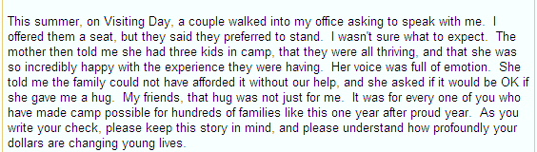
A Simple, Powerful Story

Slide 23
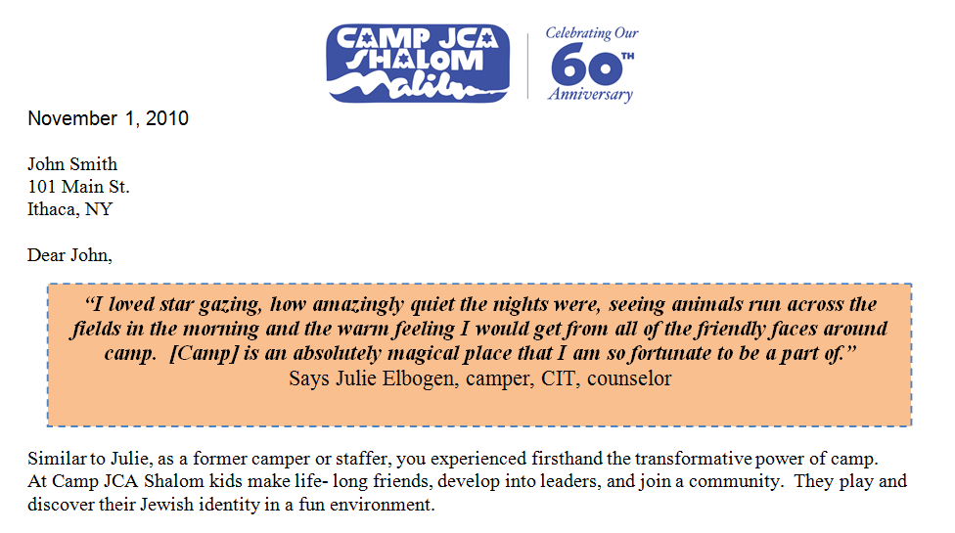
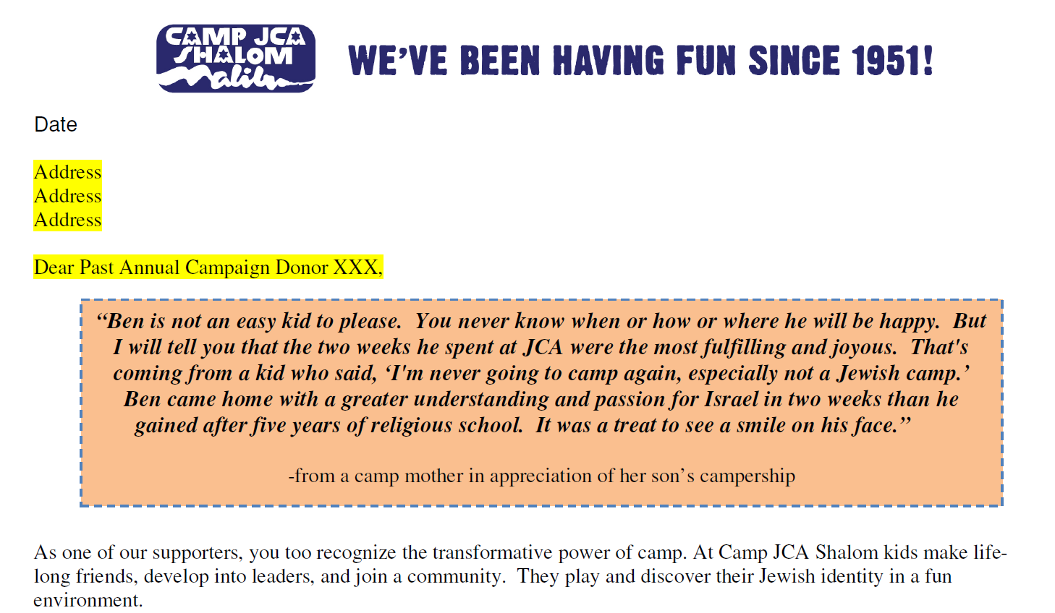

Slide 24
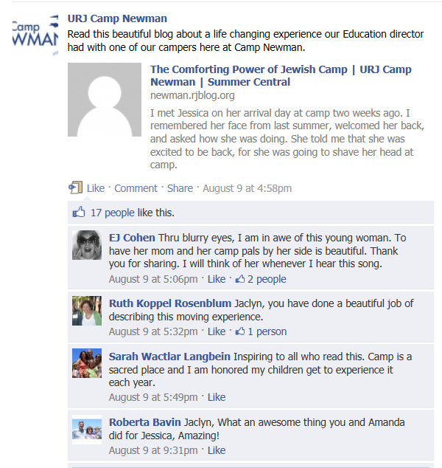

Slide 25
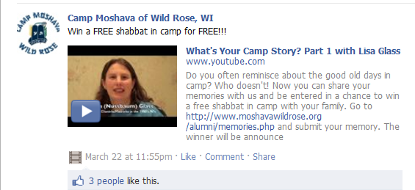
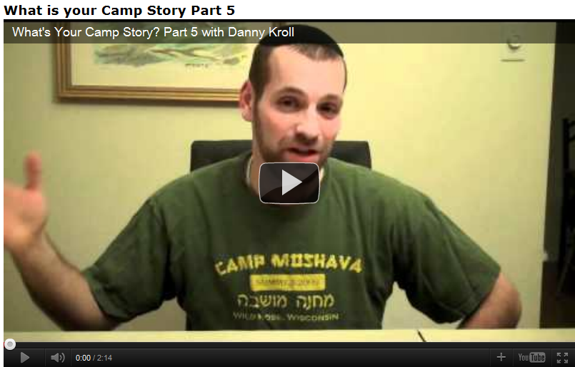

Slide 26
Gather Great Camp Stories from Your Fans – campers, staff, parents, alumni, donors
Begin documenting these stories in a central location.
Use Video. Grab one of your most loyal and approachable donors, take out your smart phone or digital camera and ask them to talk about why they began giving.
Create a Plan to share these stories over all of your various communications channels.

Slide 27

# 3 – Integrate Your Communications Across Multiple Channels

Slide 28
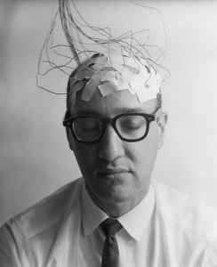
…Humans come pre-wired to be multichannel. The key for nonprofits is to focus on the experience a donor has when they switch channels. Is it easy? Is it consistent? Is it personal? Or is it fragmented and clumsy? Successful organizations make channel flipping effortless and effective.
Steve McLaughlin, Blackbaud Internet Solutions
Notes:
http://www.coetail.asia/neilcommons/category/learning/

Slide 29

We use email and social media to support print/mail solicitations and campaigns - so they work in tandem. So when we are getting ready to close a campaign, we do a reminder via email. This generally produces a lot of online gifts but also a mini-surge in snail-mail contributions too.
Holly Guncheon
Herzl Camp

Slide 30

When we sent a direct mail piece first, then the following email had a better than average response rate. A video embedded gets a slightly better look.
Dena Kaufman

Slide 31
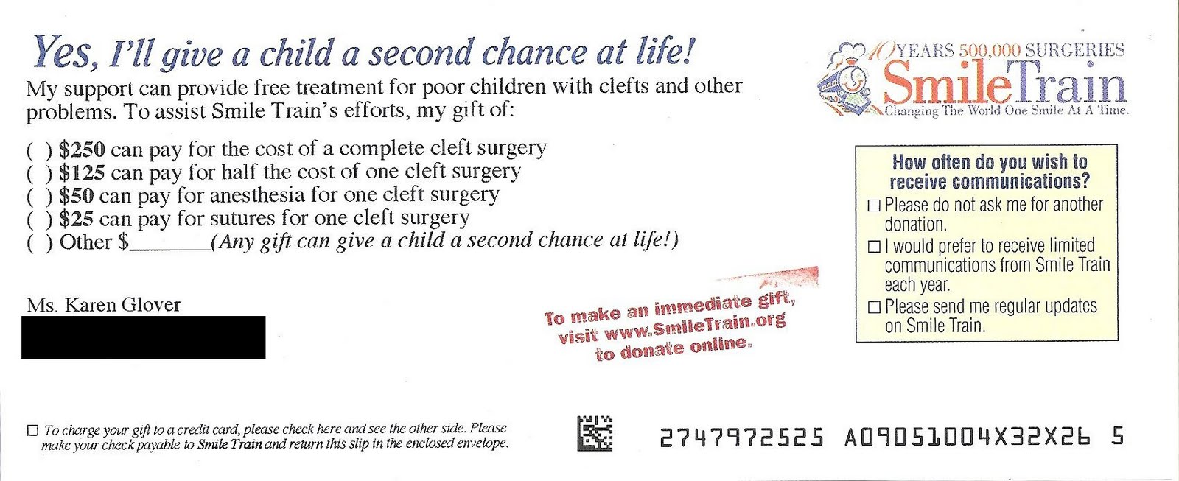
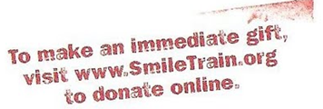
Direct Mail Reply with Online Giving Option

Slide 32
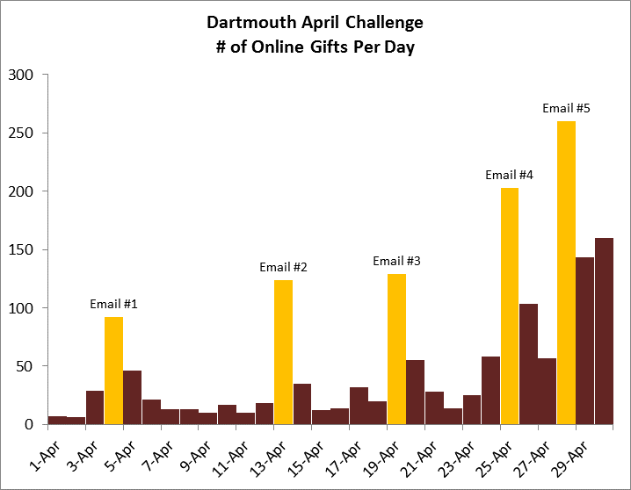
Notes:
1 Month = 6,000 Donors = 17% of Those Solicited. Really?
By Kathy Howrigan, Senior Analyst & Associate Consultant
August 11, 2011 Really. In a recent #fundchat Twitter chat, the topic of multi-channel marketing came up. I mentioned that when I was at Dartmouth College, we did a “challenge” integrating messages from direct mail, phonathon, e-mails, volunteer managers, and anyone else who would talk about it. It was hugely successful, totally exceeding our expectations, so Dan Blakemore asked me to elaborate a little bit — hence my first guest blog post. (We are republishing the blog here in case you missed it at danblakemore.org.)
Sylvia Racca, Executive Director of the Dartmouth College Fund, and I designed the challenge (but it was her idea). I debated sharing the theme and messaging we used for the challenge in this blog post, but as I worked through it, I realized it would be way too long. Anyone who is interested should feel free to contact me for more information.
——————————————
The goal: The Dartmouth College Fund’s participation goal for fiscal year 2006 was 50 percent. In February, we realized that we were behind the curve to hit 50%, especially in bringing lapsed donors back on board. To reach this milestone, the Fund needed to increase the number of lapsed donors significantly in the months of April, May and June over previous years. To help achieve our goal, we created “The April Challenge.” More specifically, our goal was to get 4,000 alumni to give in the month of April (note that the record at the time for April donors was less than 2,400).
——————————————
The strategy: A “challenge.” Find some leadership donors who would offer to give X dollars per Y donors – no matter the size of the gift.
——————————————
The plan: Four alumni challenged the Dartmouth College Fund to bring in gifts from 4,000 donors in April. At each 1,000 donor benchmark, each donor would give the Fund $25,000 (up to $100,000 each).
Because we were concerned that the challenge would only cause regular donors to give earlier in the year – in April and not June (which would get us to our challenge goal but not to 50 percent), we wanted to develop a segmentation strategy for lapsed donors. We knew we needed to do well in these categories. We set goals by solicitation strategy (direct mail, phonathon and volunteer solicitation) and by giving segment (last year donors, one year lapsed, two year lapsed, three year lapsed, four year lapsed, five year plus lapsed and never givers), and used these goals to develop the marketing plan. These goals were applied specifically to each channel as well, and closely monitored all month.
The marketing plan included a direct mail piece sent to 33,424 non-donors, inserts for pledge reminders distributed during April, customized scripts for the student phonathon callers, five e-mail solicitations directing non-donors to our website to make an online gift, and communication with our volunteers. A special webpage, which included a “thermometer” tracking progress towards the challenge goal, was created and promoted through the e-mails, student callers, and on the main webpage.
——————————————
The results: The April Challenge final cash donor count for April 2006 was 6,031 donors. The previous record for the month of April was 2,379 donors.
In the end, we did well in all segments, including LYBUNTs, but it was recapturing lapsed donors that pushed us over the top.
1,199 alumni made a gift for the first time in several years and 370 were first-time donors.
The student phonathon brought in a total of 2,058 donors, 121 percent of our goal.
Volunteer teams and direct mail donors equaled 3,973, 192 percent of our goal.
The DCF online giving site saw tremendous activity during the month of April. The number of online gifts increased with each e-mail solicitation sent. The first e-mail solicitation sent on April 4 resulted in 92 gifts in one day, while the last e-mail sent on Friday, April 28 resulted in a total of 555 gifts from Friday – Sunday.
Including the challengers, the April Challenge raised more than 3.8 million dollars.
The Dartmouth College Fund achieved its ultimate goal of 50 percent participation with a final result of 50.8 percent alumni participation. The success of the April Challenge enabled us to reach this milestone.
——————————————
Most surprising finding: I was most surprised by the e-mail responses — keep in mind that we were e-mailing the SAME PEOPLE! So the 260 donors on April 28th were replying to their FIFTH e-mail solicitation.
——————————————
Why I think The April Challenge was successful:
It was metric-driven, with desired metrics informing the strategies.
Clear and consistent messaging across all channels.
The use of all channels – one direct mail piece and two e-mails would not have been enough.
We provided feedback via callers, volunteers and in e-mails on a regular basis.
There was a clear deadline.
Notice that I didn’t list the challenge funds as one of the factors that made the challenge successful. While this is obviously critical for any challenge, finding donor/s willing to make a significant gift is not enough. The key is to be thoughtful, strategic, integrated and purposeful in how to use that generous contribution.

Slide 33
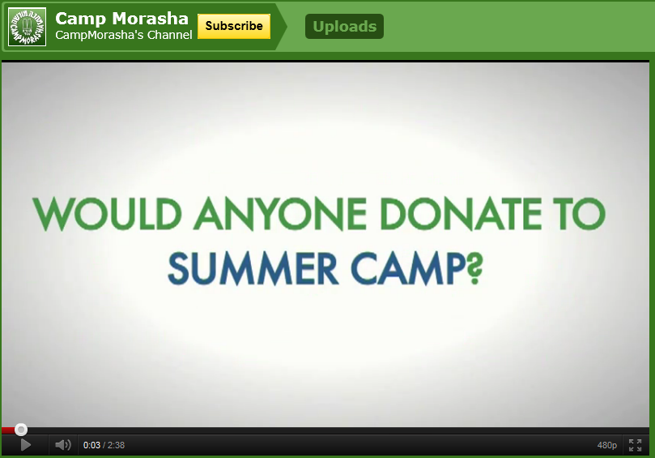

Slide 34

Optimize Your Website for Online Giving
Big, prominent DonateNow Button on every page
Button clicks directly to online donation form
Test your auto-thank you (online and via email) – Is it warm? Helpful?
*See Resources for More Tips

Slide 35
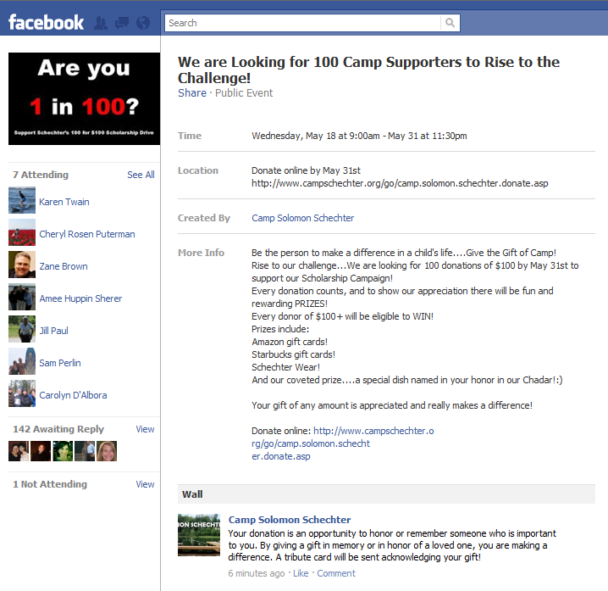
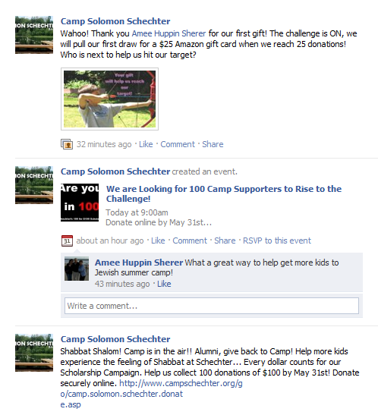
Drive to Online Giving

Slide 36
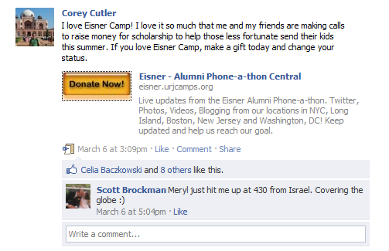
Allow Others to Share Your Message

Slide 37
Double-Check Your Appeal Letters, Reply Forms and Envelopes. Do you make it easy to find the URL for online giving?
Check your e-mail appeals and online donation form. Do you provide a snail mail address? Someone to call?
Test to see if your communications across all channels convey consistent theme, look and “feel”.
Start a Plan that integrates communications over all channels throughout the year.

Slide 38
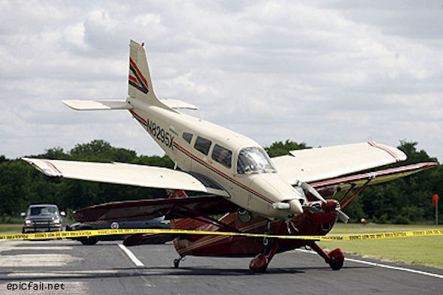
# 4 Test & Improve Your Landing Page

Slide 39
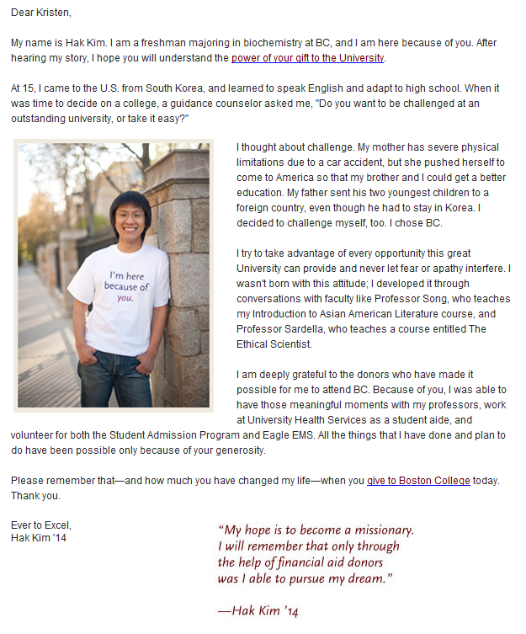
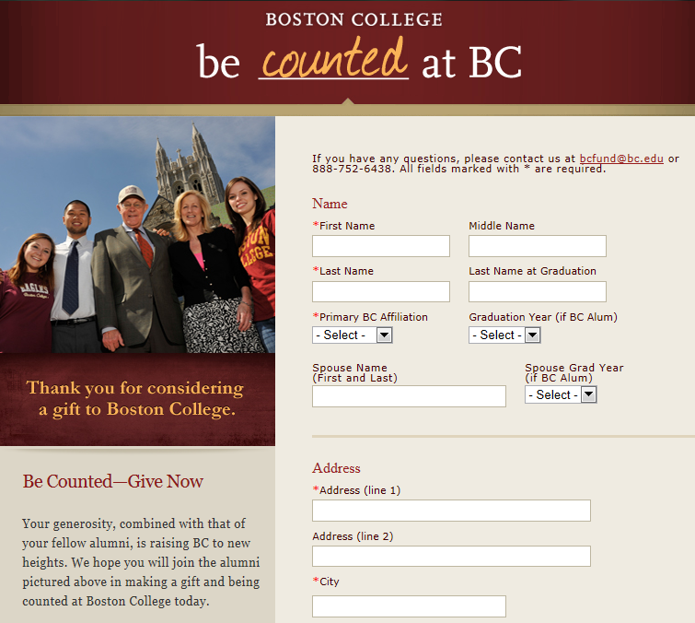
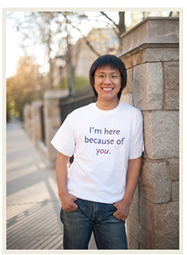
Connect Appeal to Landing Page
Thank You!

Slide 40
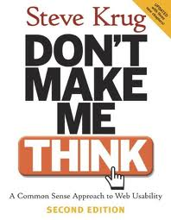

Slide 41
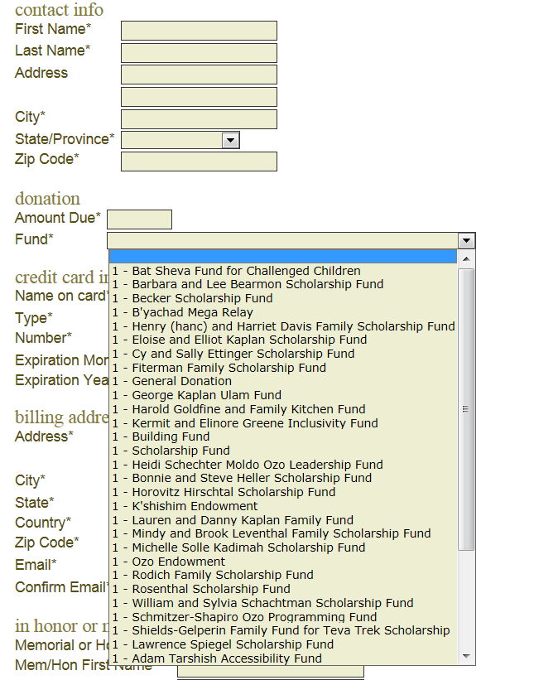

Slide 42

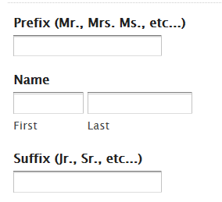
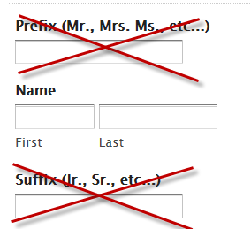
Just a Couple of Fields…
30% increase in the conversion rate (30% more people actually gave when they reached the donation page!)
Source: NTEN Blog

Slide 43
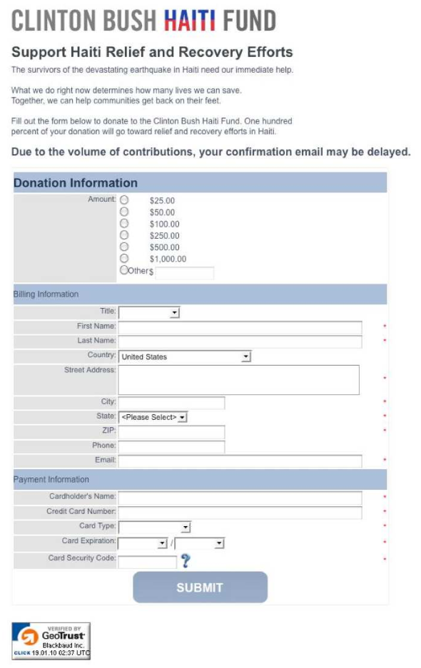

Slide 44
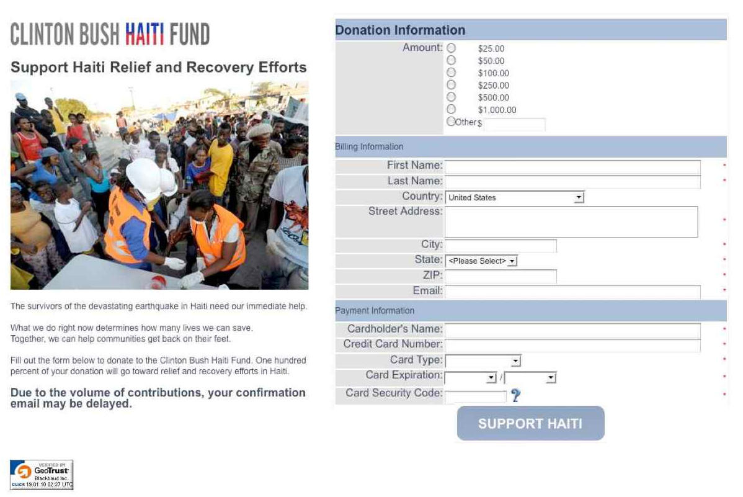
+ $1 Million

Slide 45
Perform the 3 Second Test.
Ask people to test your donation page and giving form . Watch silently as they navigate. Ask for blunt feedback on the experience.
Check your donation form - are there extraneous fields? Do you have brief engaging content and stories that connect to your other campaign communications?
Track stats on number of donation page visitors who don’t “convert” to donors?

Slide 46
Wrap Up, Resources, Q & A. . .
Key Lessons
  It’s all about Your Donors not Your Needs. Speak to their Needs, Wants, Expectations.
  How Will You Know? Ask them = “ENGAGE”
  Be Campy – Use Camp Focused Stories Across Channels
  Test the Process & Tools: Is it easy? Is it consistent? Is it personal? Or is it fragmented and clumsy?
  Love Your Data
Resource List will be available (along with this presentation) on the Webinar Archive Page: www.gijp.org/webinars.
Questions?

Slide 47

Has social media fundraising finally arrived?
Not…completely.
But SOCIAL has arrived.
ONLINE GIVING has arrived.
And the key to all successful online fundraising…
is ENGAGEMENT
http://www.flickr.com/photos/51352360@N00/4327438430/
Notes:
http://www.flickr.com/photos/51352360@N00/4327438430/

