Slide 1
Pricing and Discounting
Presentation by Lucie Lapovsky
March 2, 2021

Slide 2
Pricing and Discounting – Camps, Colleges, K-12
What are the goals?
What do pricing vs discounting strategies accomplish?
What is the situation in each sector?
What are the tools that they each have?

Slide 3
Goals when Establishing Pricing and Discounting Strategies
To enroll the desired number of campers - reach capacity
To enroll the desired mix of campers
Geography
Diversity
Gender
Sessions
Overnight/Day
To maximize net revenue

Slide 4
Considerations for Pricing Decisions vs. Discounting
Tuition/Published Price is usually quite visible vs. discounted price
Market Competition – competitor institutions
Value Add/ROI
Elasticity of Demand
Ability to pay
Willingness to pay
15

Slide 5
Pricing
Impacts who looks at your camp
Too high a price can discourage people from looking at you
Too low a price may raise quality concerns
Appropriate pricing can increase the number of inquiries

Slide 6
Tuition/Pricing Strategies
Annual Decision
Raise price
Significant increase
Most common – moderate annual increases
Freeze price
Multi-year price guarantee
Lower price/price reset
Differential prices by program, session, age, etc.
Price matches with other camps/programs
Relationship between day and boarding price
16

Slide 7
Camper Demand and Price Discrimination
Price
Published
Price
D
full-pay campers
total campers
Enrollment
Discounted campers
Notes:
Suppliers that price discriminate charge each consumer a price as close as possible to individual willingness to pay.
The distance between the full price and the net price is the price discount or grant amount.
The distance between the quantity of full pay students and the quantity of all students is the number of students receiving grant aid.
Think of each point along the demand curve as corresponding to one student, each able and willing to pay a different price to enroll. The institution gives a different institutional grant to each student - larger grants to those who are farther down the demand curve, able and willing to pay lower prices on their own. They keep moving down the demand curve until it doesn't pay to enroll any more students because they don't even pay enough to cover the marginal cost of the extra student on campus. In the real world, students come with some external grant if they are penniless, so there may or may not be a lower limit, depending on excess capacity.
Institutional aid increases the pool of people who can afford to come to your institution, because more of them can afford to enroll at the reduced net price.
However, in most cases, institutional aid does not result in an overall shift in the demand curve for higher education. If all those students enrolled with lower net prices, then the institutions get more revenue. Total revenue is the area under the demand curve up to the last enrolled student. Without the aid, but with the same sticker price, revenue would just be the rectangle going out as far as the number of full pay students.

Slide 8
Demand and Affordability
Demand shifts out:
when incomes increase
when preferences change
when the value of the camp changes
when price changes significantly

Slide 9
Demand for a College or Camp
Price
Published
Price
D
D'
Actual
Desired
ENROLLMENT

Slide 10
Tools for Enrollment Management
Setting the sticker price
Allocating incentives
Program initiatives – increasing the attractiveness of the camp
Additional sports
Adding enrichment programs
Enhancing facilities, etc.
Changing session times

Slide 11
Pricing Strategies
Low price/low aid – few incentives
High price/high aid – lots of incentives/discounts

Slide 12
Motivation for Lowering Price
To grow and diversify the inquiries
To grow net camper revenue
Sticker Shock
Complexities of explaining net price/discounts
Desire to be more transparent in pricing
Other

Slide 13
When to Consider a Price Reset
Inquiries have been declining
Enrollment has been declining
Net revenue per camper is not increasing
There is excess capacity
Almost all campers receive aid/discounts
Desire to grow enrollment
Increase in new campers and/or
Improved Retention
Discount Rate is above 50%
Many/Most competitors have lower published prices
21

Slide 14
Goals for a Price Reset
Increase total net revenue
Maintain or increase net revenue per camper at least within a few years of the reset
Increase/change the inquiry pool/those looking at the camp
Increase enrollment
Other goals
22

Slide 15
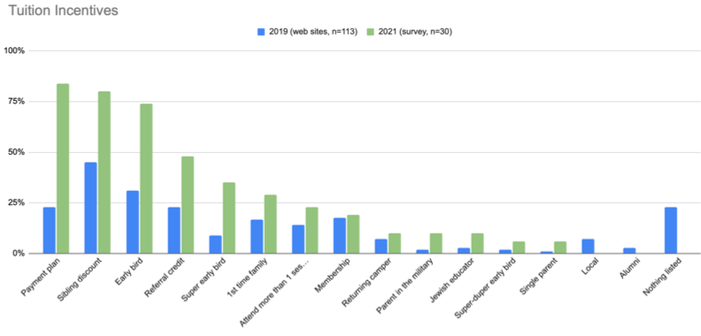

Slide 16
The Percentage of Students on Financial Aid Has Been Climbing at K-12 schools
Source: NAIS. Hirtle Callaghan.

Slide 17
Independent School Tuition Increases Have Vastly Outpaced Inflation
Growing gap between what people can afford and tuition rates
Source: NAIS, Bureau of Statistics. Hirtle Callaghan. 2008-2018.

Slide 18
More than 1/3 of all private colleges
provide financial aid to all of their students
Source: NACUBO Tuition Discounting Surveys

Slide 19
Source: Trends in College Pricing: 2018

Slide 20
The average freshman discount rate is
> than half the published price
Source: NACUBO Tuition Discounting Surveys

Slide 21
Assessment Of Applicant Pool
And Enrollment Results (Assume $10,000 Price)
Your Camp Peers
Inquiries 1,600 1,600
Serious inq. 800 800
Conversion Rate 50% 50%
New Campers 200 200
Yield 25% 25%
Discount Rate 51% 45%
Avg. Net Price $4,900 $5,500
Net Total Revenue $980K $1.100K

Slide 22
Distribution of Campers by Discount Rate (Assume 200 campers and a published price of $10,000)
Discountrate per Camper | 0% | 1 - 10% | 11 – 25% | 26% - 50% | 51% - 75% | 76% + | Average Net Price Per Camper | Discount Rate
Camp A # of campers | 200 | 0 | 0 | 0 | 0 | 0 | $10,000 | 0%
Camp B # of campers | 150 | 0 | 0 | 12 | 13 | 25 | $8,250 | 17.4%
Camp C # of campers | 100 | 25 | 25 | 25 | 25 | 0 | $8,400 | 16%
Camp D # of Campers | 0 | 60 | 100 | 40 | 0 | 0 | $8,050 | 19.5%

Slide 23
Concerns about Pricing
and Discounting
Do camper’s families prefer higher price and higher discounts vs. lower price and lower/fewer discounts?
Is price a proxy for quality?
Is a discount a positive sign of wanting the camper?
Is getting a discount considered a “good deal?”
Does the size of the discount matter or is the net price more important?
31

Slide 24
Implementation Challenges of a Price Reset
Deciding what your new price should be
How to change your marketing messages – what to package with your price reset announcement
How to redo your discounting/incentives
How to change your recruitment area and strategy
Educating your sales staff in the new messaging and discounts
Other
32

Slide 25
What Does a Price Reset Do
Lowers Published Proce
Should Increase/Change the Inquiry Pool
Requires that Discounts/Incentive Levels be Reduced/Eliminated

Slide 26
Roadmap for a Price Reset
Decide on your new price
Review competitors published and net prices
Review data on the distribution of net prices your campers are currently paying
Review yield of campers at different discount rates/with different incentives
Make changes to your incentive strategy
Make changes to your recruitment strategy
23

Slide 27
Roadmap for a Price Reset (cont.)
Decide what to do about current campers
How to change their price and incentives
When and how to announce the changes to them
Develop your marketing plan to roll-out the new price
Timing - when will you announce the price change
What other camp enhancements/changes will you include with the announcement
How will you announce/market the price change to internal and external constituents
24

Slide 28
What Data Should You Consider
What % of your campers are receiving discounts?
How do you distribute your discounts –
Number of campers getting discounts
Amount of discounts
How much are your campers paying by ability and need?
What are your overlap camps and where do you win and lose – what are their prices and incentive strategies?
How do you aid similar campers compared to overlap camps – mystery shop
Marketing/positioning implications

Slide 29
Tuition/Pricing Risks – Key Concern
No change in strategy
Are you getting the results you want?
What is riskier – staying the course or trying something different?
33

Slide 30
Questions and Conversation

